Slide 1
Open API
Understanding your Agency’s IT Landscape
Jacob Armour, P.E.
Bridge Management Systems Engineer
armourj1@michigan.gov

Slide 2


Programmer?
Source: https://www.geeksforgeeks.org/software-testing/what-is-an-api/

Slide 3
API?
Application Programming Interface
API
API
Application Please Integrate
Alien Programming Interface
API
API
All Problems Ignored

Slide 4
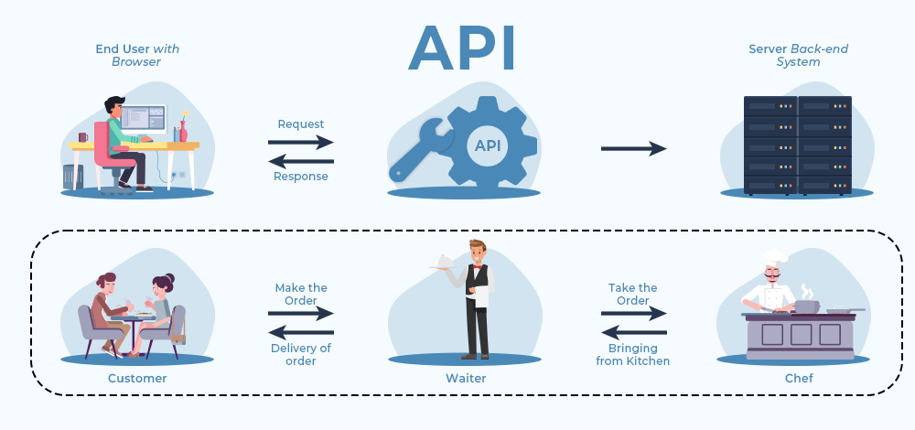
API?
Source: https://www.geeksforgeeks.org/software-testing/what-is-an-api/

Slide 5

Open API Benefits
Security
  Control Access to Specific API Calls
Interoperability
  Ohio using Integration that Michigan Enhanced
Database Integrity
  Adheres to Database Integrity Rules by Default
  Can Incorporate Buinsess Logic/Validation
Cost
  Free

Slide 6
How to Access OpenAPI?
https://developer.aashtoware.org/
  Use Free AASHTOWare Account
Configure OpenAPI Key in BrM
Agency Agnostic Testing Environment

Slide 7
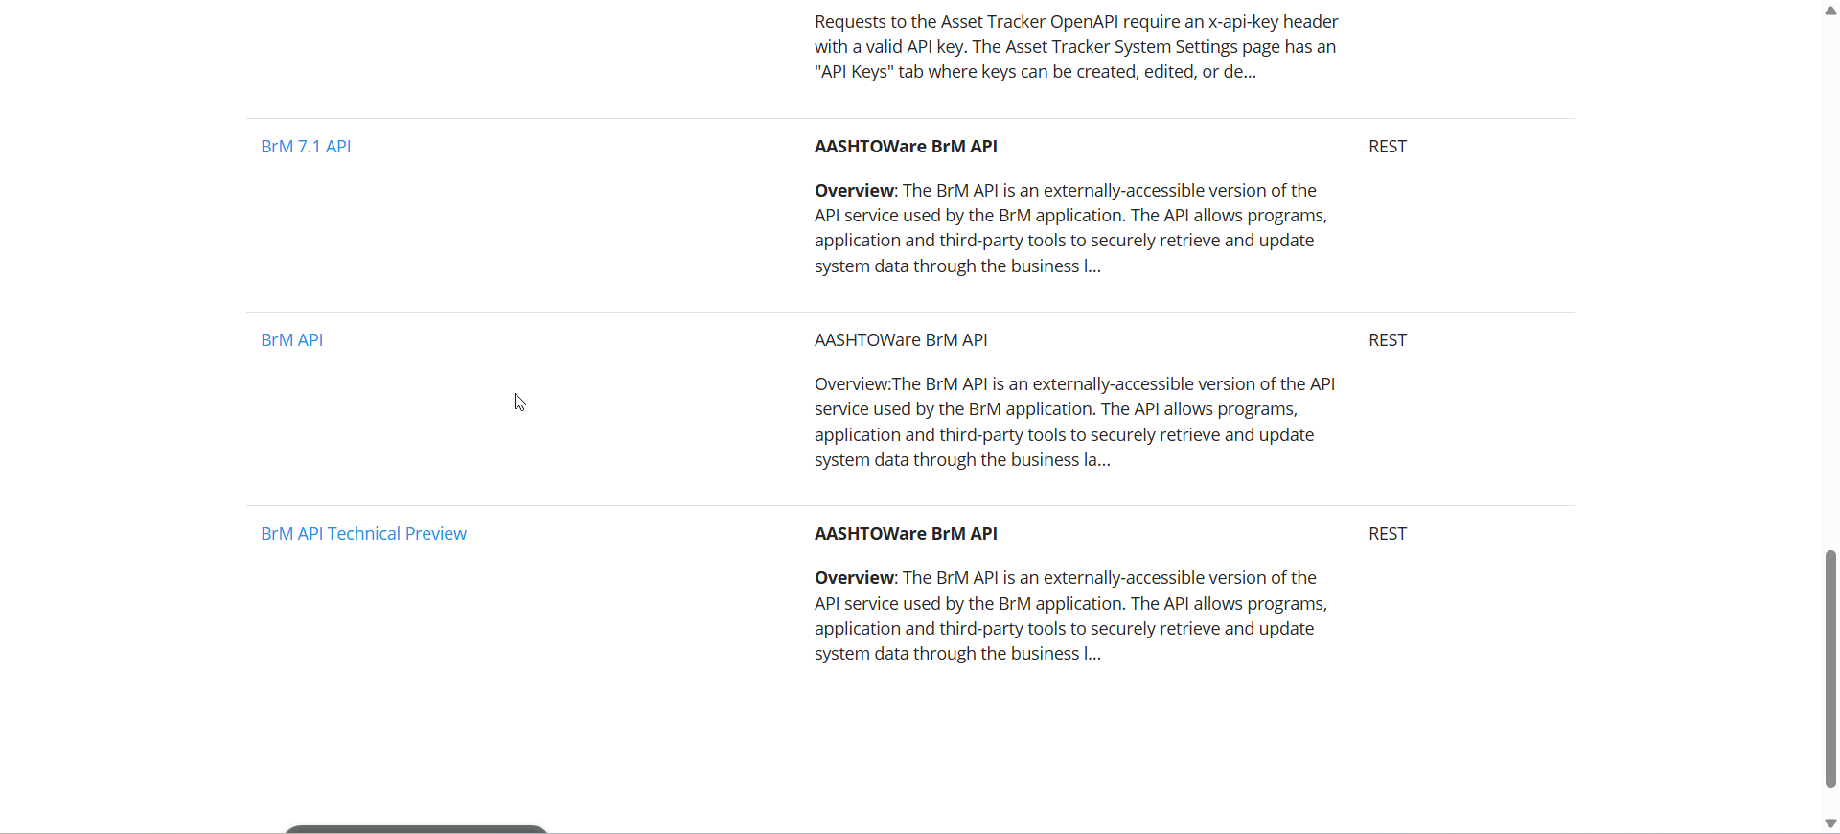
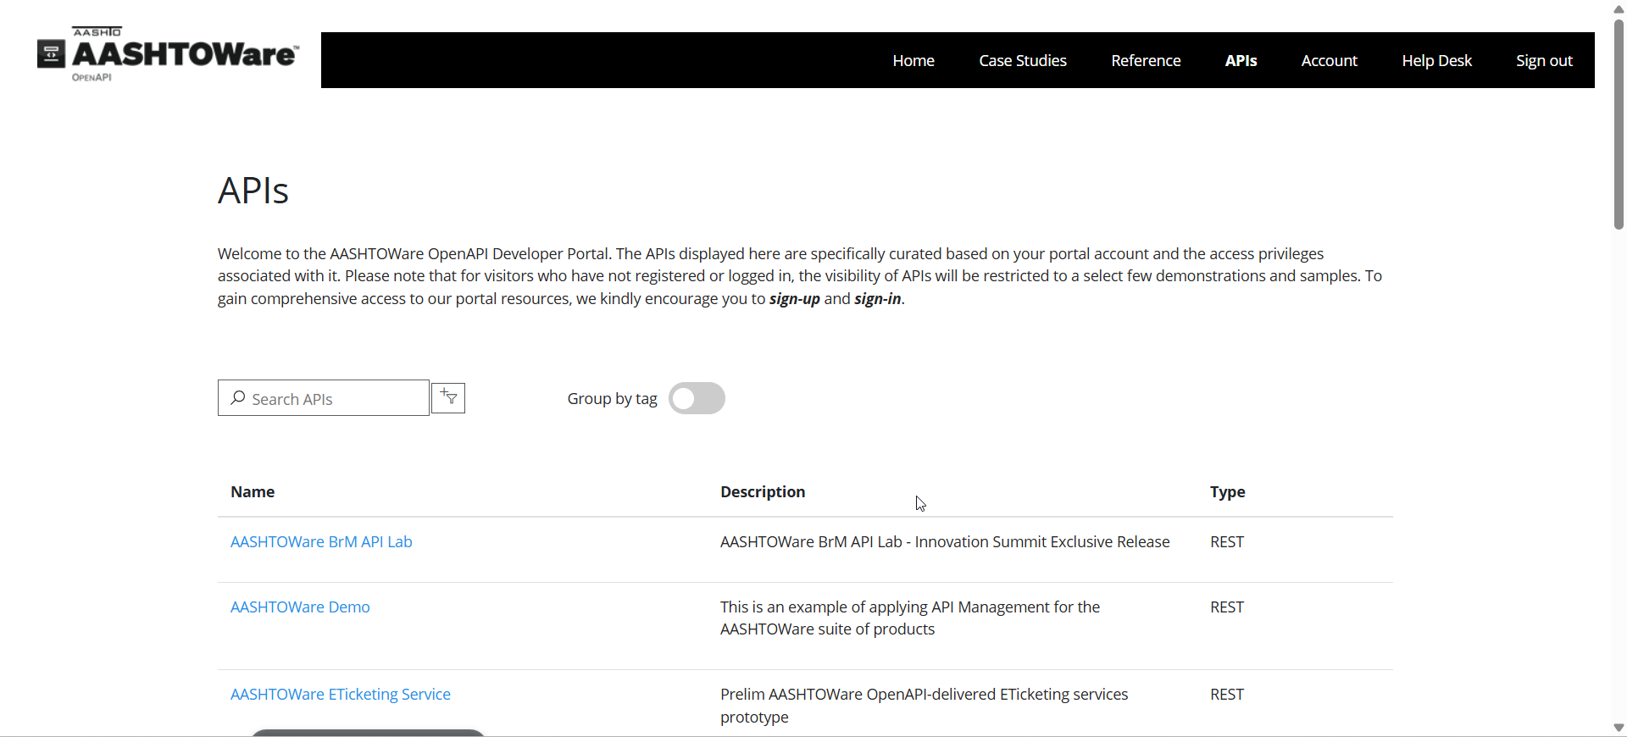

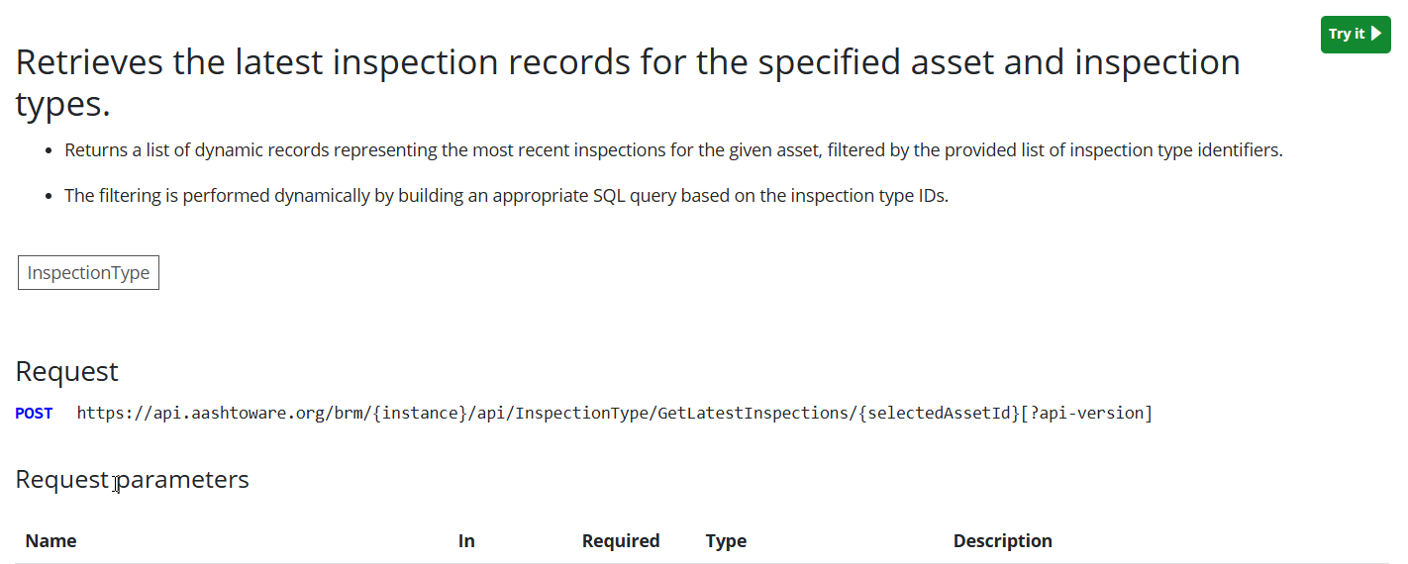
Open API Documentation
Uses Swagger like Interface

Slide 8
Open API Documentation
Uses Swagger like Interface

Slide 9
Open API Documentation
Uses Swagger like Interface

Slide 10
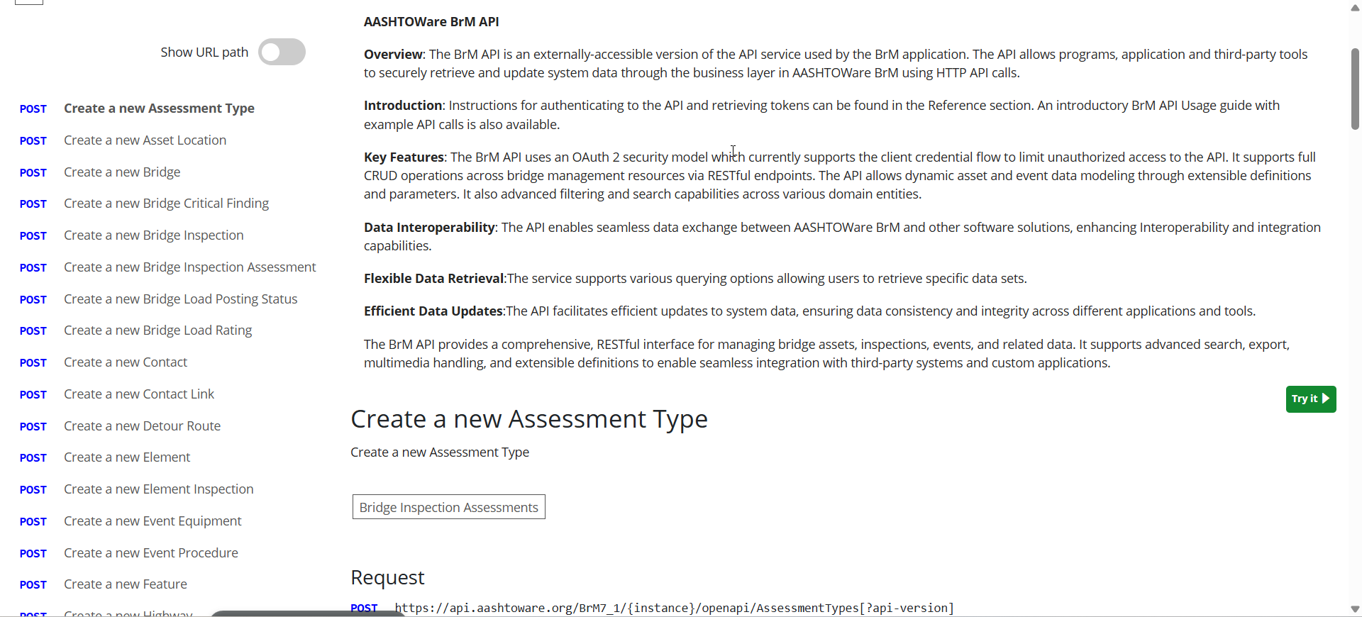
Open API Documentation
Uses Swagger like Interface

Slide 11
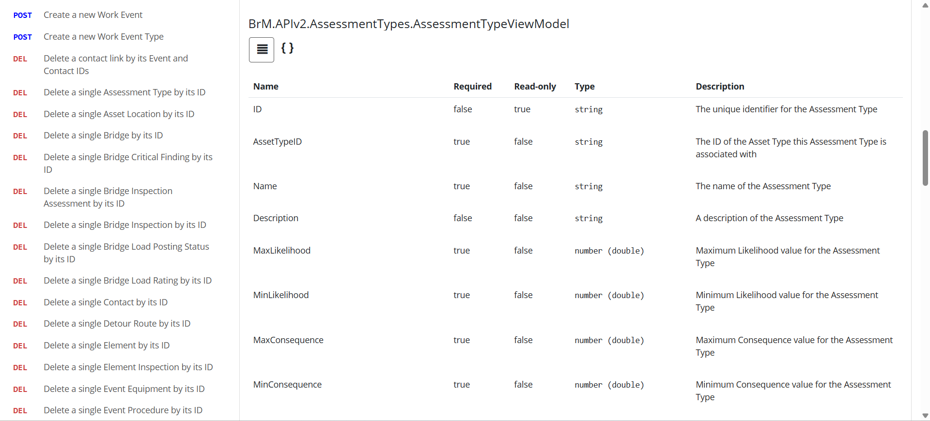
Open API Documentation
Uses Swagger like Interface

Slide 12

DOT AASHTOWare Open API Issues?
Tier 1 Support
Have DOT EUD Enter Support Ticket with Mayvue
  Support.Mayvue.com
  brm@mayvue.com
Tier 2 Support
  Have DOT Technical Resource submit Tickey
  Contact AASHTOWare Open API Vender
  https://developer.aashtoware.org/support/helpdesk

Slide 13
Questions?
Jacob Armour, P.E.
Bridge Management Systems Engineer
(517)-249-0590
armourj1@michigan.gov

