Slide 1
Caltrans Updated SNBI Element to Component Rating Converter
Cory Cowden PE
California Department of Transportation
Structure Maintenance & Investigations

Slide 2
Disclaimer
This converter was developed, tested, reviewed, calibrated, double-checked, tweaked, adjusted, fine-tuned, and finalized using methodologies, data sets, and input specifically derived from, guided by, and in compliance with the standards, protocols, and recommendations provided by Caltrans—the California Department of Transportation—as well as applicable guidance from regional branches of the Federal Highway Administration, hereinafter referred to as FHWA. This tool, its associated outputs, implications, extrapolations, assumptions, interpretations, and/or any conclusions drawn from its use, are therefore intended for applications aligned with those particular jurisdictions. Any use, application, replication, deployment, reliance upon, or extrapolation of this converter outside the state of California—or any jurisdiction not explicitly aligned with the originating Caltrans and regional FHWA guidelines—is hereby undertaken solely and entirely at the user’s own risk, discretion, and liability. No warranty, guarantee, promise, assurance, or suggestion of fitness for use in other states, territories, municipalities, agencies, counties, sovereign lands, or planetary bodies is expressed or implied. The developers assume no responsibility for errors, omissions, misinterpretations, regulatory non-compliance, unintended infrastructure consequences, misaligned policy decisions, or unexpected time travel anomalies that may result from such external use. Proceed accordingly

Slide 3

What’s a Converter?
The Converter/Translator converts the element inspection data to a correlated component rating.
It is used to improve consistency between inspectors.

Slide 4

History of the Converter
Caltrans has been using a converter/translator since 1997
Initially used the FHWA translator
Updated the converter in 2014 and 2016.
Added the ability for the inspector to override the ratings in 2016.
Latest update in 2024 for compliance with SNBI

Slide 5
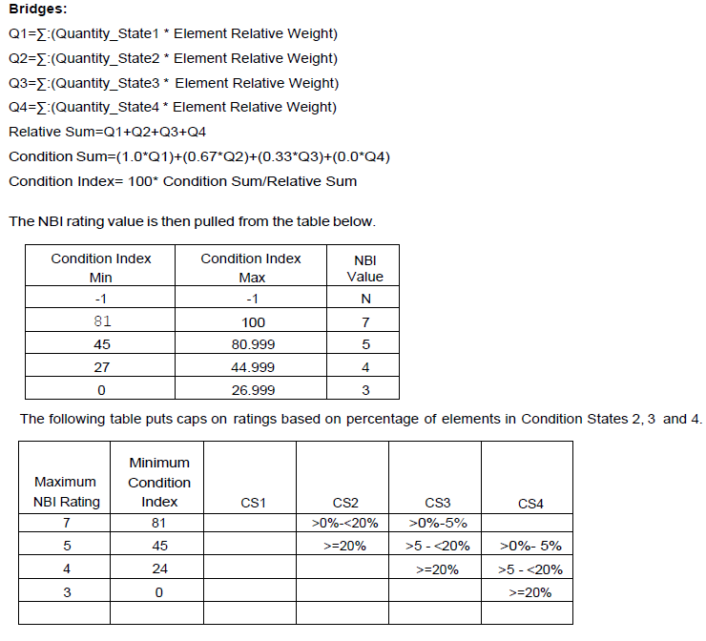

CT NBIS Converter
Used different weighting for different elements but used consistent percentages for all elements or defects.

Slide 6
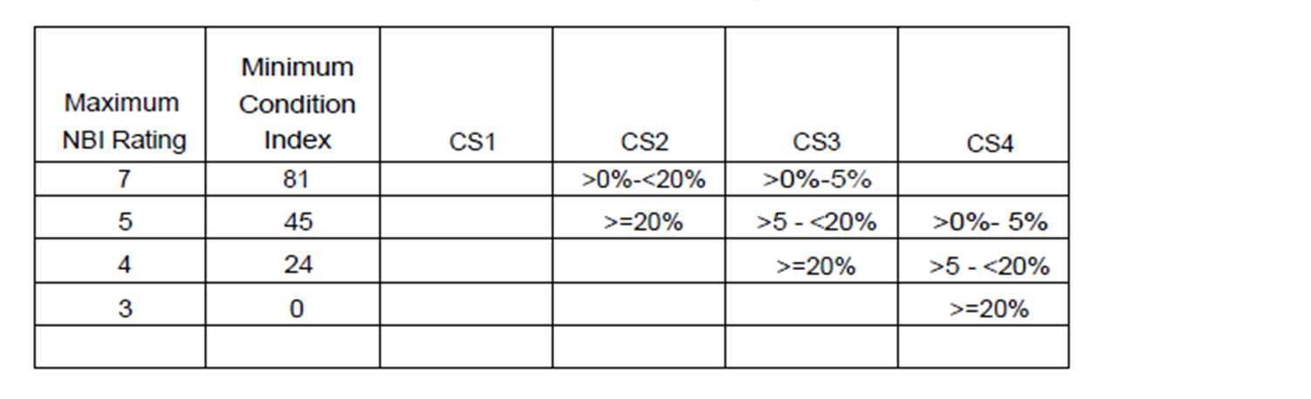
Problems with our NBIS Current Converter
Bridge Deck Defects
Element Fidelity
Protective Systems
Defects have different severity.
A delamination is not equivalent to a crack
Square Foot
Linear Foot
Each
State 3 cracking remains after treatment causing protective systems to not influence the bridge rating.

Slide 7

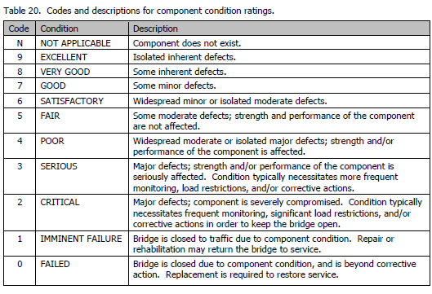
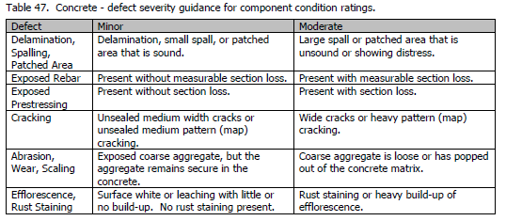
SNBI
The SNBI gives guidance with a direct correlation between the component ratings and the quantity and severity of defects.
Component ratings are defined in Table 20 (Page 240)
Appendix C (Page 331) Defines the Defect Severity
The quantity of defects (Isolated, Some, Widespread) is not specifically defined.
Our converter defines these quantity thresholds.

Slide 8
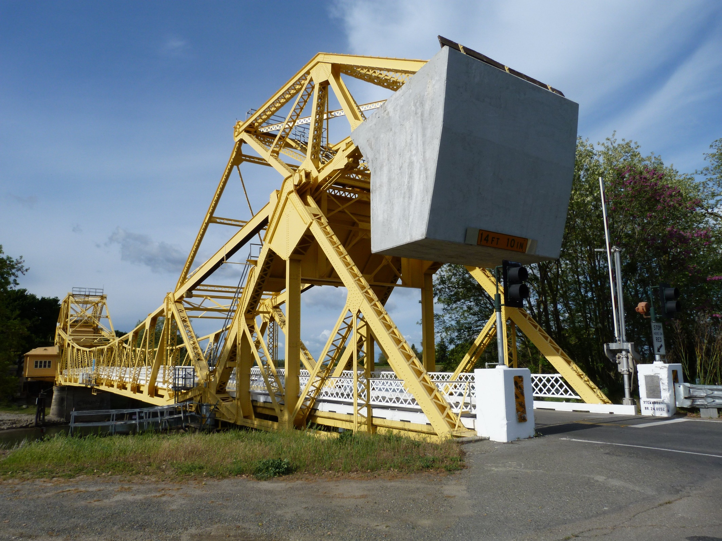
New SNBI Converter
The new converter strives to modernize our converter to the SNBI but also to correct the deficiencies of the existing converter.
  Defect severity
  Element Fidelity
  Protective Systems
New converter has a 2 different algorithms for Deck and Super, Sub, and Culvert Ratings.
The Deck Component Rating is calculated in 2 parts.
  The General Deck Defects
  The Spalling/Delamination Defect
Then uses the lowest of the 2 calculations for the Deck Component Rating.

Slide 9
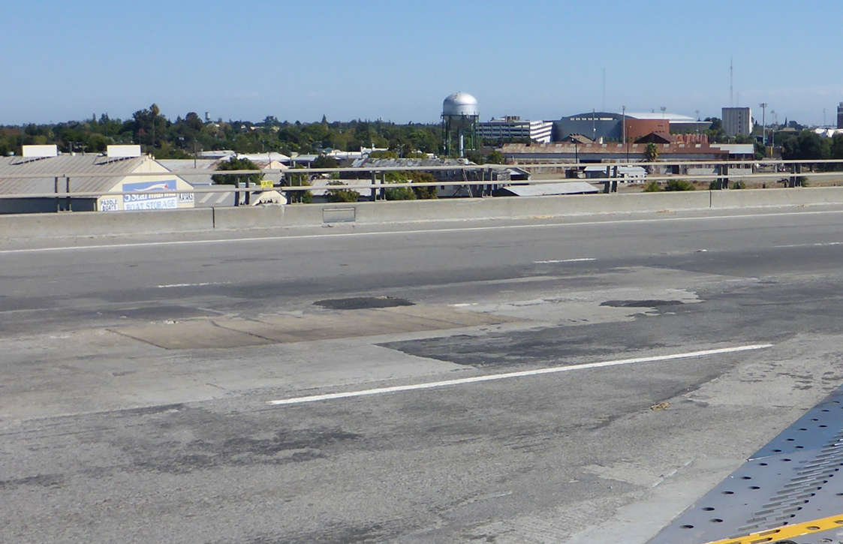
Deck Rating Converter
1st, the Allowable Defect Area is calculated.
Does not allow defects to count in areas of the deck with polyester/methacrylate in State 1.
Allowable Defects = 100 – (% Prot. Sys. St 1)
  Ex. 90% of the deck area has protective system in St. 1. Allowable area is 10%.

Slide 10
Deck Rating Converter
Deck General Defect Table
Min. % Defects | CS1 | CS2 | CS3 | CS4
8 | 100
7 |  | 0 | 0
6 |  | 50 | 1
5 |  |  | 10
4 |  |  | 55 | 0
General Deck Defects
0% | isolated
10% | some
50/55% | widespread
*Allowable Defect Area only applies to general calculation.
Deck Delamination Defect Table
Min. % Delam/Ex. Rebar | CS1 | CS2 | CS3 | CS4
8
7 | 100 | 0
6 |  | 10 | 0
5 |  |  | 5
4 |  |  | 10 | 0
Delamination/Exp. Rebar
0% | isolated
5% | Some Spalling
10% | Widespread Spalling

Slide 11
Example
Bridge has 75% of its methacrylate protective system in St.1
60% St3 Deck Cracking and 4% St3 Spalling.
Allowable Defect of 100-75=25%.
Cracking limited to 25% St3 – General Rating 5.
4% St3 Spalling – Delam Rating 6
Deck Component Rating is 5.
Deck General Defect Table
Min. % Defects | CS1 | CS2 | CS3 | CS4
8 | 100
7 |  | 0 | 0
6 |  | 50 | 1
5 |  |  | 10
4 |  |  | 55 | 0
Deck Delamination Defect Table
Min. % Delam/Ex. Rebar | CS1 | CS2 | CS3 | CS4
8
7 | 100 | 0
6 |  | 10 | 0
5 |  |  | 5
4 |  |  | 10 | 0

Slide 12
Superstructure, Substructure, and Culvert Ratings
Looks at each element CS’s and assigns each element its own rating based on General Defect Thresholds.
Then takes the lowest element rating for the Super, Sub, or Culvert Rating
Different percentages for Each and Linear Foot Elements.
Super/Sub/Cul General Defect Table Each
Min. % Defects | CS1 | CS2 | CS3 | CS4
8 | 100
7 |  | 0 | 0
6 |  | 50 | 10
5 |  |  | 20
4 |  |  |  | 0
Super/Sub/Cul General Defect Table LF
Min. % Defects | CS1 | CS2 | CS3 | CS4
8 | 100
7 |  | 0 | 0
6 |  | 50 | 5
5 |  |  | 10
4 |  |  |  | 0

Slide 13
Example
50% columns have St. 2 cracking.
Abutment has 15% of length with a St 3 Crack.
Columns Rating of 6
Abutment Rating of 5
Substructure Component Rating is 5.
Super/Sub/Cul General Defect Table Each
Min. % Defects | CS1 | CS2 | CS3 | CS4
8 | 100
7 |  | 0 | 0
6 |  | 50 | 10
5 |  |  | 20
4 |  |  |  | 0
Super/Sub/Cul General Defect Table LF
Min. % Defects | CS1 | CS2 | CS3 | CS4
8 | 100
7 |  | 0 | 0
6 |  | 50 | 5
5 |  |  | 10
4 |  |  |  | 0

Slide 14
Results

Slide 15
Key Takeaways
Bridge Inspectors are still allowed to override the condition rating if needed.
Calibrated for California's typical bridge inventory.
Protective Systems now can improve a bridges condition rating.
Initiates a defect level analysis rather than element level.
Helps correct irregularities due to different element quantities (SF, EA, LF).
Questions?

