Slide 1




BrM Inspection 202
The Un-Abridged Version
BrMUG 2025 | Providence, RI | September 17-18
Photo by Evan Leith on Unsplash

Slide 2

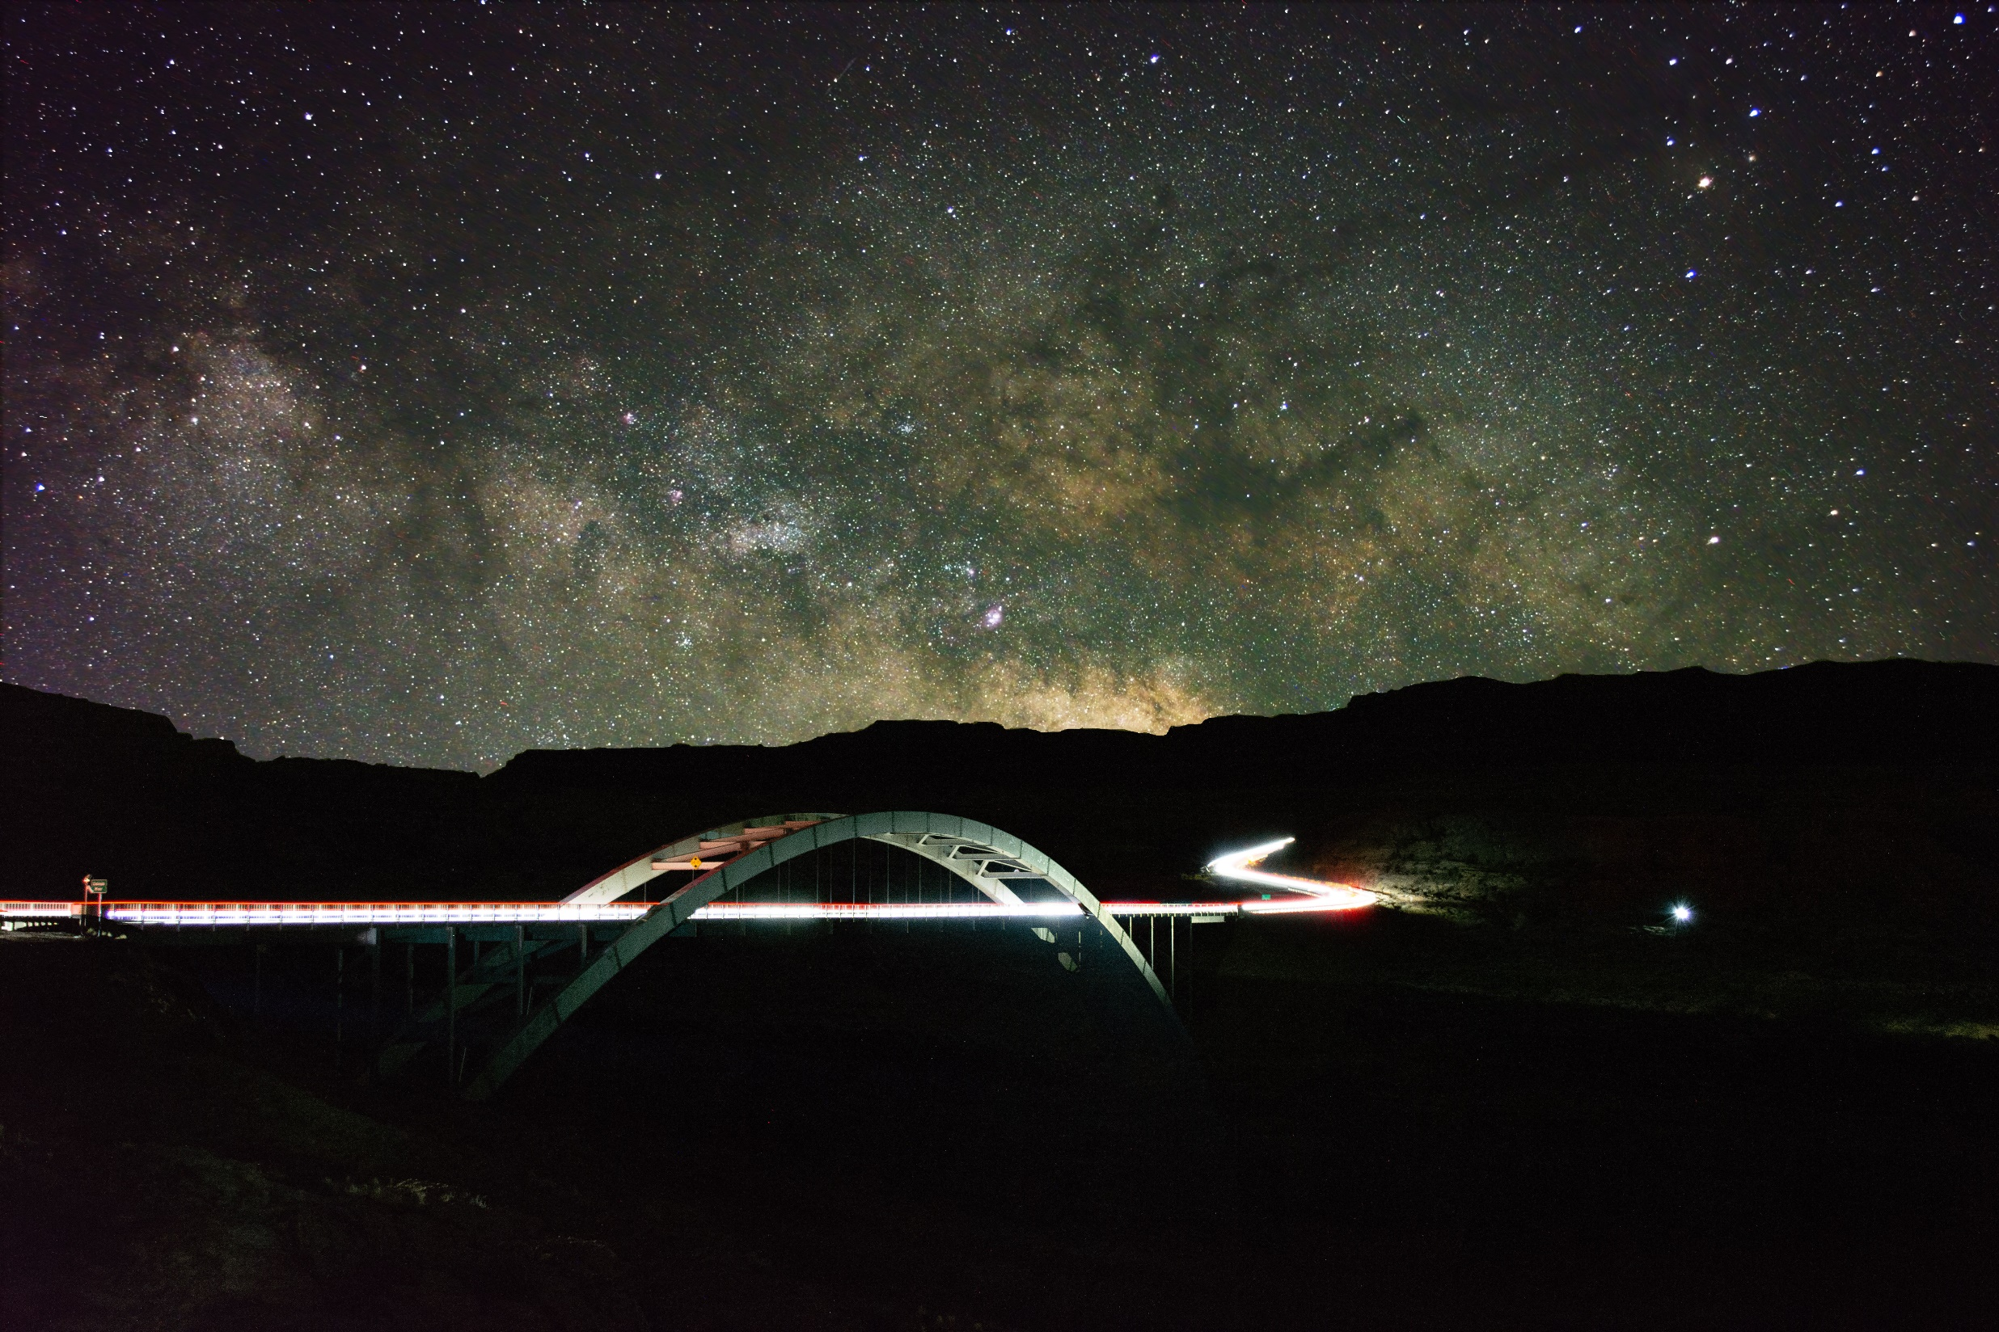



BrM 7.0 Migration
CONTACT
The Abridged Version
Jira Service Desk
ZACHARY BOYLE
zac.boyle@mayvue.com
Text | Voicemail | (801) 450-9716
BrM@mayvue.com
1-877-462-9883
http://support.mayvue.com
BrMUG 2024 | Long Beach, CA | September 17-18
Photo by Evan Leith on Unsplash

Slide 3

Course Overview
Photo by Evan Leith on Unsplash

Slide 4
Course Overview
TODAY
TOMORROW
Before Break (Insp 101)
Login
Roles & Groups
Bridge List
Inspection List
Scheduling
Inspection Plans
Inventory
Design
Features
After Break (Insp 102)
Condition & Elements
Load Posting
Multimedia
Sketches
Cross Sections
Before Break (Insp 201)
Work Candidates
Certifications
Inspection Assignment
Validation
Inspection Review
Future Planning
After Break (Insp 202)
Submittal
Critical Findings
Reports
Dashboards
API Calls
Photo by Evan Leith on Unsplash

Slide 5
Submittal
Photo by Evan Leith on Unsplash

Slide 6
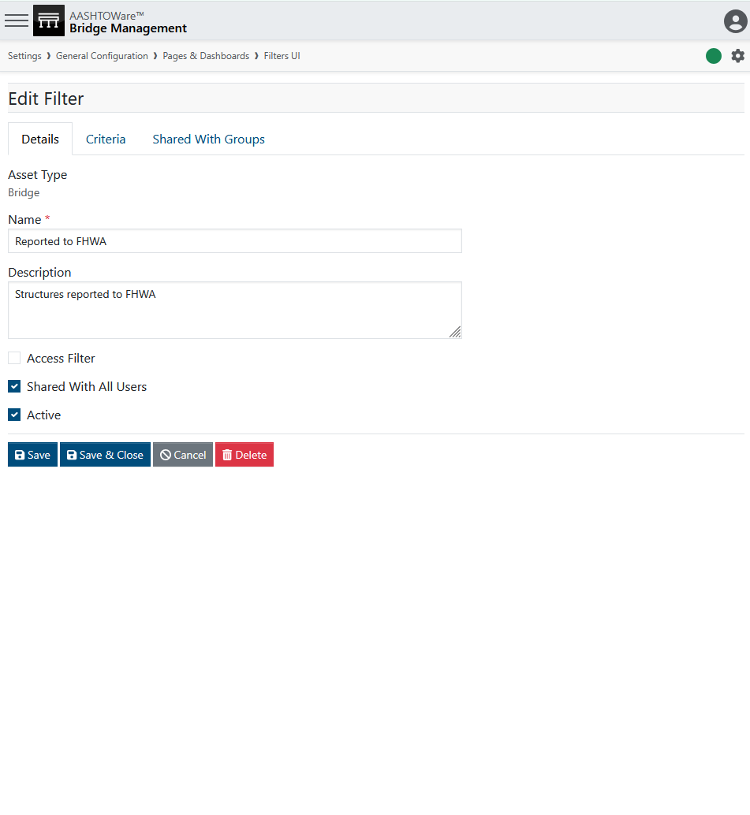
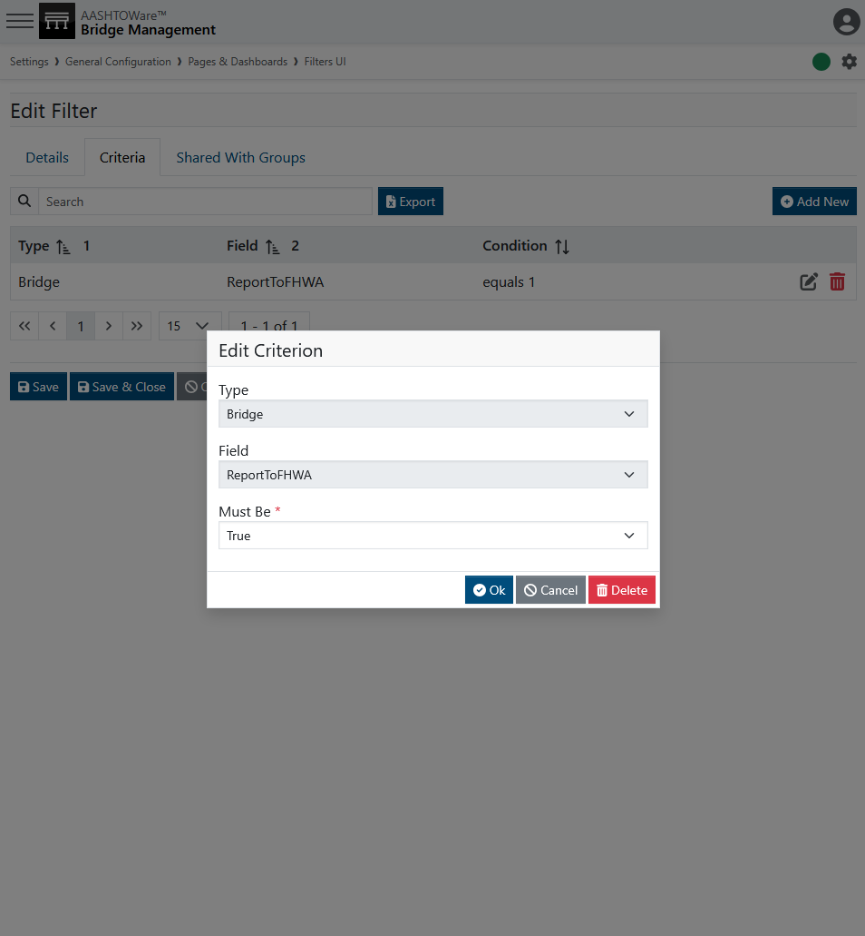
Submittal

Slide 7
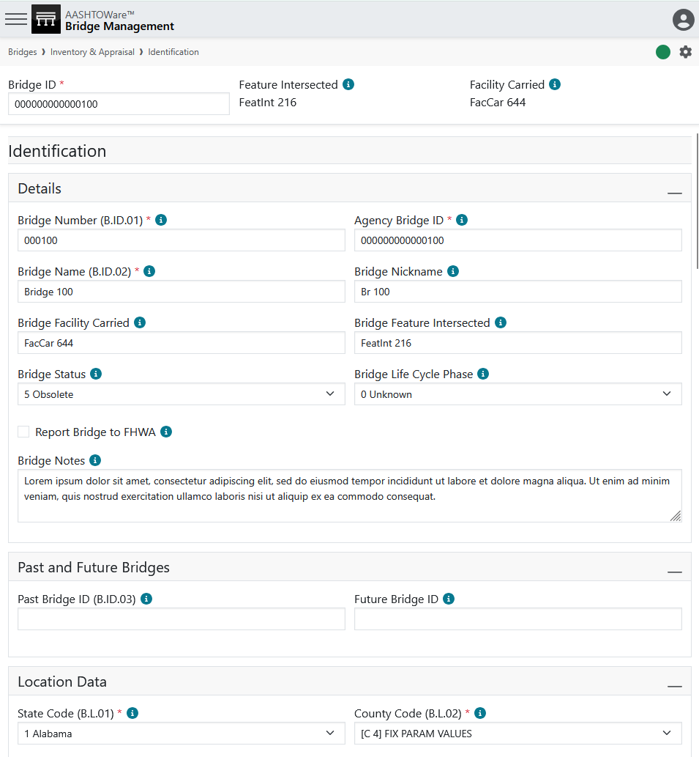
Submittal

Slide 8
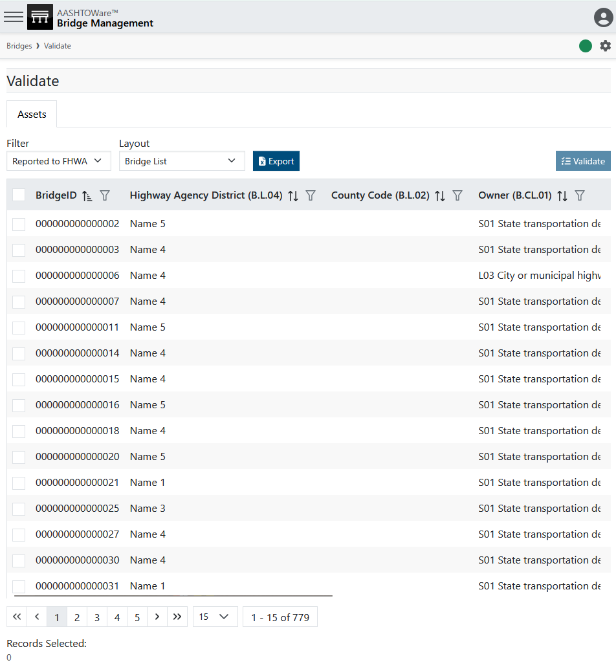
Submittal

Slide 9
Submittal

Slide 10
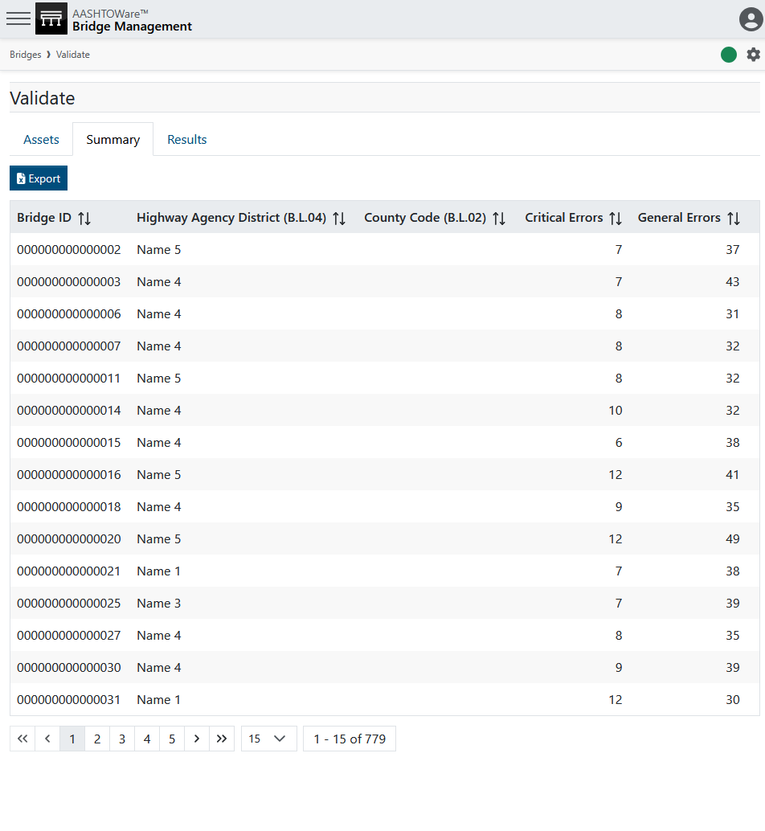
Submittal

Slide 11
Submittal

Slide 12
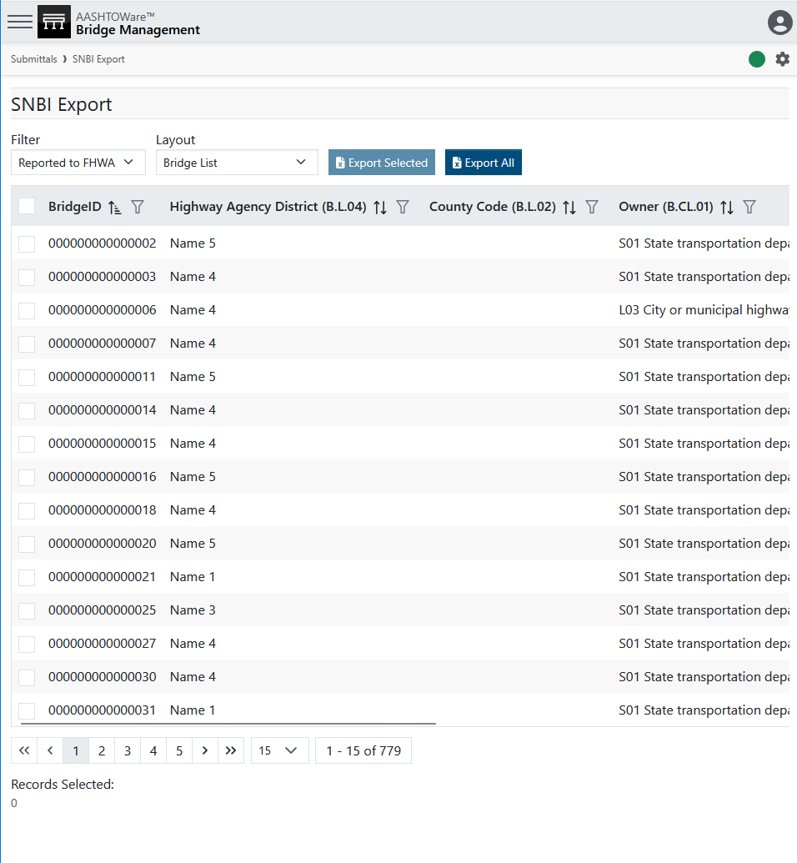
Submittal

Slide 13
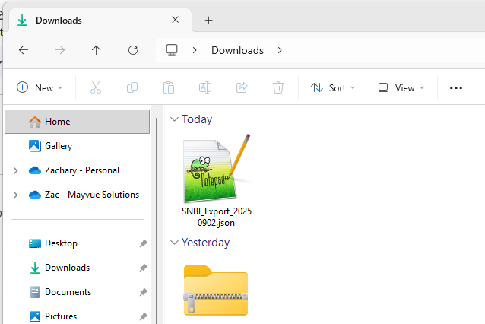
Submittal

Slide 14
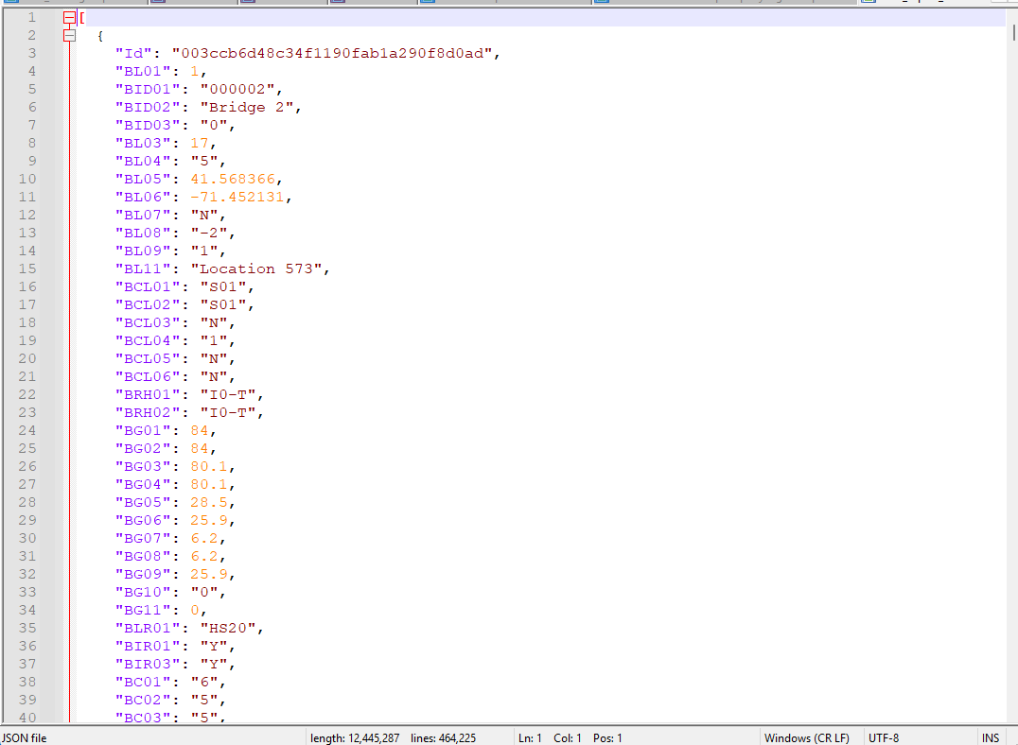
Submittal

Slide 15
Submittal

Slide 16

Submittal
https://www.fhwa.dot.gov/bridge/snbi.cfm

Slide 17
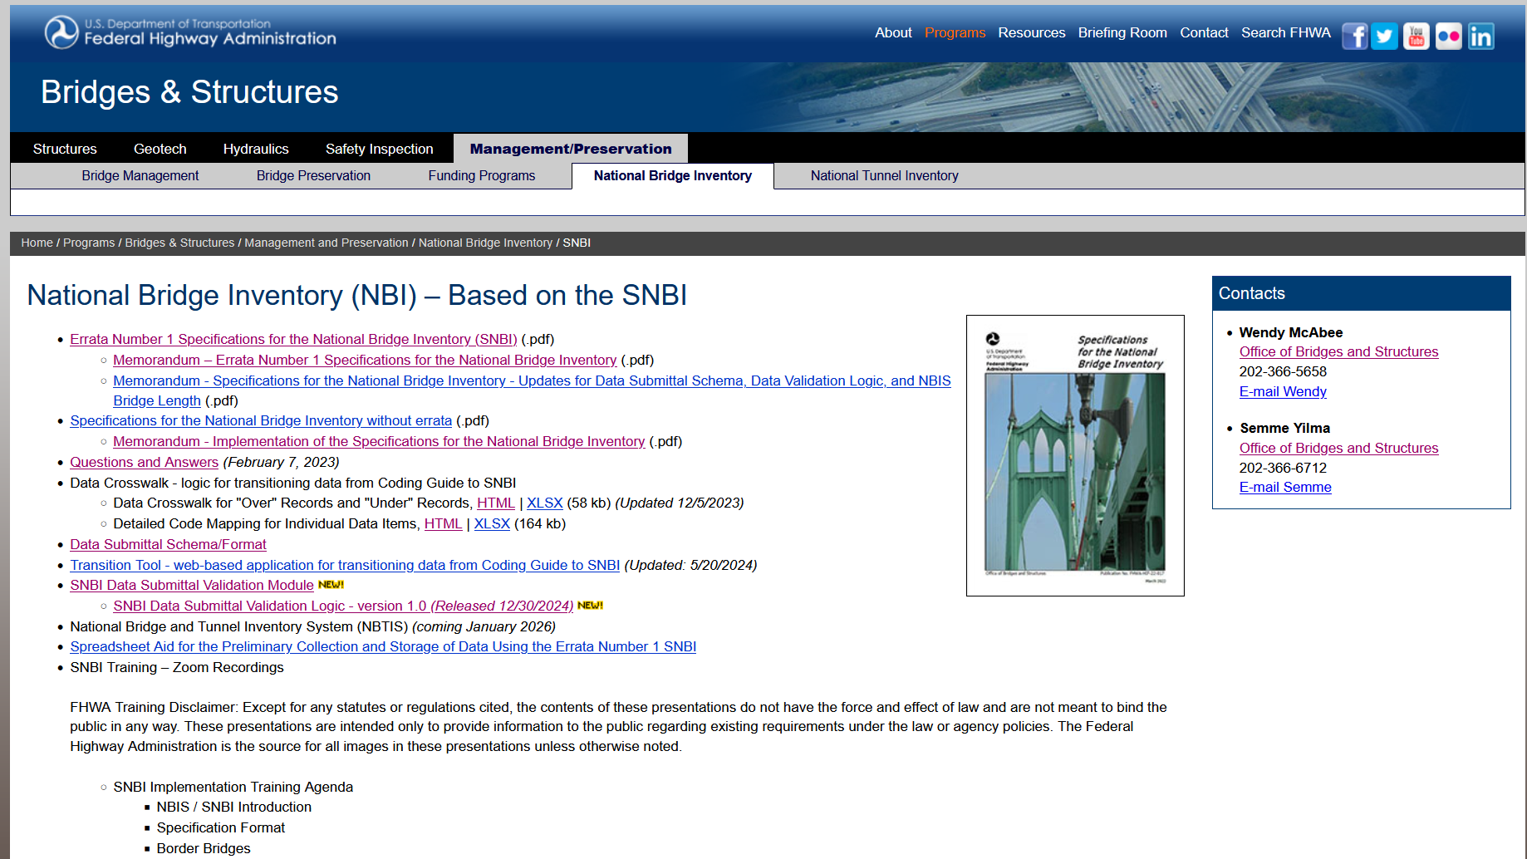
Submittal

Slide 18
Submittal

Slide 19
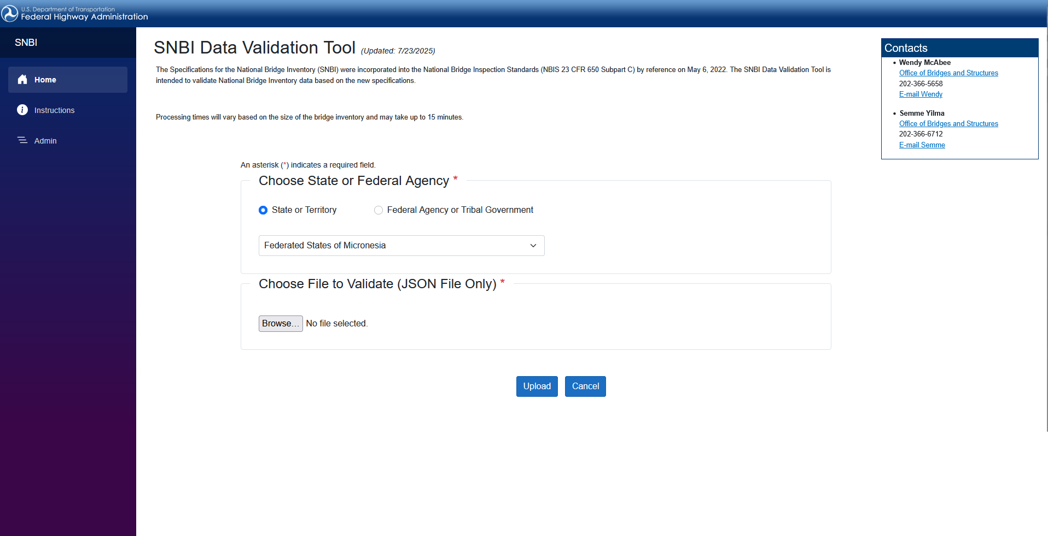
Submittal

Slide 20
Critical Findings
Photo by Evan Leith on Unsplash

Slide 21
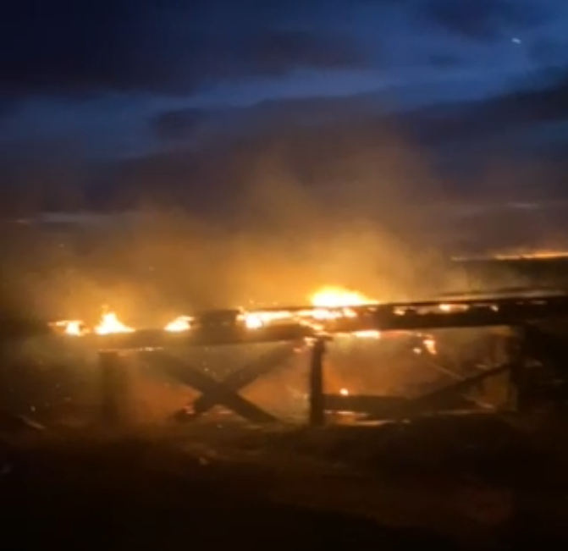
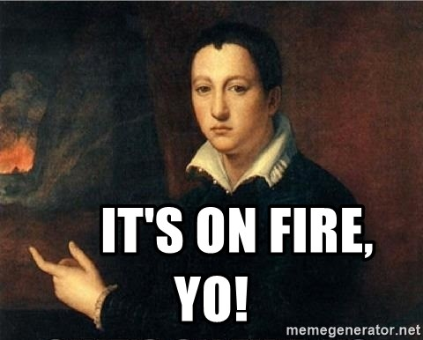
Critical Findings
DENTON MONATA FIRE – DEC 2021 | MDT
Photo by Evan Leith on Unsplash

Slide 22
Critical Findings
DENTON MONATA FIRE – DEC 2021 | MDT
Photo by Evan Leith on Unsplash

Slide 23
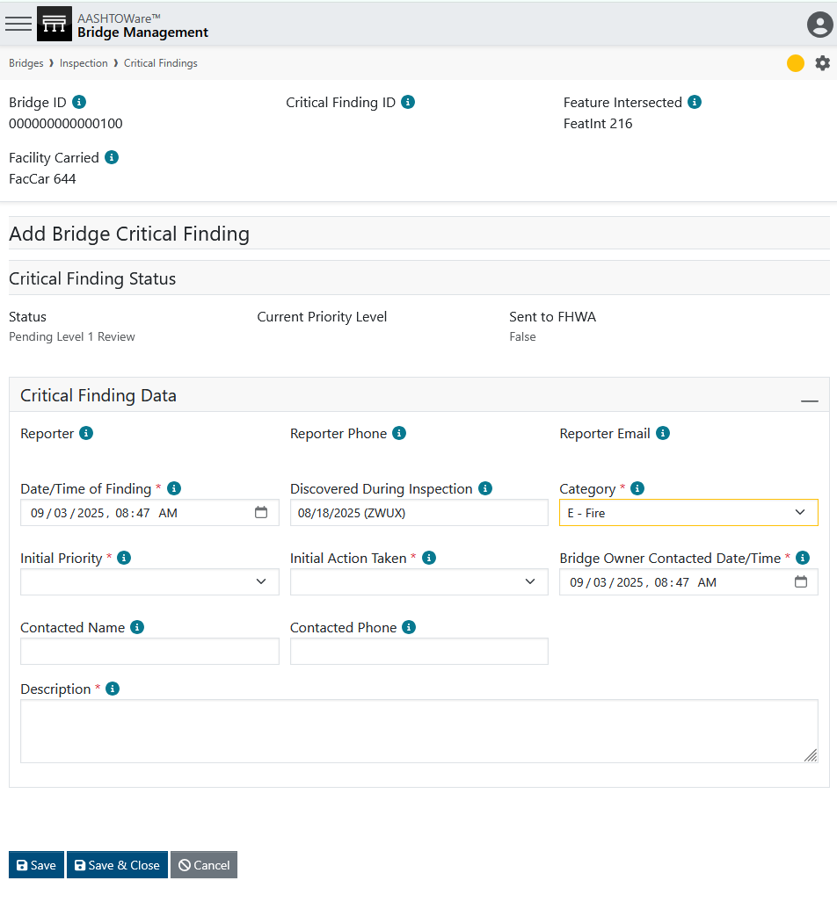
Critical Findings
DENTON MONATA FIRE – DEC 2021 | MDT
Photo by Evan Leith on Unsplash

Slide 24
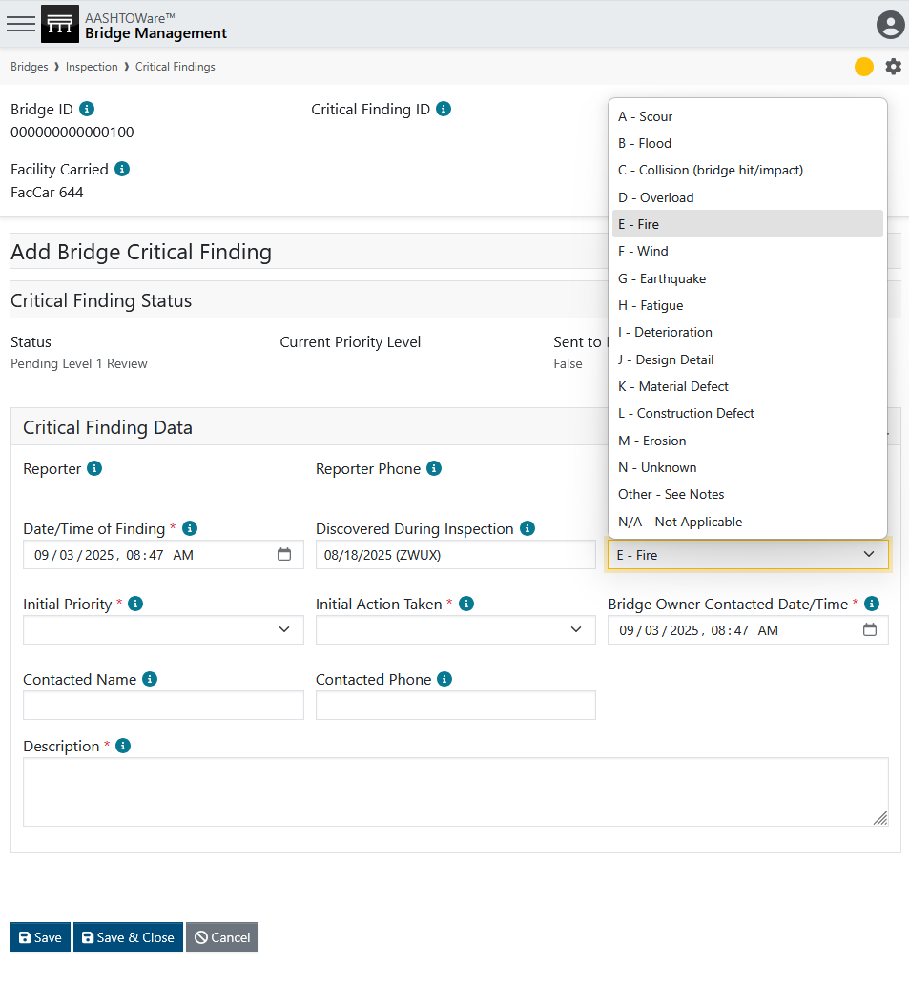
Critical Findings
DENTON MONATA FIRE – DEC 2021 | MDT
Photo by Evan Leith on Unsplash

Slide 25
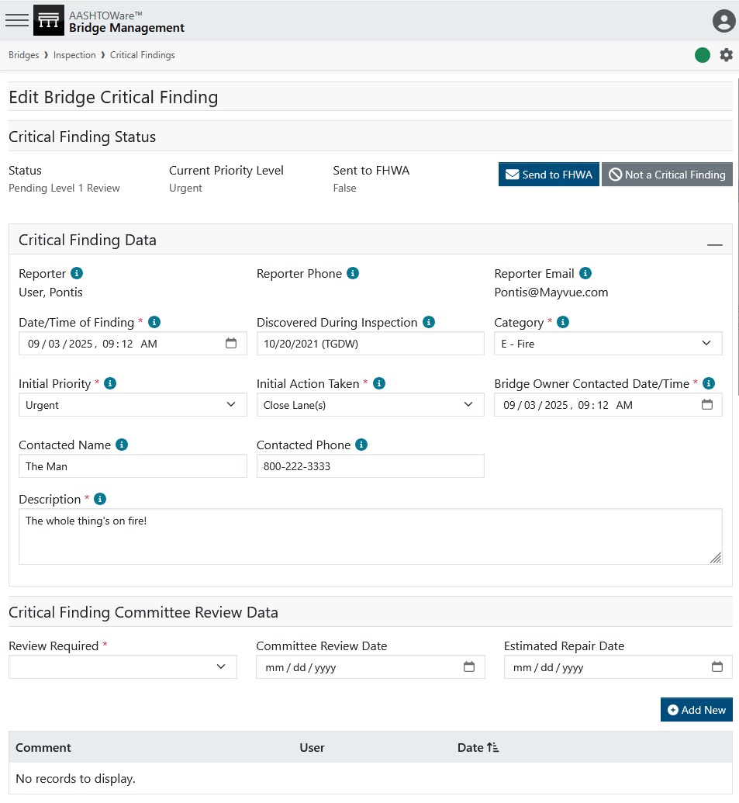
Critical Findings
Report Finding
Confirm Critical Finding
(Optional)
Level 2 Review
Notify Stakeholders
Manage Repairs
Resolve
Photo by Evan Leith on Unsplash

Slide 26
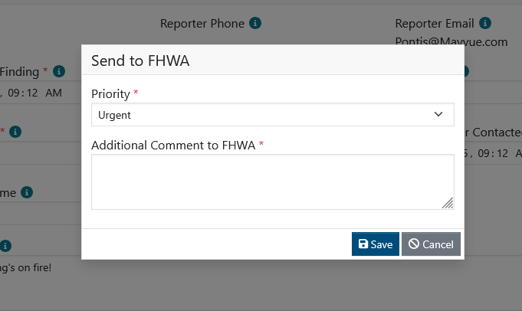
Critical Findings
Report Finding
Confirm Critical Finding
(Optional)
Level 2 Review
Notify Stakeholders
Manage Repairs
Resolve
Photo by Evan Leith on Unsplash

Slide 27
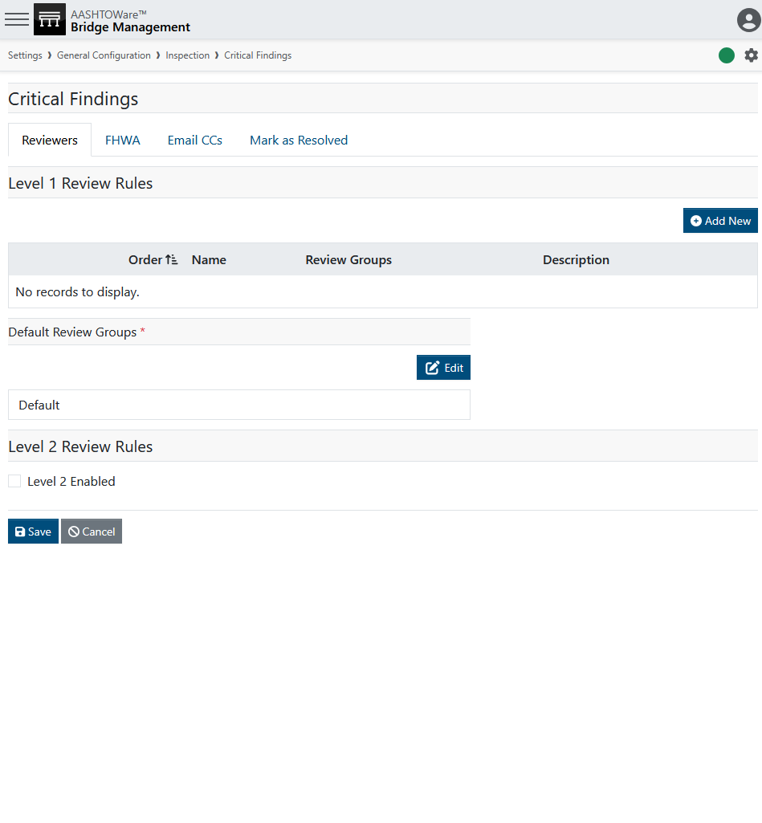
Critical Findings
Report Finding
Confirm Critical Finding
(Optional)
Level 2 Review
Notify Stakeholders
Manage Repairs
Resolve
Photo by Evan Leith on Unsplash

Slide 28
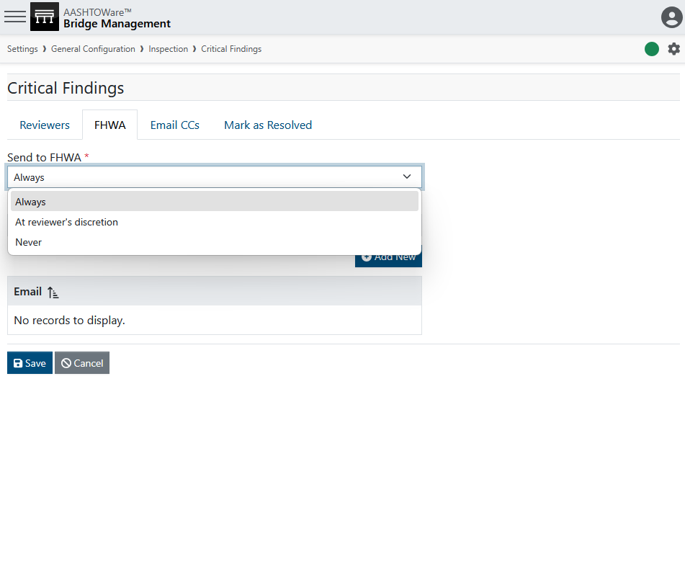
Critical Findings
Report Finding
Confirm Critical Finding
(Optional)
Level 2 Review
Notify Stakeholders
Manage Repairs
Resolve
Photo by Evan Leith on Unsplash

Slide 29
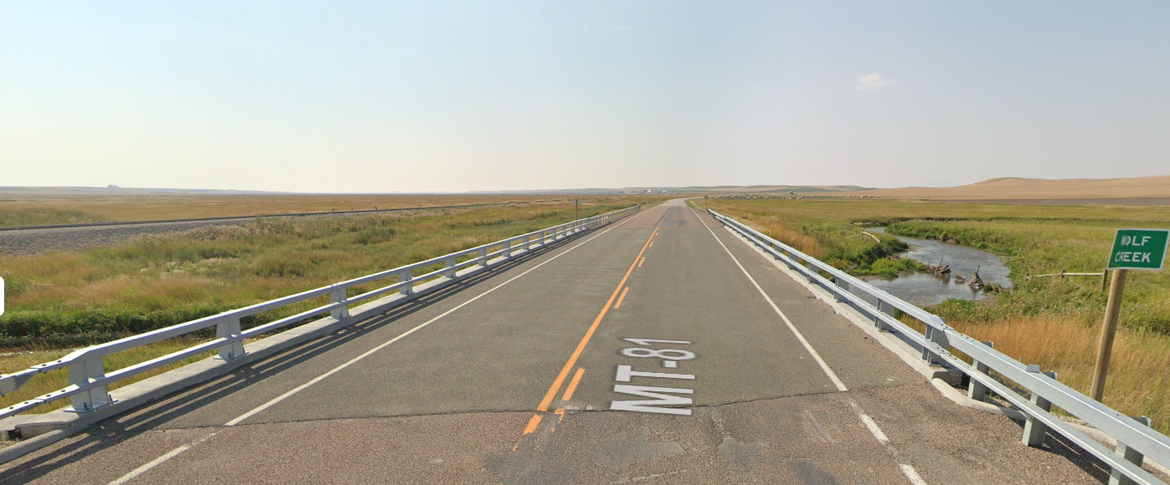
Critical Findings
Report Finding
Confirm Critical Finding
(Optional)
Level 2 Review
Notify Stakeholders
Manage Repairs
Resolve
Photo by Evan Leith on Unsplash

Slide 30
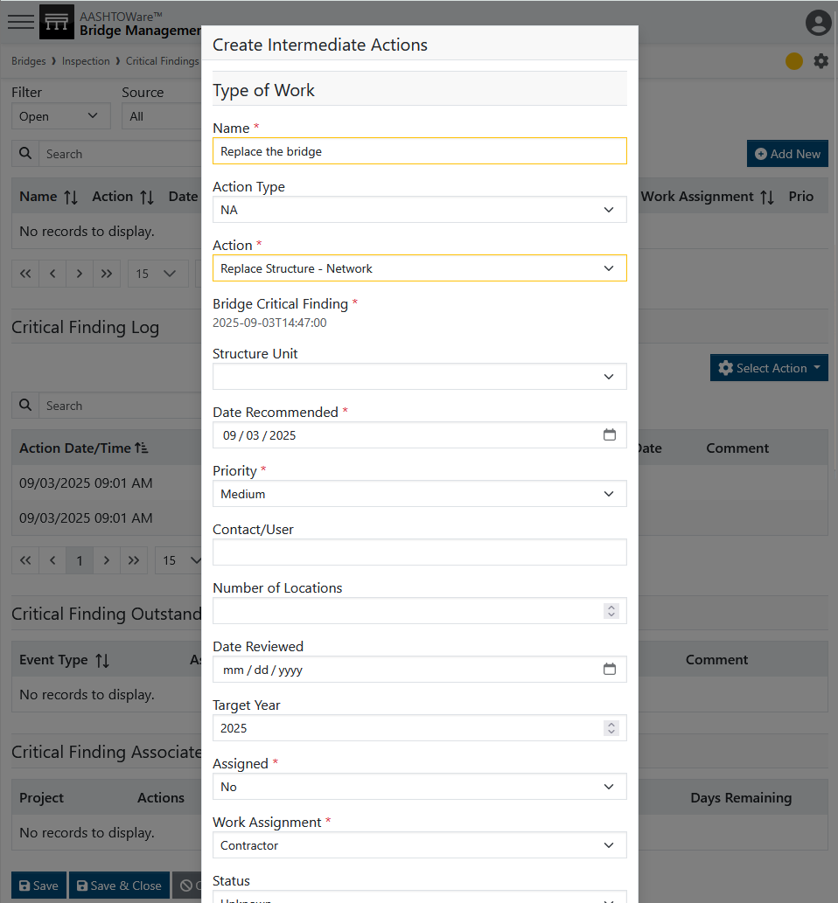
Critical Findings
Report Finding
Confirm Critical Finding
(Optional)
Level 2 Review
Notify Stakeholders
Manage Repairs
Resolve
Photo by Evan Leith on Unsplash

Slide 31
Critical Findings
Report Finding
Confirm Critical Finding
(Optional)
Level 2 Review
Notify Stakeholders
Manage Repairs
Resolve
Photo by Evan Leith on Unsplash

Slide 32
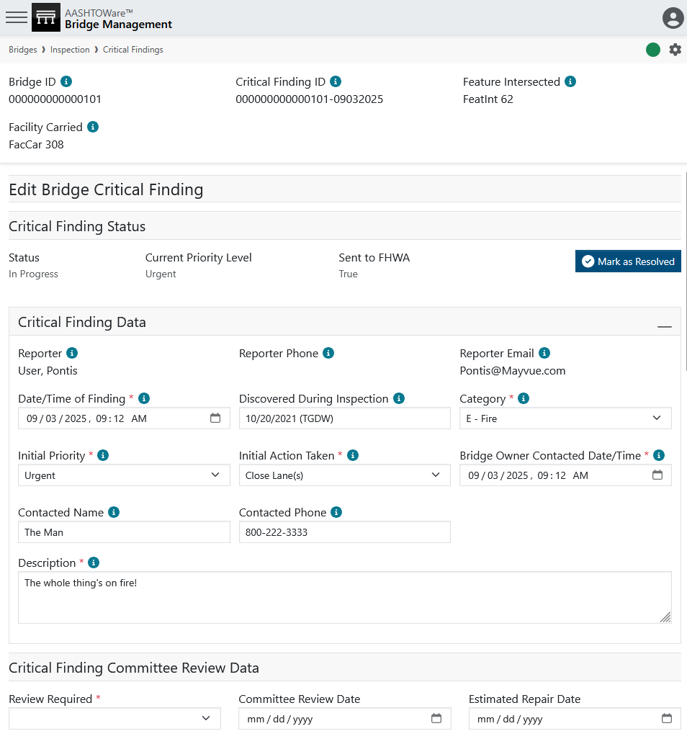
Critical Findings
Report Finding
Confirm Critical Finding
(Optional)
Level 2 Review
Notify Stakeholders
Manage Repairs
Resolve
Photo by Evan Leith on Unsplash

Slide 33
Critical Findings
Report Finding
Confirm Critical Finding
(Optional)
Level 2 Review
Notify Stakeholders
Manage Repairs
Resolve
Photo by Evan Leith on Unsplash

Slide 34
Reports
Photo by Evan Leith on Unsplash

Slide 35
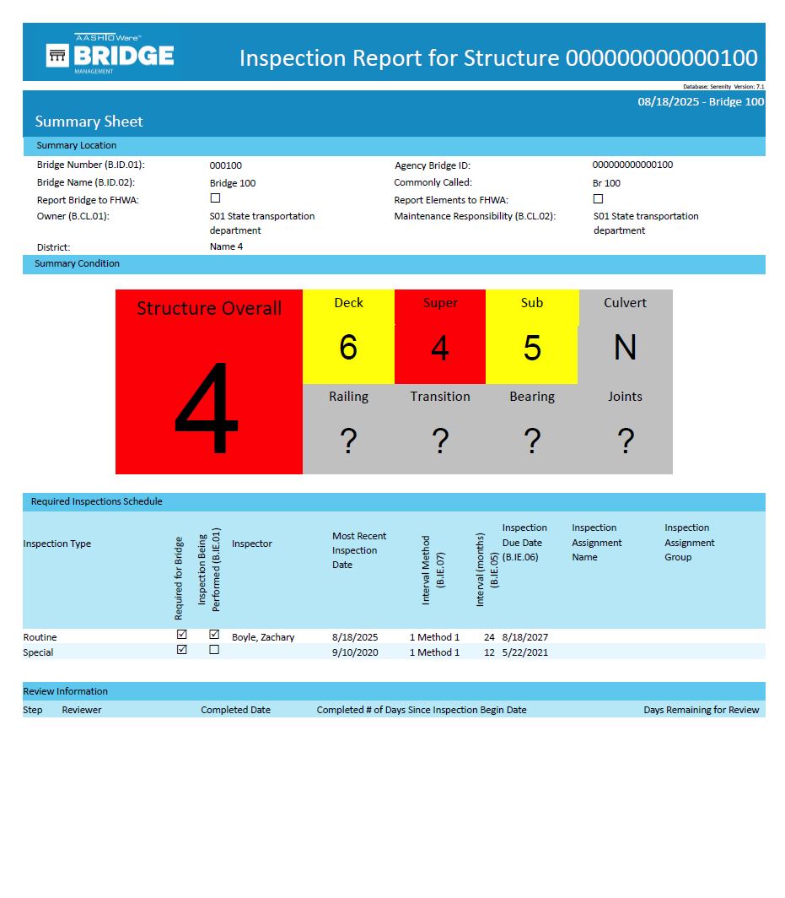
Reports
Photo by Evan Leith on Unsplash

Slide 36
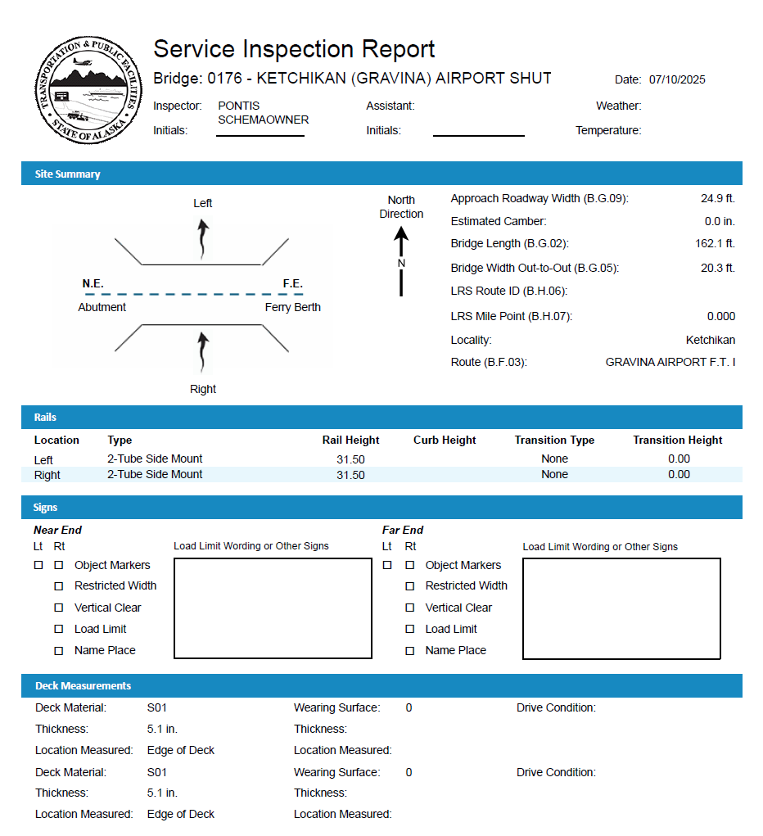
Reports
Photo by Evan Leith on Unsplash

Slide 37
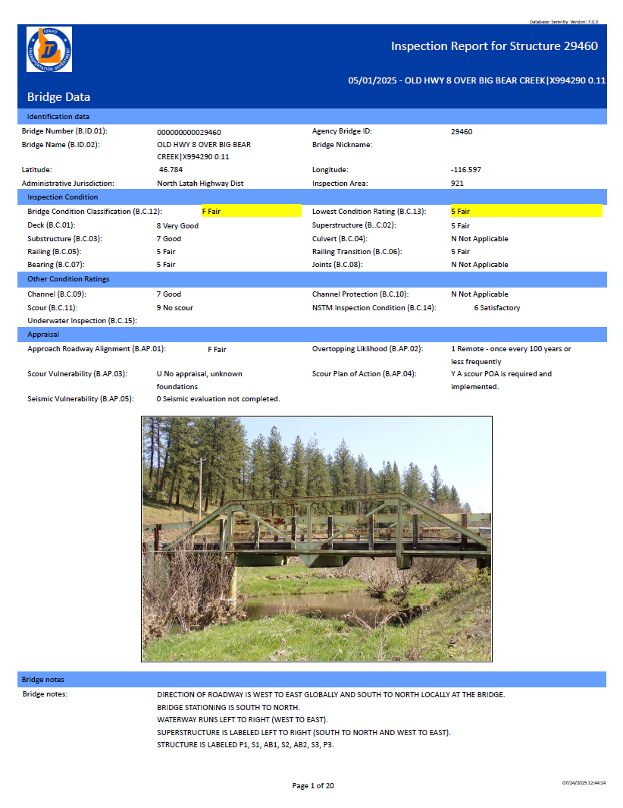
Reports
Photo by Evan Leith on Unsplash

Slide 38
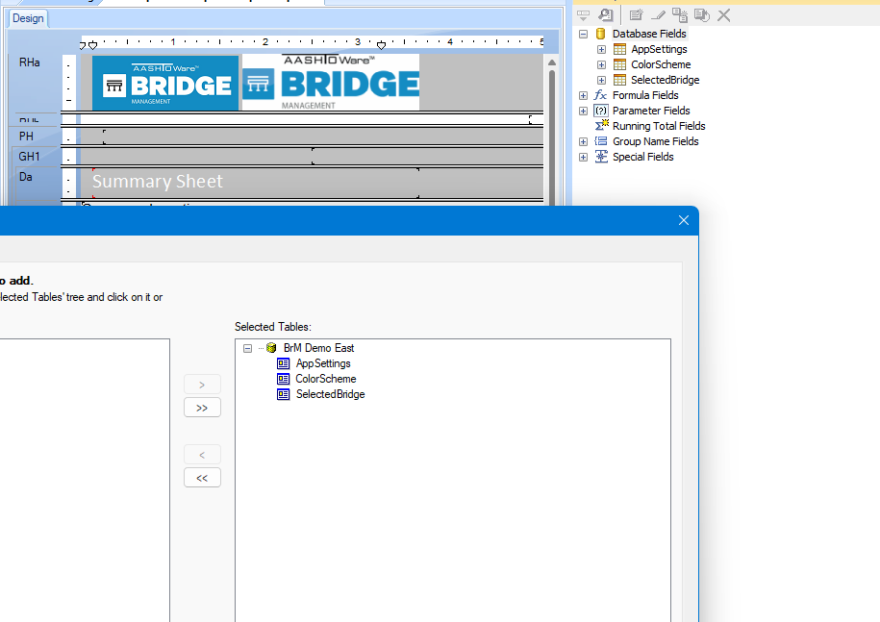
Reports
Inspection Level
Top-level query selects for the selected bridge(s) and the associated events:
Inspection (selected)
Load Posting (latest)
Load Rating (reported)
Top-level query for the color codes
Photo by Evan Leith on Unsplash

Slide 39
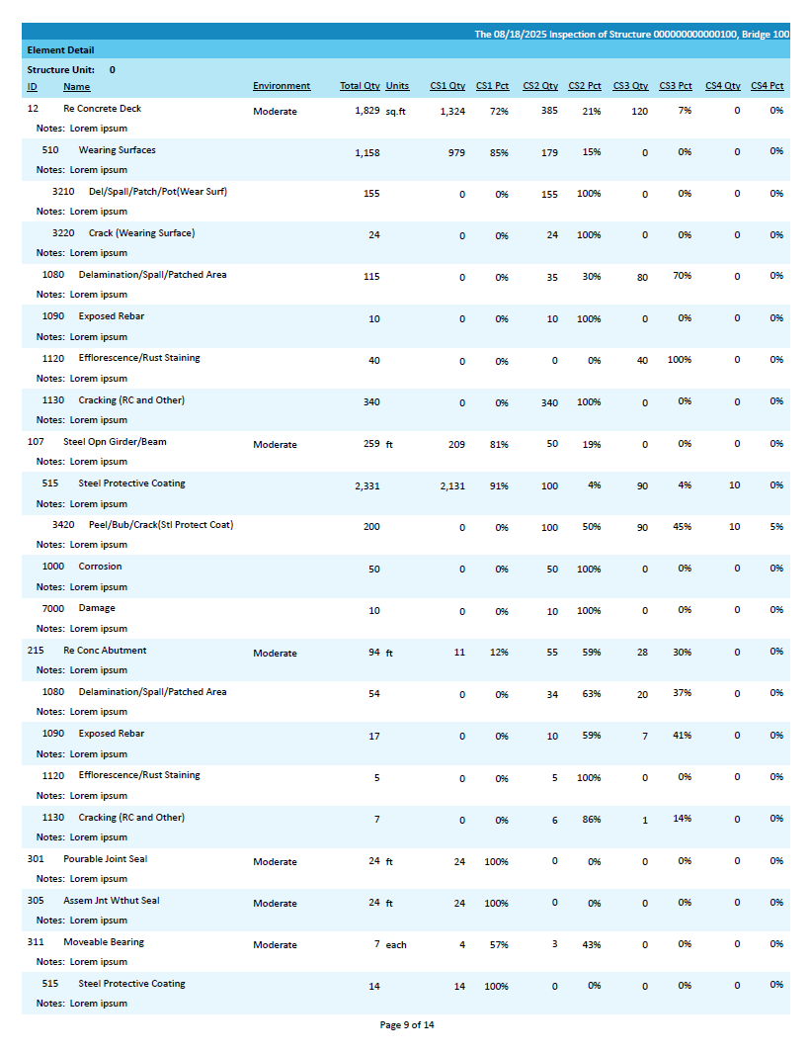
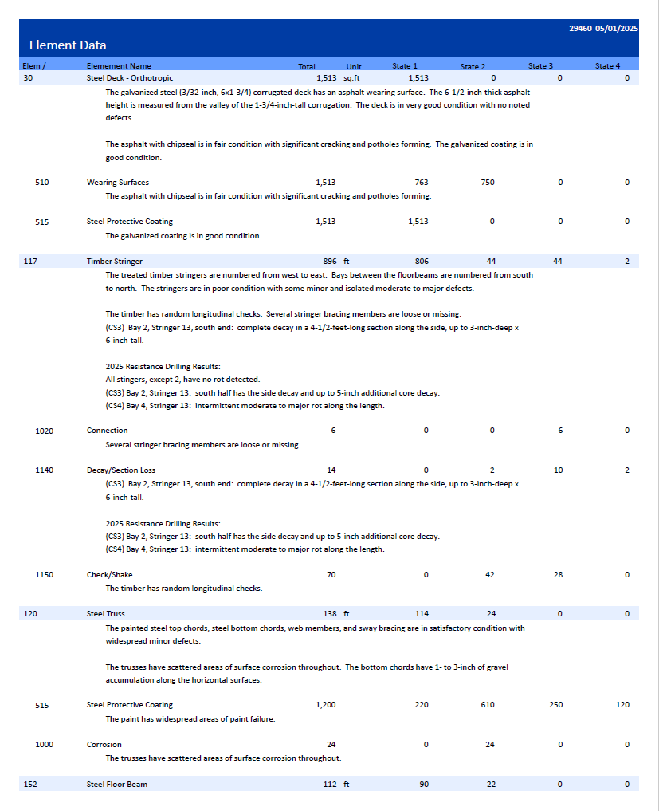
Reports
Photo by Evan Leith on Unsplash

Slide 40
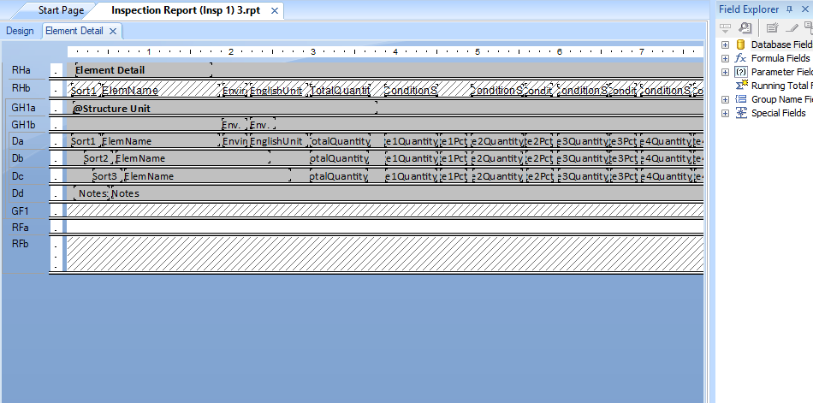
Reports
Element Level
Joins to the selected inspection, then joins the element table again for “child” and again for “grandchild” elements.
The details are copied out three times with the different colors or indentations, then selectively hidden based on the needed indent.
Photo by Evan Leith on Unsplash

Slide 41
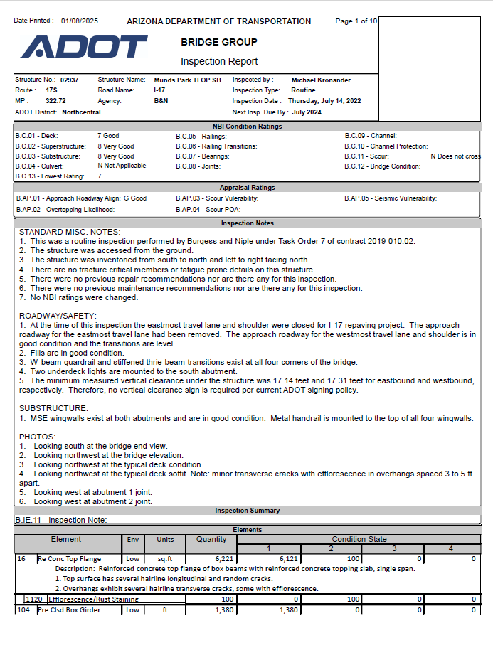
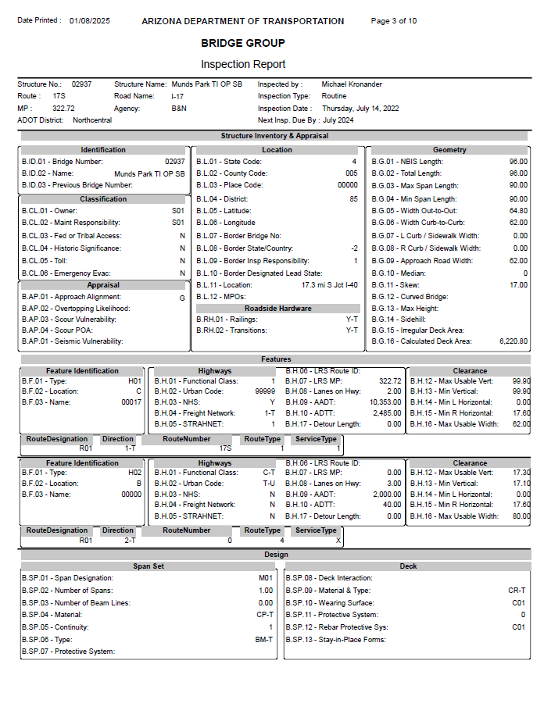


Reports
Photo by Evan Leith on Unsplash

Slide 42
Reports
Stamp & Signature
Information density
Photo by Evan Leith on Unsplash

Slide 43
Reports
Features section fields change based on feature type
Super / Sub sets repeat as needed
Photo by Evan Leith on Unsplash

Slide 44
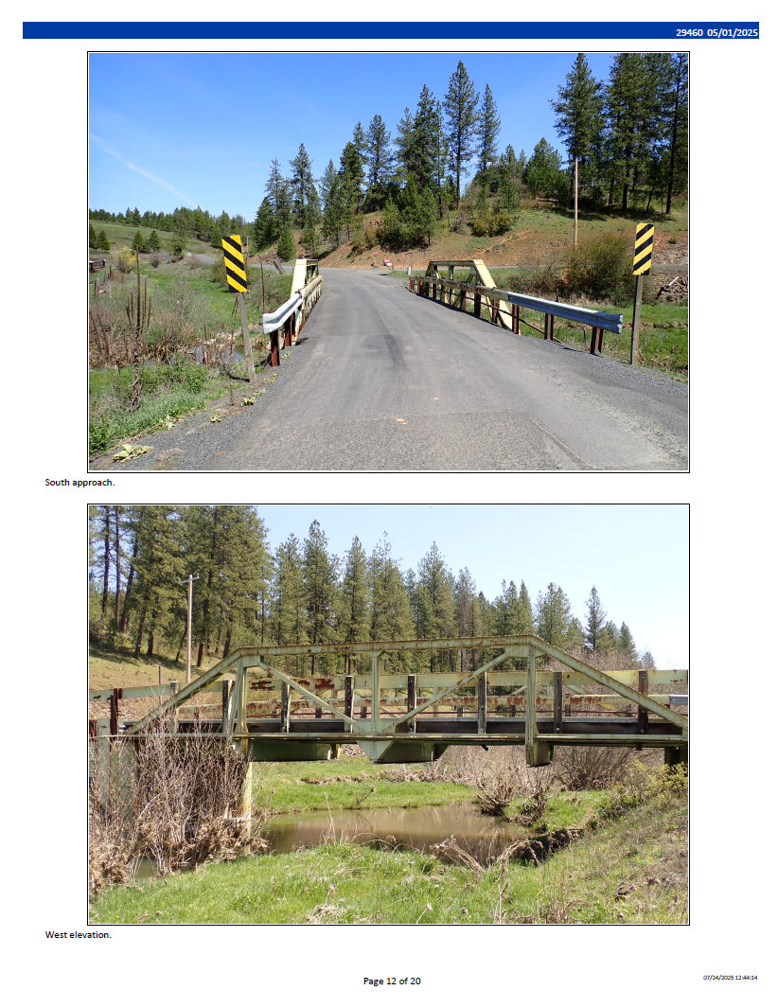
Reports
Photo by Evan Leith on Unsplash

Slide 45
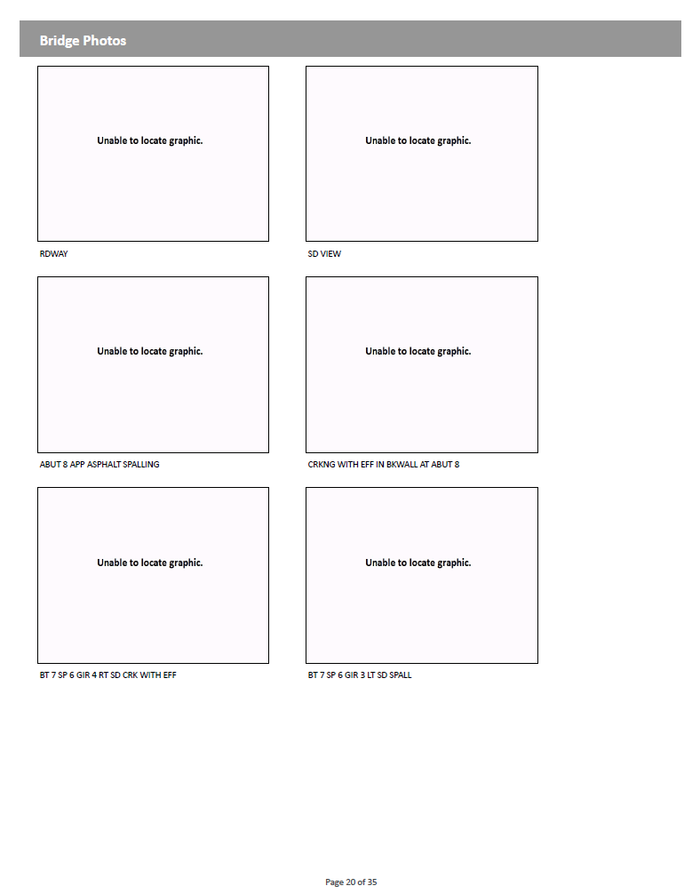
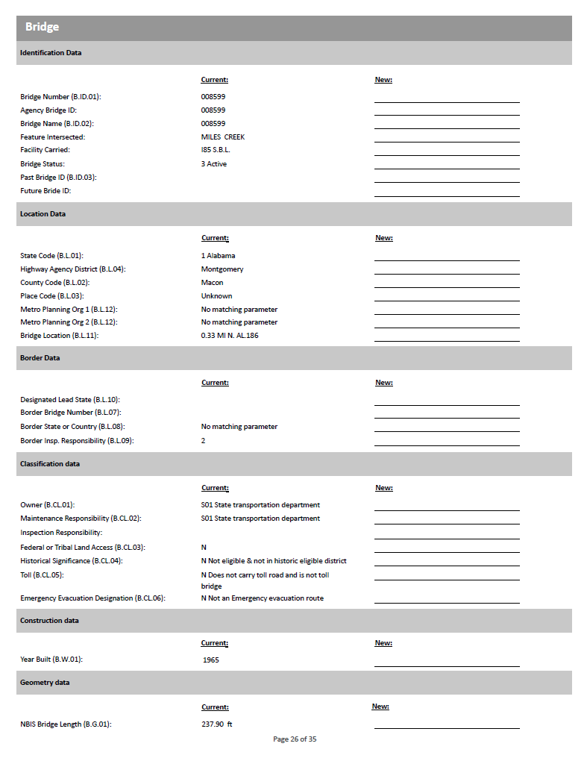
Reports
Photo by Evan Leith on Unsplash

Slide 46
Reports
Photo by Evan Leith on Unsplash

Slide 47
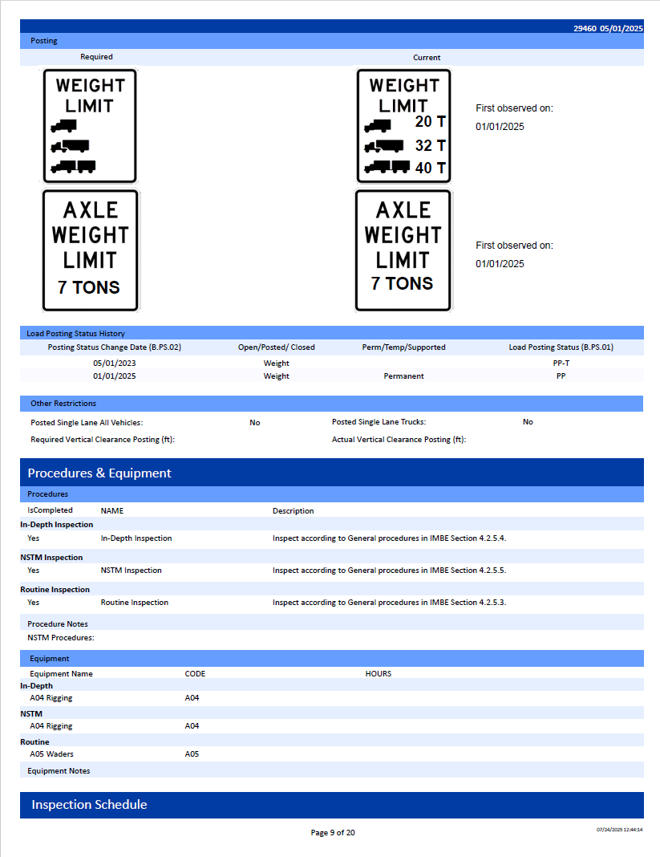
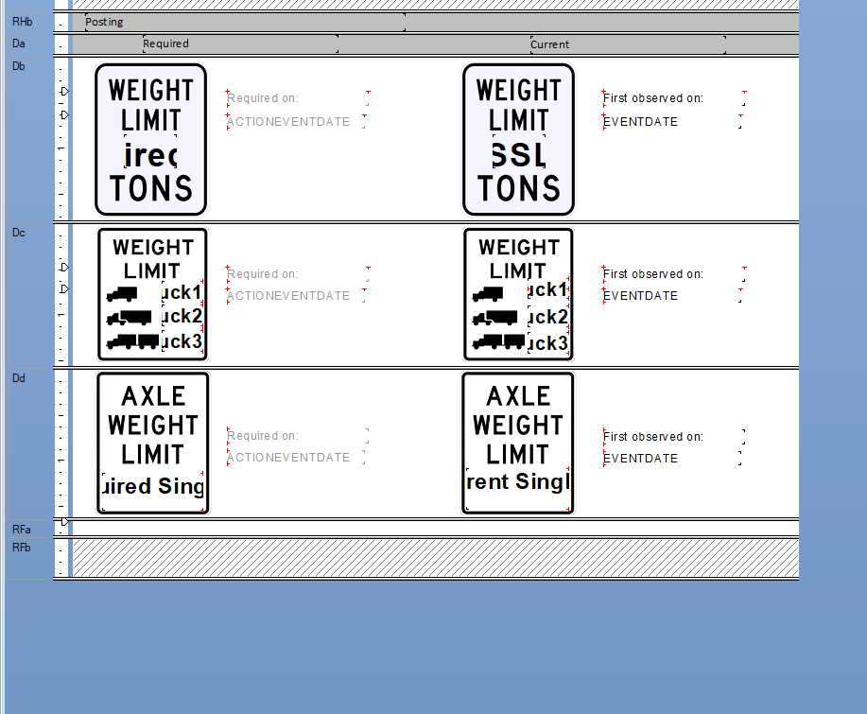
Reports
Photo by Evan Leith on Unsplash

Slide 48
Reports
Photo by Evan Leith on Unsplash

Slide 49
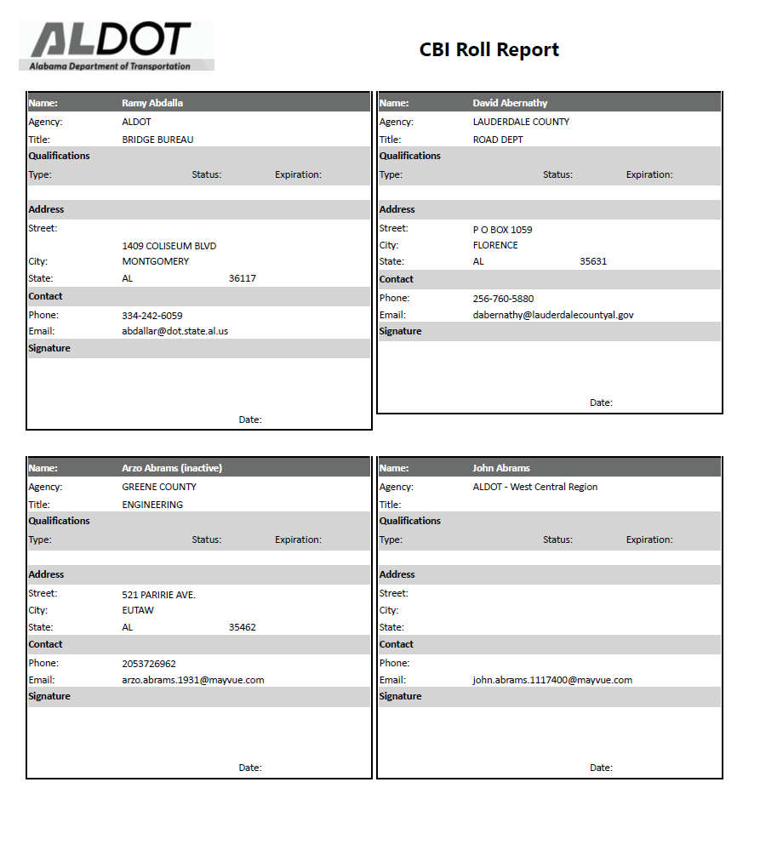
Reports
Photo by Evan Leith on Unsplash

Slide 50
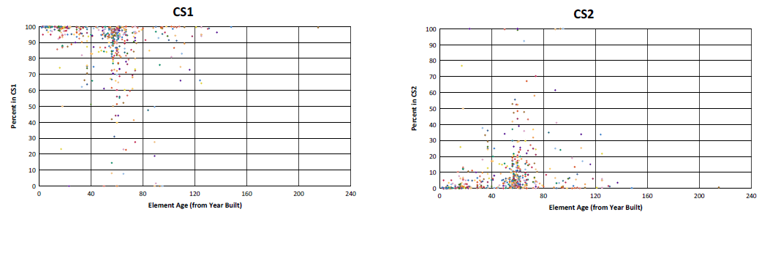
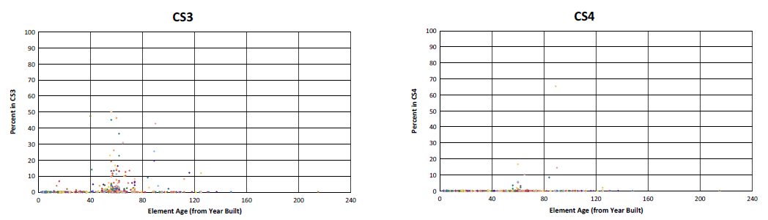
Reports
Photo by Evan Leith on Unsplash

Slide 51
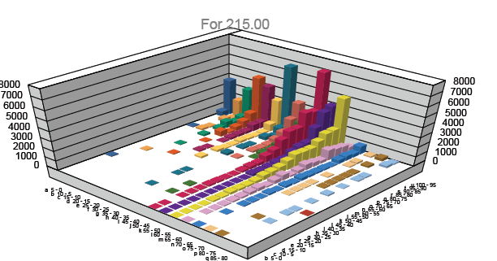
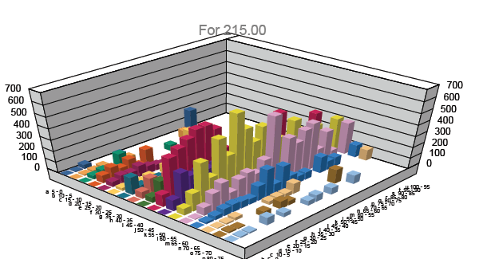
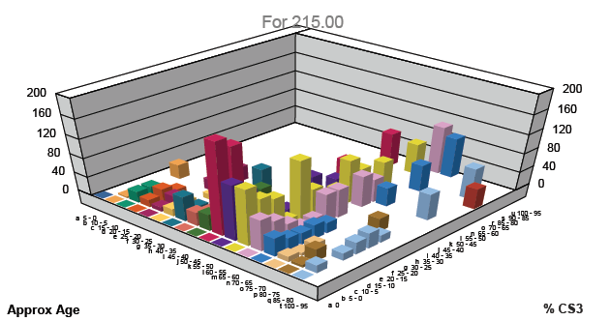
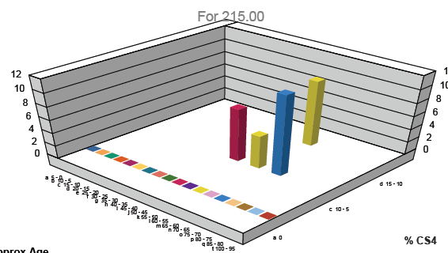
Reports
Photo by Evan Leith on Unsplash

Slide 52
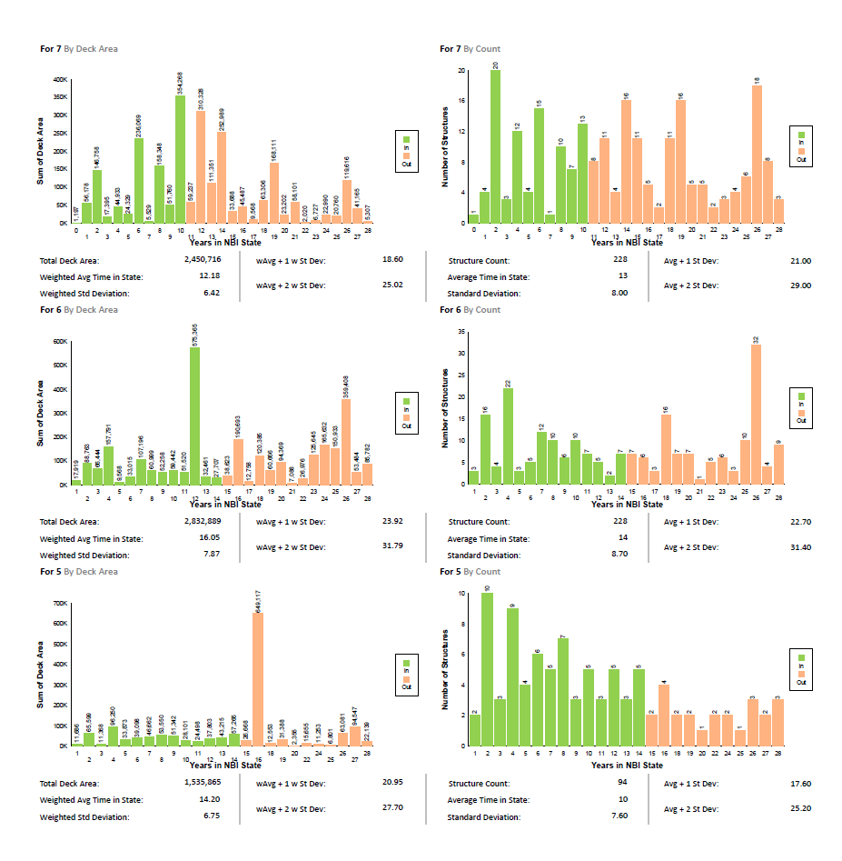
Reports
Photo by Evan Leith on Unsplash

Slide 53
Dashboards
Photo by Evan Leith on Unsplash

Slide 54
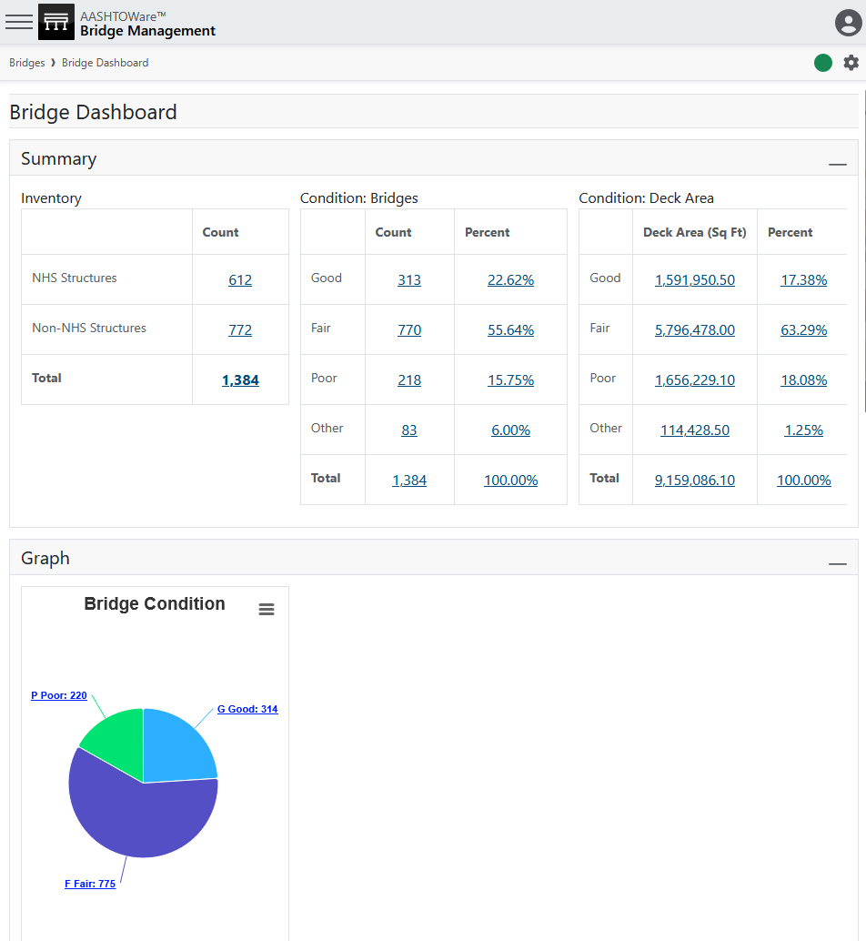
Dashboards
Photo by Evan Leith on Unsplash

Slide 55
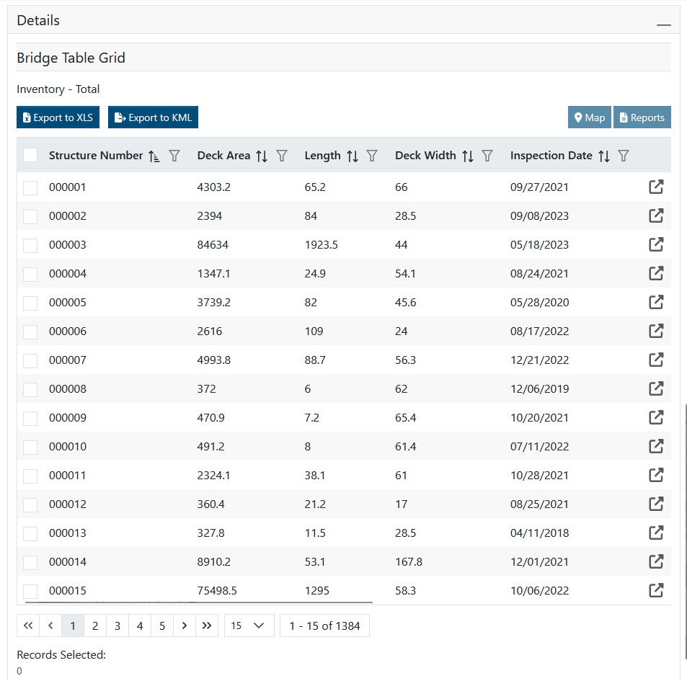
Dashboards
Photo by Evan Leith on Unsplash

Slide 56
Dashboards
Scaler Query
What appears in the hyperlink
Filter Query
What appears in the grid (if you add one)
Photo by Evan Leith on Unsplash

Slide 57
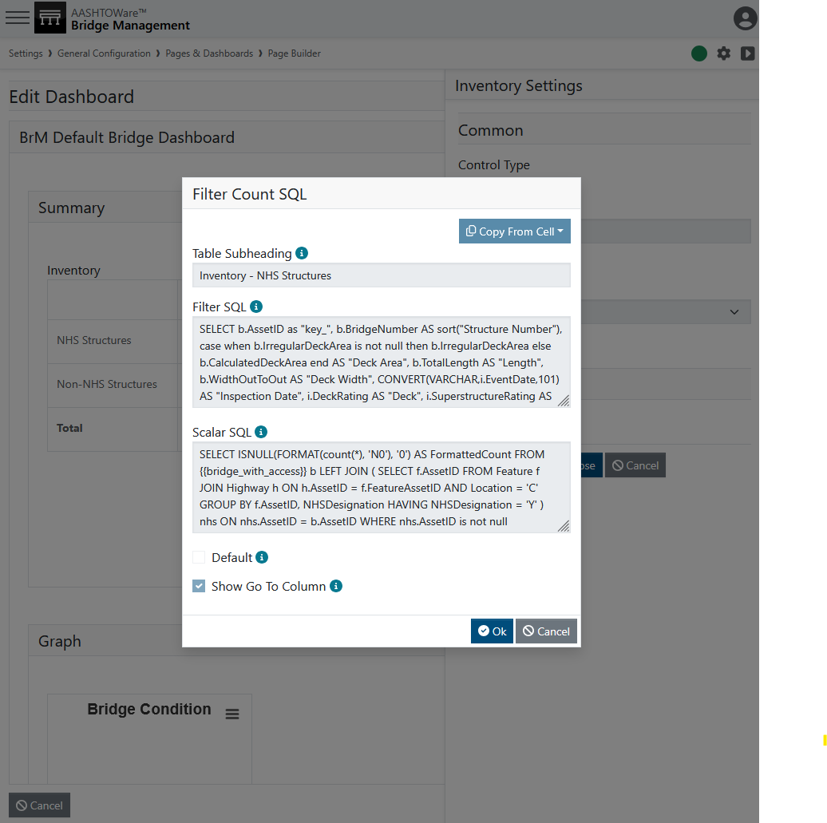
Dashboards
Photo by Evan Leith on Unsplash

Slide 58
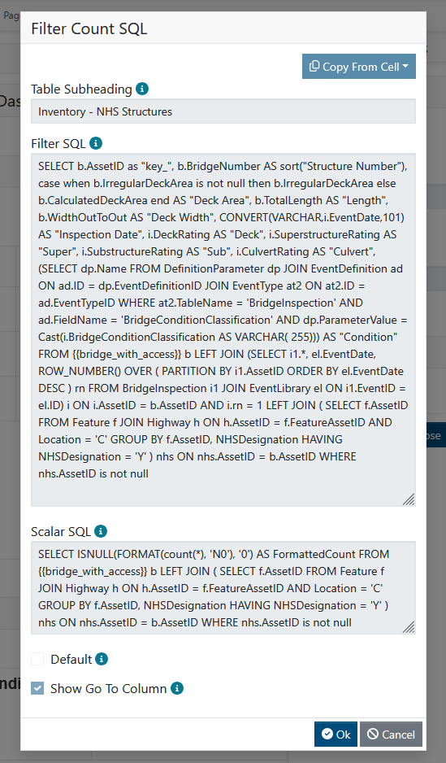
Dashboards
Photo by Evan Leith on Unsplash

Slide 59
Dashboards
Photo by Evan Leith on Unsplash

Slide 60
Dashboards
The columns that appear in the grid
Carries a road on the NHS
Photo by Evan Leith on Unsplash

Slide 61
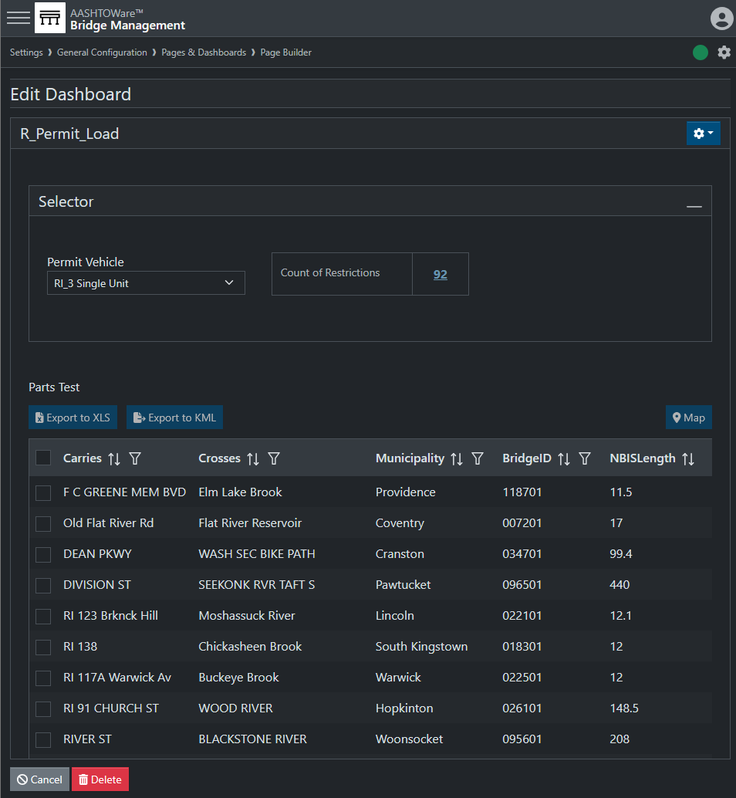
Dashboards
RIDOT Use Case (2025):
Select a vehicle
Filter will return bridges that block that vehicle by load rating or by posting.
Results given by report, list (with optional excel) and map.
Photo by Evan Leith on Unsplash

Slide 62
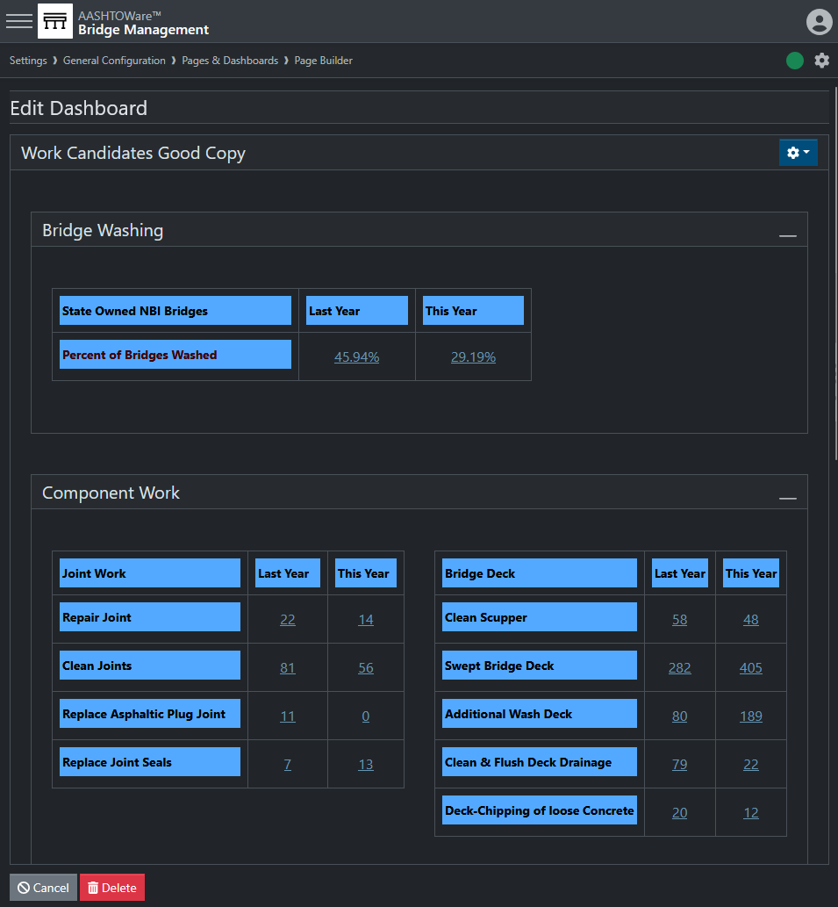
Dashboards
RIDOT Use Case (2025):
Status of particular work candidates.
Photo by Evan Leith on Unsplash

Slide 63

Dashboards
Photo by Evan Leith on Unsplash

Slide 64
Dashboards
Use case examples:
Scour critical management
Clearance routing
Critical Findings summary
Inspector Qualifications
QC review statuses
Optimization settings
Optimization results

Slide 65
Dashboards
AN IMPORTAT CAUTIONARY NOTE ABOUT
SPEED

Slide 66


Dashboards
1.
4.
9.
14.
19.
2.
5.
10.
15.
20.
3.
6.
11.
16.
21.
7.
12.
17.
22.
8.
13.
18.
23.

Slide 67
1.
4.
9.
14.
19.
2.
5.
10.
15.
20.
3.
6.
11.
16.
21.
7.
12.
17.
22.
8.
13.
18.
23.
Dashboards
24.
28.
32.
36.
25.
29.
33.
37.
26.
30.
34.
38.
27.
31.
35.
39.
40.

Slide 68

Dashboards

Slide 69
Dashboards
40 calls x ? Users x ? Landings on page
May impact the speed
Things to consider:
How many calls need to be on a page?
How many users will be checking it?
How often will they be checking it?
Perhaps don’t use the default dashboard as the main landing page for all your inspectors.

Slide 70
API Calls
Photo by Evan Leith on Unsplash

Slide 71

API Calls

Slide 72

API Calls
From BrM 6, but you get the idea

Slide 73
API Calls

Slide 74


API Calls

Slide 75


API Calls

Slide 76
API Calls

Slide 77
API Calls
Step 1 – Register your site
(Only if you have an agency-hosted 7.0+ site.
If you are hosted by Mayvue, this is done.)
Send an email to:
Step 2 – Get subscriber key
Sedrick.Bouknight@wsp.com
Step 3 – See the API guide
Step 4 – Get BrM API key
Good afternoon Sedrick,
I am the representative for MAYDOT and looking to get started with the AASHTOWare OpenAPI process. My agency’s URL’s are:
Production: Example.MAYDOT.gov/BrM7
Test: TextExample.MAYDOT.gov/BrM7
Thank you for your help.
Zachary Boyle, PE
Chief Structural Engineer - MAYDOT
Step 5 – Get Postman
Step 6 – Give Postman your keys
Step 7 – Get a token
Step 8 – Make a call

Slide 78

API Calls
Step 1 – Register your site
https://developer.aashtoware.org/
Step 2 – Get subscriber key
Step 3 – See the API guide
Step 4 – Get BrM API key
Step 5 – Get Postman
Step 6 – Give Postman your keys
Step 7 – Get a token
Step 8 – Make a call

Slide 79

API Calls
Step 1 – Register your site
https://developer.aashtoware.org/
Step 2 – Get subscriber key
Step 3 – See the API guide
Step 4 – Get BrM API key
Step 5 – Get Postman
May take up to 24 hrs
Step 6 – Give Postman your keys
Step 7 – Get a token
Step 8 – Make a call

Slide 80

API Calls
Step 1 – Register your site
Step 2 – Get subscriber key
Step 3 – See the API guide
Step 4 – Get BrM API key
Step 5 – Get Postman
Step 6 – Give Postman your keys
Your subscriber key
Step 7 – Get a token
Step 8 – Make a call

Slide 81

API Calls
Step 1 – Register your site
Step 2 – Get subscriber key
Step 3 – See the API guide
Step 4 – Get BrM API key
Step 5 – Get Postman
Step 6 – Give Postman your keys
Step 7 – Get a token
Step 8 – Make a call

Slide 82

API Calls
Step 1 – Register your site
Step 2 – Get subscriber key
Step 3 – See the API guide
Step 4 – Get BrM API key
Step 5 – Get Postman
Step 6 – Give Postman your keys
Step 7 – Get a token
Step 8 – Make a call

Slide 83

API Calls
Step 1 – Register your site
Step 2 – Get subscriber key
Step 3 – See the API guide
Step 4 – Get BrM API key
Step 5 – Get Postman
These are your client ID
Step 6 – Give Postman your keys
Step 7 – Get a token
Step 8 – Make a call

Slide 84
API Calls
Step 1 – Register your site
Make a new key for:
Different use cases
  Examples:
  Inspection sync
  Data warehouse
  your testing
Different software connections
  Examples:
  Inspection software
  AASHTOWare BrR
  Clearance routing software
Different users (where possible)
  Your testing
  Your intern’s testing
  Your intern’s cousin’s roommate’s testing.
Step 2 – Get subscriber key
Step 3 – See the API guide
Step 4 – Get BrM API key
Step 5 – Get Postman
Step 6 – Give Postman your keys
Step 7 – Get a token
Step 8 – Make a call

Slide 85

API Calls
Step 1 – Register your site
Step 2 – Get subscriber key
Step 3 – See the API guide
Get Postman
Create Collection
Set Authentication type
Step 4 – Get BrM API key
Postman.com
Step 5 – Get Postman
Step 6 – Give Postman your keys
You can use online or on your desktop.
But you’ll want an account either way.
Step 7 – Get a token
Step 8 – Make a call

Slide 86

API Calls
Step 1 – Register your site
Step 2 – Get subscriber key
Step 3 – See the API guide
Get Postman
Create Collection
Set Authentication type
Step 4 – Get BrM API key
Step 5 – Get Postman
Step 6 – Give Postman your keys
Step 7 – Get a token
Step 8 – Make a call

Slide 87

API Calls
Step 1 – Register your site
Step 2 – Get subscriber key
Step 3 – See the API guide
Get Postman
Create Collection
Set Authentication type
Step 4 – Get BrM API key
Step 5 – Get Postman
Step 6 – Give Postman your keys
Note: double brackets mean a variable. You might need to make the variable first.
Step 7 – Get a token
Step 8 – Make a call

Slide 88

API Calls
Step 1 – Register your site
Step 2 – Get subscriber key
Step 3 – See the API guide
Step 4 – Get BrM API key
From AASHTOWare developer portal
Step 5 – Get Postman
From BrM
From BrM
From Sedrick about your agency
Step 6 – Give Postman your keys
Step 7 – Get a token
Blank until step 7
Step 8 – Make a call

Slide 89
API Calls
Step 1 – Register your site
Step 2 – Get subscriber key
Getting a token
is like logging into BrM. You will need to get a new token as often as you would need to log in.
It starts a new session.
Step 3 – See the API guide
Step 4 – Get BrM API key
Step 5 – Get Postman
Step 6 – Give Postman your keys
Step 7 – Get a token
Step 8 – Make a call

Slide 90

API Calls
Step 1 – Register your site
Step 2 – Get subscriber key
Step 3 – See the API guide
Step 4 – Get BrM API key
Step 5 – Get Postman
Step 6 – Give Postman your keys
Step 7 – Get a token
Step 8 – Make a call

Slide 91
API Calls
Step 1 – Register your site
Step 2 – Get subscriber key
Step 3 – See the API guide
GET ≈ SELECT
POST ≈ INSERT
(and sometimes do the thing)
PUT ≈ UPDATE
DELETE ≈ you’ve made a terrible mistake and should turn around now.
Step 4 – Get BrM API key
Step 5 – Get Postman
Step 6 – Give Postman your keys
Step 7 – Get a token
Step 8 – Make a call

Slide 92
API Calls
Step 1 – Register your site
Step 2 – Get subscriber key
Step 3 – See the API guide
Step 4 – Get BrM API key
Step 5 – Get Postman
Step 6 – Give Postman your keys
Step 7 – Get a token
Step 8 – Make a call

Slide 93
API Calls
Step 1 – Register your site
Step 2 – Get subscriber key
Step 3 – See the API guide
Step 4 – Get BrM API key
Step 5 – Get Postman
Step 6 – Give Postman your keys
Step 7 – Get a token
Step 8 – Make a call

Slide 94

API Calls
Step 1 – Register your site
Step 2 – Get subscriber key
Step 3 – See the API guide
Step 4 – Get BrM API key
Step 5 – Get Postman
Step 6 – Give Postman your keys
Step 7 – Get a token
Step 8 – Make a call

Slide 95
API Calls
Step 1 – Register your site
Step 2 – Get subscriber key
Step 3 – See the API guide
Step 4 – Get BrM API key
Step 5 – Get Postman
Step 6 – Give Postman your keys
Step 7 – Get a token
Step 8 – Make a call

Slide 96
API Calls
Step 1 – Register your site
Step 2 – Get subscriber key
Step 3 – See the API guide
Step 4 – Get BrM API key
Step 5 – Get Postman
Step 6 – Give Postman your keys
Step 7 – Get a token
Step 8 – Make a call

Slide 97

API Calls
Step 1 – Register your site
Step 2 – Get subscriber key
Step 3 – See the API guide
Step 4 – Get BrM API key
Step 5 – Get Postman
Step 6 – Give Postman your keys
Step 7 – Get a token
Step 8 – Make a call

Slide 98

API Calls
Step 1 – Register your site
Step 2 – Get subscriber key
Step 3 – See the API guide
Step 4 – Get BrM API key
Step 5 – Get Postman
Step 6 – Give Postman your keys
Step 7 – Get a token
Step 8 – Make a call

Slide 99

API Calls
Step 1 – Register your site
Step 2 – Get subscriber key
Step 3 – See the API guide
Step 4 – Get BrM API key
Step 5 – Get Postman
Step 6 – Give Postman your keys
Step 7 – Get a token
Step 8 – Make a call

Slide 100

API Calls
Step 1 – Register your site
Step 2 – Get subscriber key
Step 3 – See the API guide
Step 4 – Get BrM API key
Step 5 – Get Postman
Step 6 – Give Postman your keys
Step 7 – Get a token
Step 8 – Make a call

Slide 101
API Calls
Step 1 – Register your site
Step 2 – Get subscriber key
Step 3 – See the API guide
Step 4 – Get BrM API key
Step 5 – Get Postman
Step 6 – Give Postman your keys
Step 7 – Get a token
Step 8 – Make a call

Slide 102

API Calls
Step 1 – Register your site
Step 2 – Get subscriber key
Step 3 – See the API guide
Step 4 – Get BrM API key
Step 5 – Get Postman
Step 6 – Give Postman your keys
Step 7 – Get a token
Step 8 – Make a call

Slide 103
BrM 7.0 Migration
CONTACT
The Abridged Version
Jira Service Desk
ZACHARY BOYLE
zac.boyle@mayvue.com
Text | Voicemail | (801) 450-9716
BrM@mayvue.com
1-877-462-9883
http://support.mayvue.com
BrMUG 2024 | Long Beach, CA | September 17-18
Photo by Evan Leith on Unsplash

Slide 104
BrM Inspection 202
The Un-Abridged Version
BrMUG 2025 | Providence, RI | September 17-18
Photo by Evan Leith on Unsplash

