Slide 1




BrM Inspection 201
The Un-Abridged Version
BrMUG 2025 | Providence, RI | September 17-18
Photo by Evan Leith on Unsplash

Slide 2





BrM 7.0 Migration
CONTACT
The Abridged Version
Jira Service Desk
ZACHARY BOYLE
zac.boyle@mayvue.com
Text | Voicemail | (801) 450-9716
BrM@mayvue.com
1-877-462-9883
http://support.mayvue.com
BrMUG 2024 | Long Beach, CA | September 17-18
Photo by Evan Leith on Unsplash

Slide 3

Course Overview
Photo by Evan Leith on Unsplash

Slide 4
Course Overview
TODAY
TOMORROW
Before Break (Insp 101)
Login
Roles & Groups
Bridge List
Inspection List
Scheduling
Inspection Plans
Inventory
Design
Features
After Break (Insp 102)
Condition & Elements
Load Posting
Multimedia
Sketches
Cross Sections
Before Break (Insp 201)
Work Candidates
Certifications
Inspection Assignment
Validation
Inspection Review
Future Planning
After Break (Insp 202)
Submittal
Critical Findings
Reports
Dashboards
API Calls
Photo by Evan Leith on Unsplash

Slide 5
Work Candidates
Photo by Evan Leith on Unsplash

Slide 6
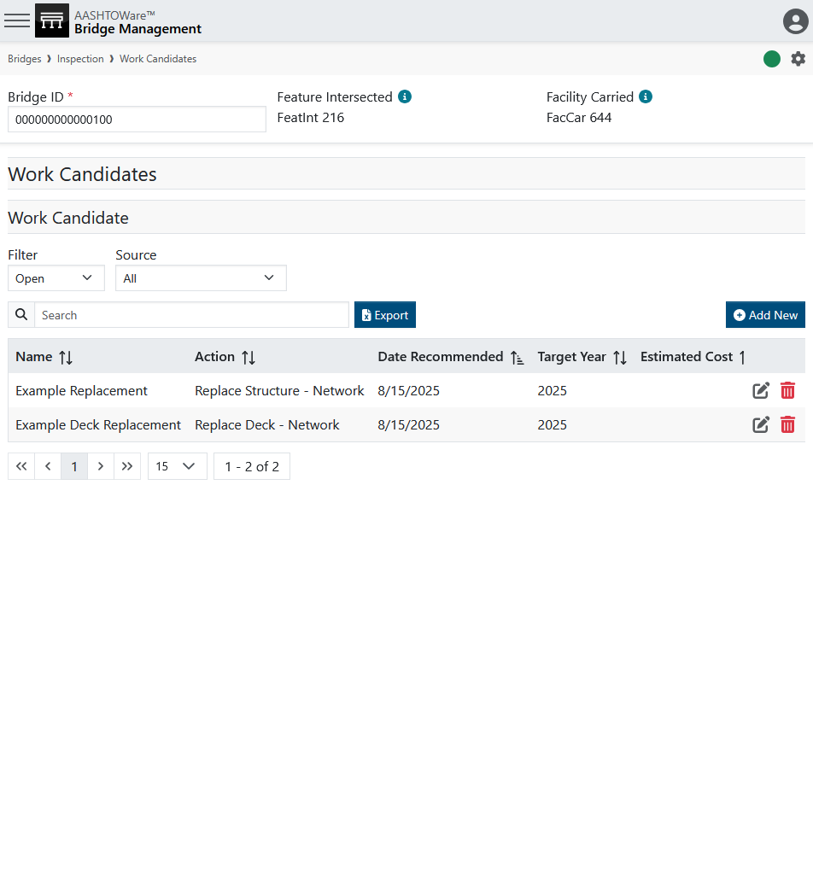
Work Candidates
Photo by Evan Leith on Unsplash

Slide 7
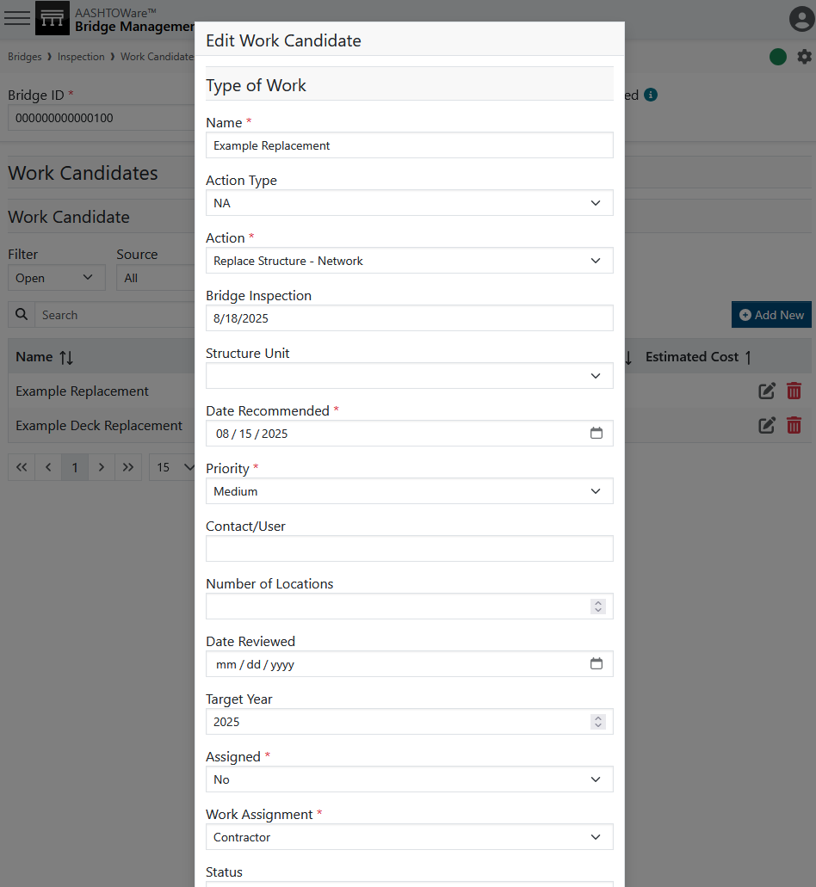
Work Candidates
Photo by Evan Leith on Unsplash

Slide 8
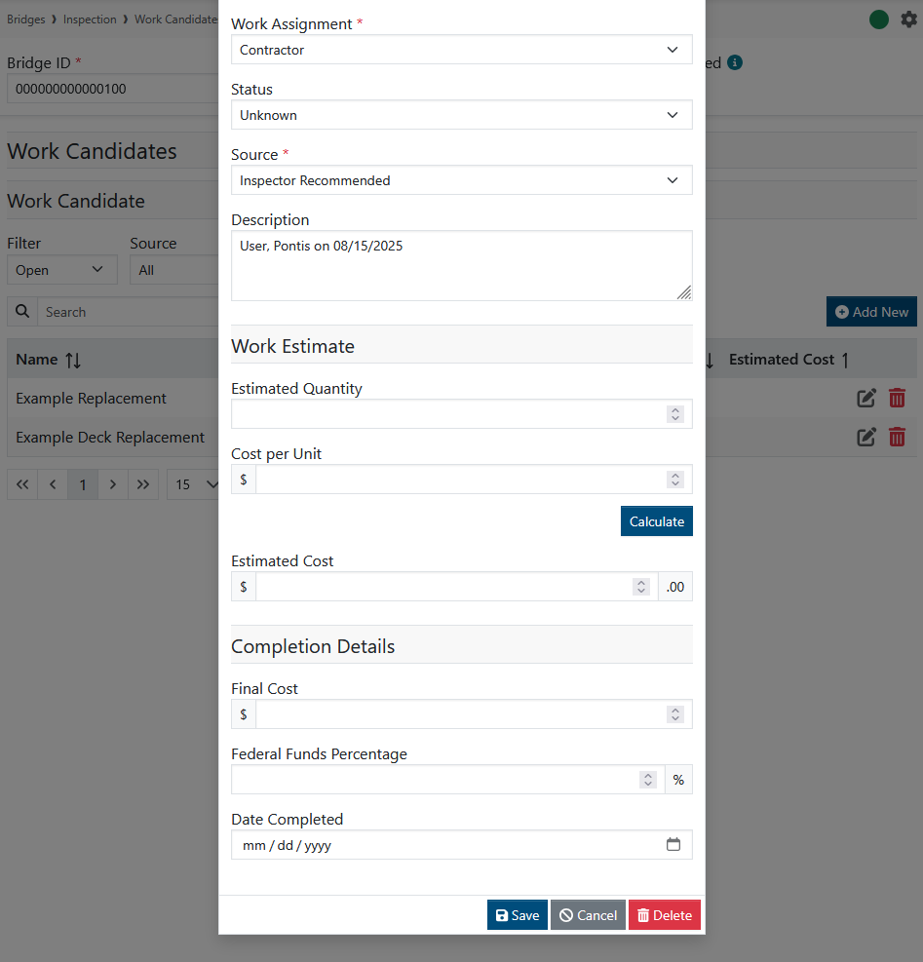
Work Candidates
Photo by Evan Leith on Unsplash

Slide 9
Work Candidates
Photo by Evan Leith on Unsplash

Slide 10
Certifications
Photo by Evan Leith on Unsplash

Slide 11
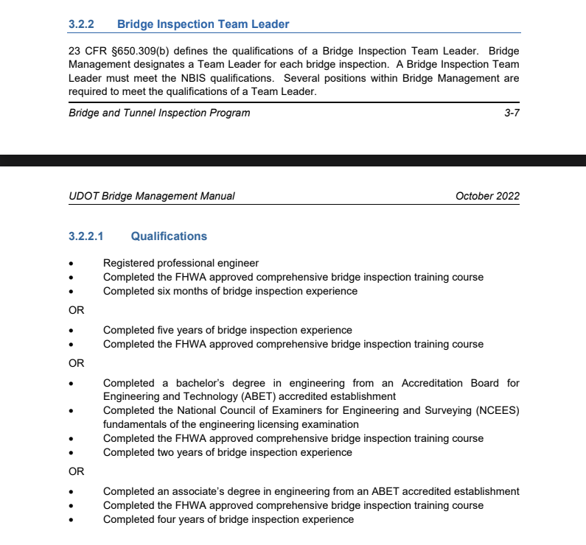
Certifications
Photo by Evan Leith on Unsplash

Slide 12
Certifications
Experience
Certifications
Photo by Evan Leith on Unsplash

Slide 13
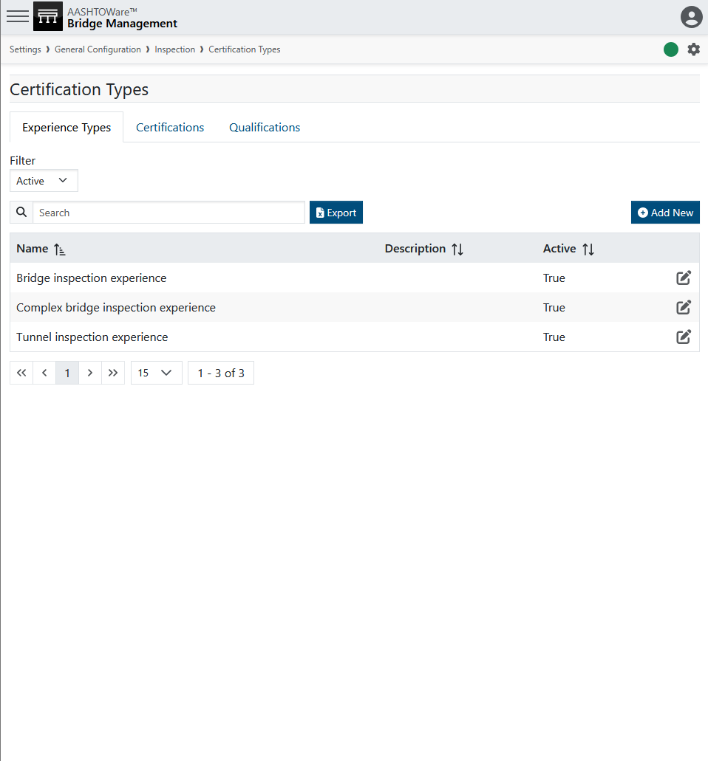
Certifications
Photo by Evan Leith on Unsplash

Slide 14
Certifications
SCDOT experience types (2024):
Bridge construction
Bridge design
Bridge inspection
Bridge maintenance
Complex bridge design
Complex bridge inspection
Electrical inspection
Mechanical inspection
Underwater bridge inspection
Photo by Evan Leith on Unsplash

Slide 15
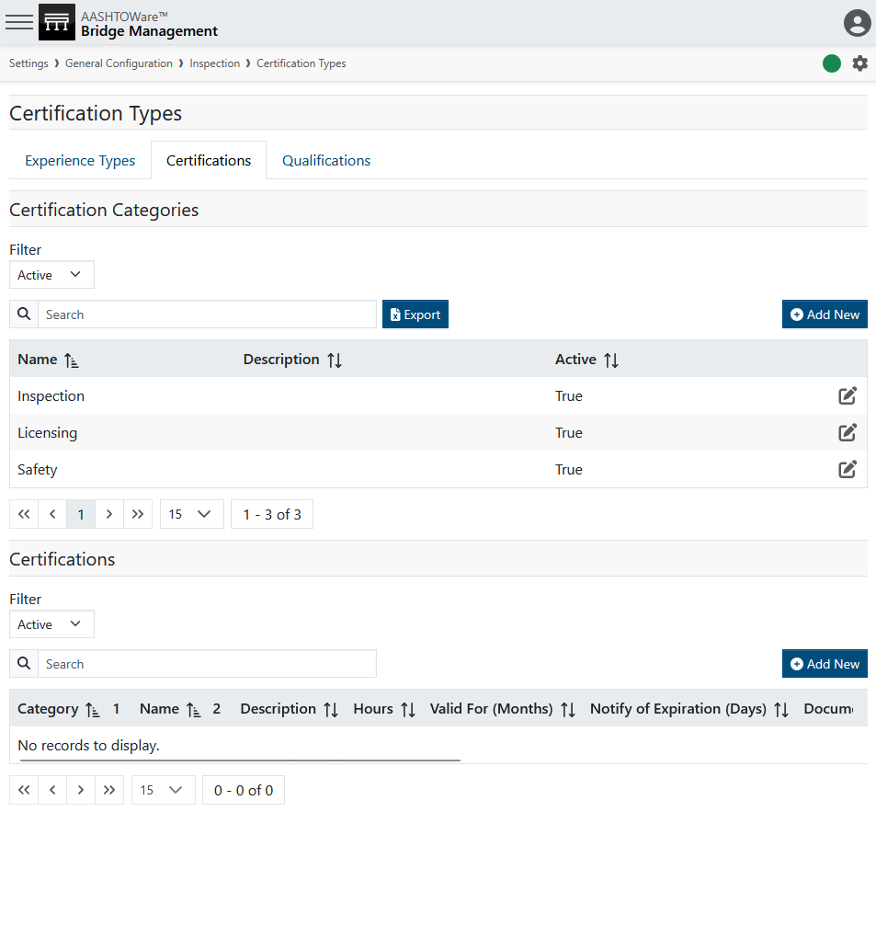
Certifications
Photo by Evan Leith on Unsplash

Slide 16
Certifications
RIDOT certification types (2025):
Course
Educational Degree
Engineering License
Exam
Form
Photo by Evan Leith on Unsplash

Slide 17
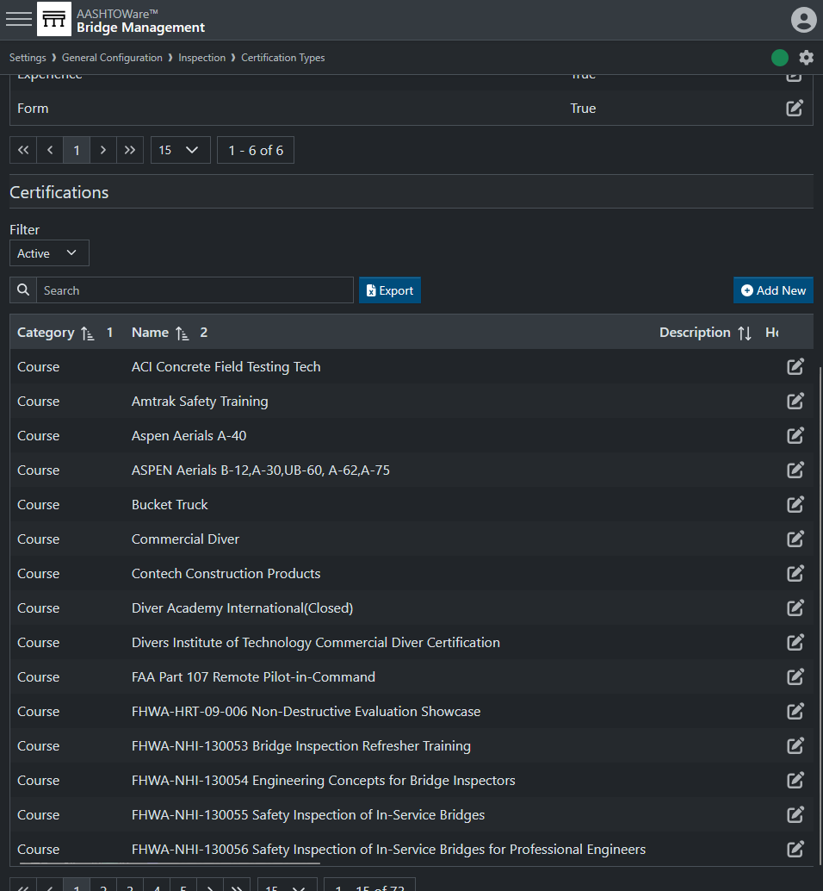
Certifications
RIDOT certification types (2025):
Course
Educational Degree
Engineering License
Exam
Form
RIDOT 2025 examples
Photo by Evan Leith on Unsplash

Slide 18
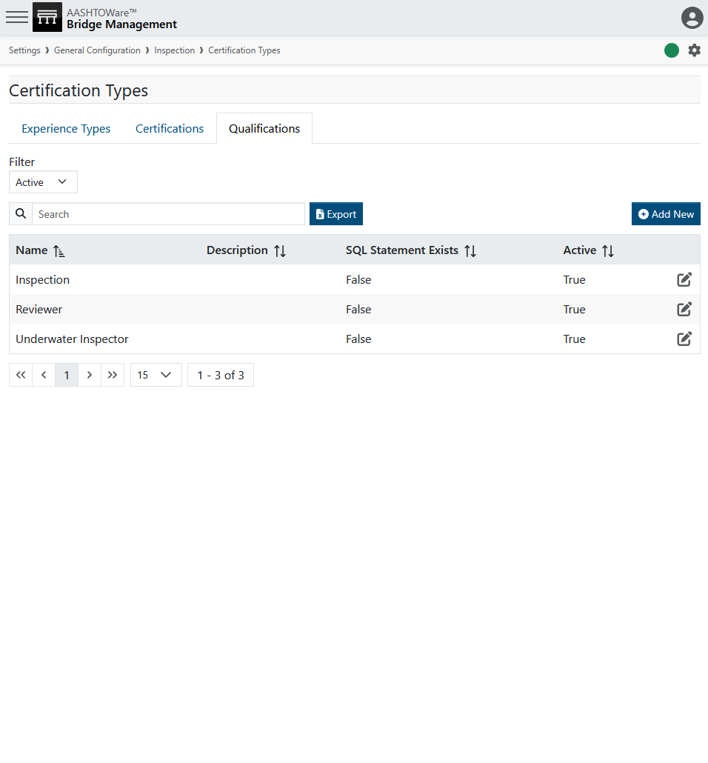
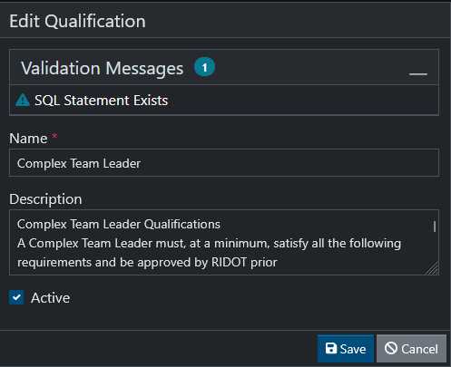
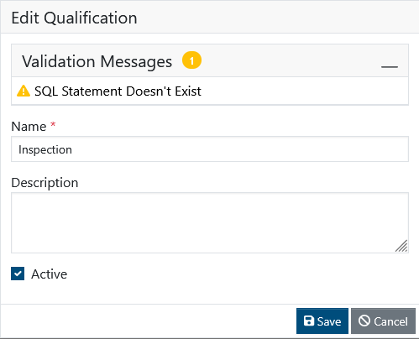
Certifications
Qualifications
Can be used to control access to:
Perform certain inspection types
Perform inspection reviews
Photo by Evan Leith on Unsplash

Slide 19
Certifications
EXAMPLE Qualification Logic (Ask Mayvue for more examples):
WITH ThisU AS (
SELECT ID
FROM USERS
WHERE ID = @UserID
)
… (logic: sum of user relevant XP)
… (logic: date, if available of latest safety cert)
…
Select case when TotalXP >=60
and SafetyCert = 1
and datediff(month,SYSDATETIME(),RefCertExp) >=0
)
then RefCertExp
else null
end as QualLogic
from ThisU u
left join (safety cert WITH statement)
Return date it will expire or null if there is not an active qualification.
Qualifications
Can be used to control access to:
Perform certain inspection types
Perform inspection reviews
Photo by Evan Leith on Unsplash

Slide 20
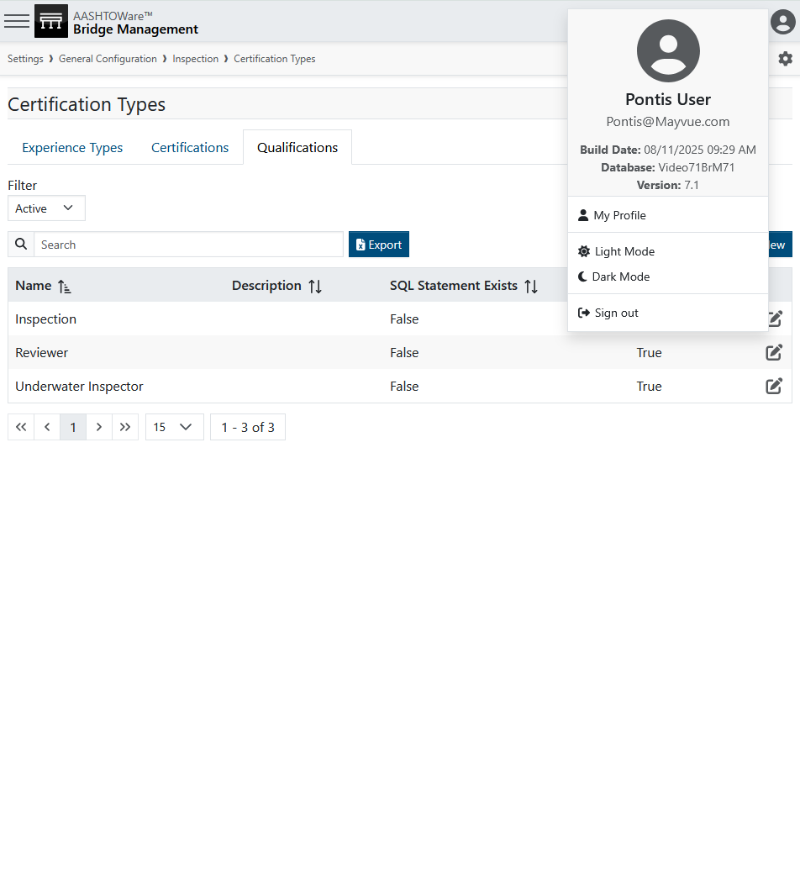
Certifications
Photo by Evan Leith on Unsplash

Slide 21
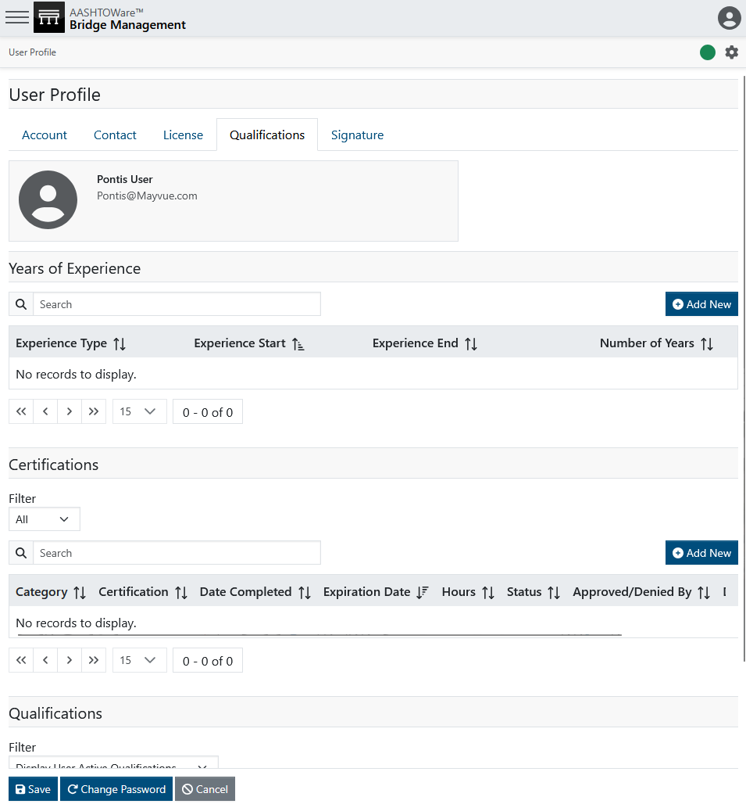
Certifications
Photo by Evan Leith on Unsplash

Slide 22
Inspection Assignment
Photo by Evan Leith on Unsplash

Slide 23
Inspection Assignment
Assignment
Assignment
Reassignment
Inspection
Start Inspection
End Inspection
Review
Validation
Review
Repeats
Photo by Evan Leith on Unsplash

Slide 24
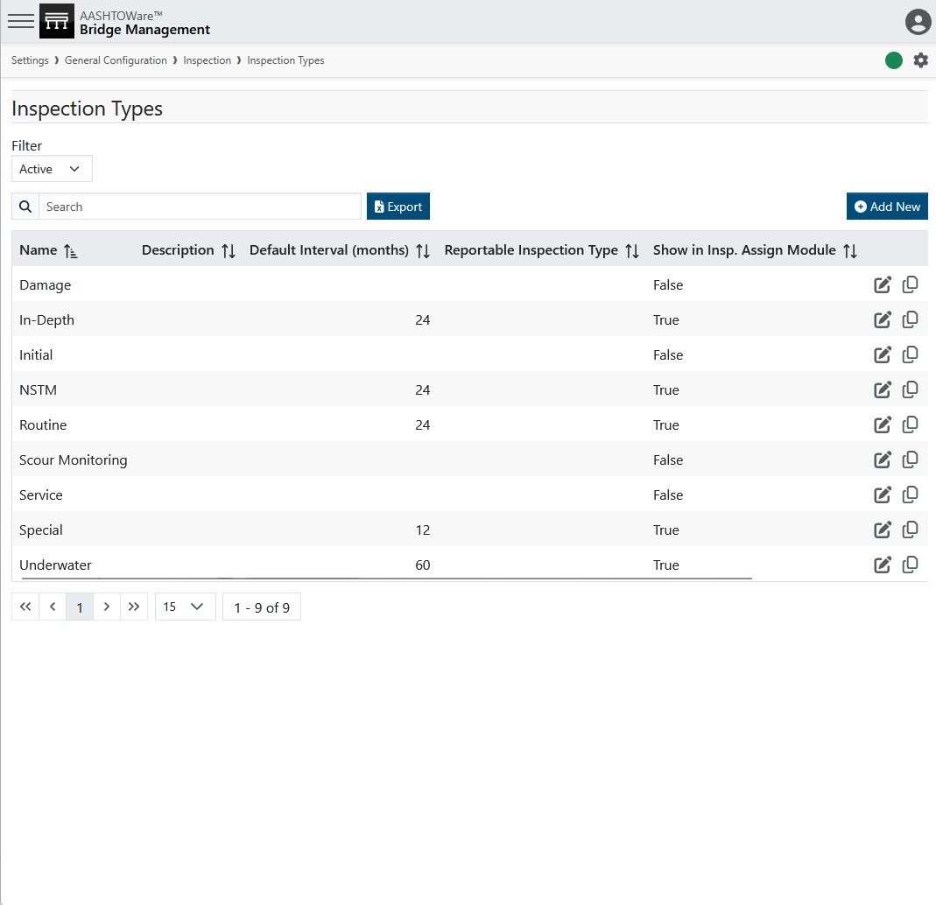
Inspection Assignment
Photo by Evan Leith on Unsplash

Slide 25
Inspection Assignment
Photo by Evan Leith on Unsplash

Slide 26
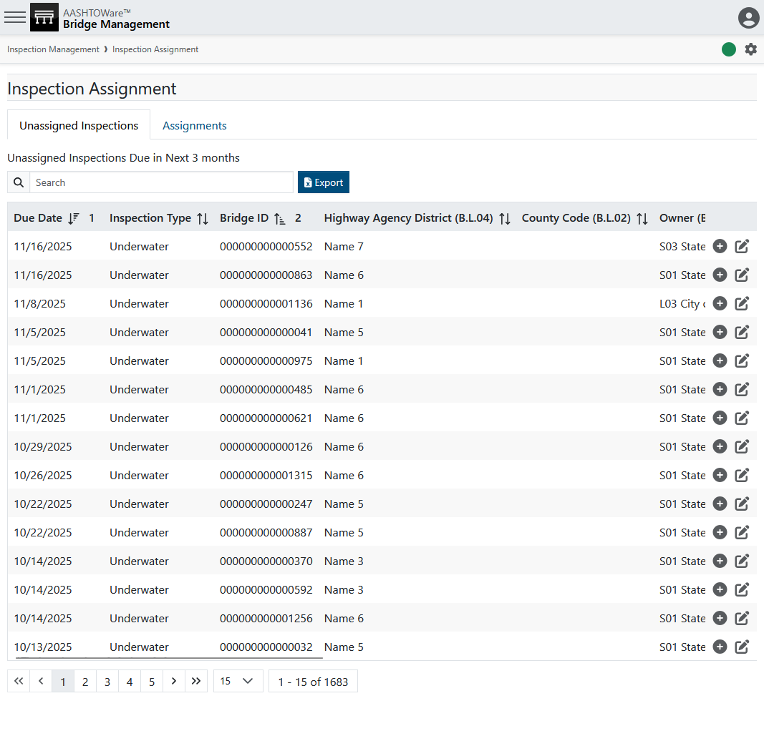
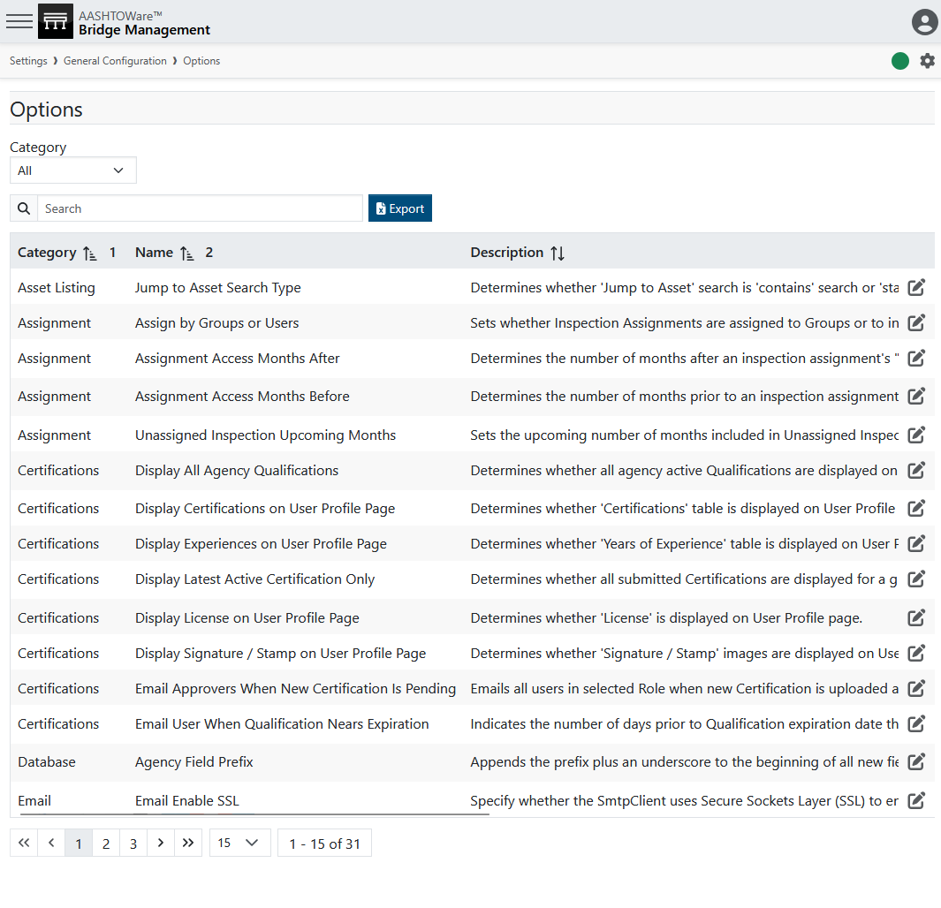
Inspection Assignment
Photo by Evan Leith on Unsplash

Slide 27
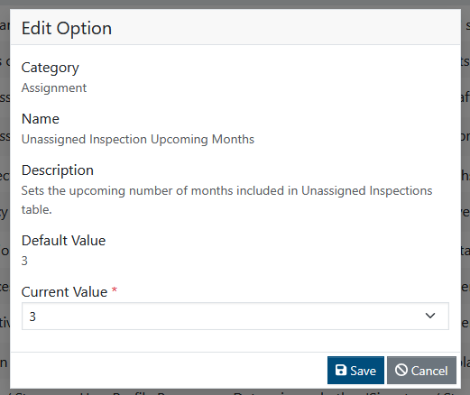
Inspection Assignment
Photo by Evan Leith on Unsplash

Slide 28
Inspection Assignment
Photo by Evan Leith on Unsplash

Slide 29
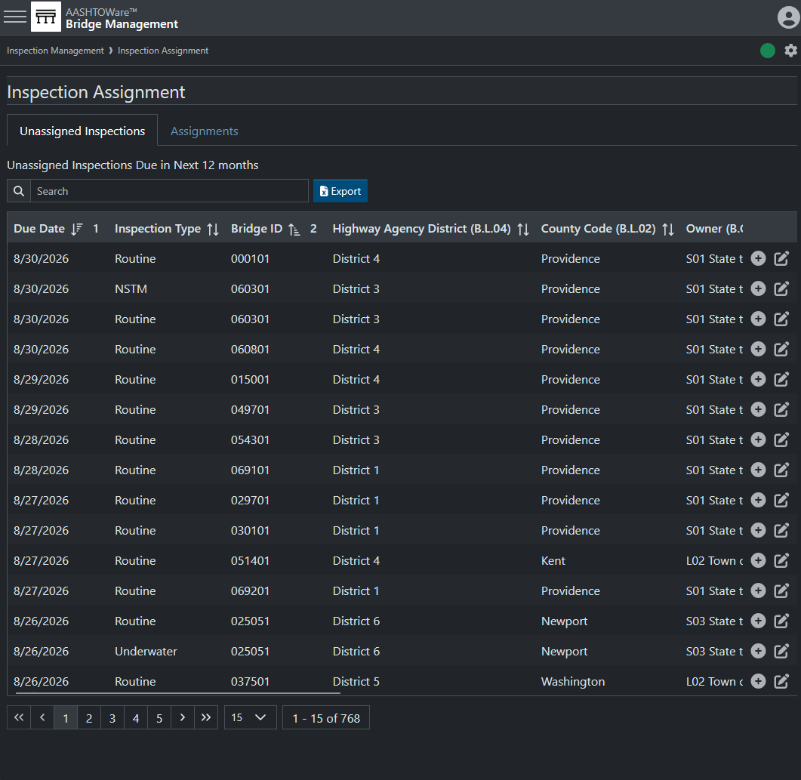
Inspection Assignment
Photo by Evan Leith on Unsplash

Slide 30
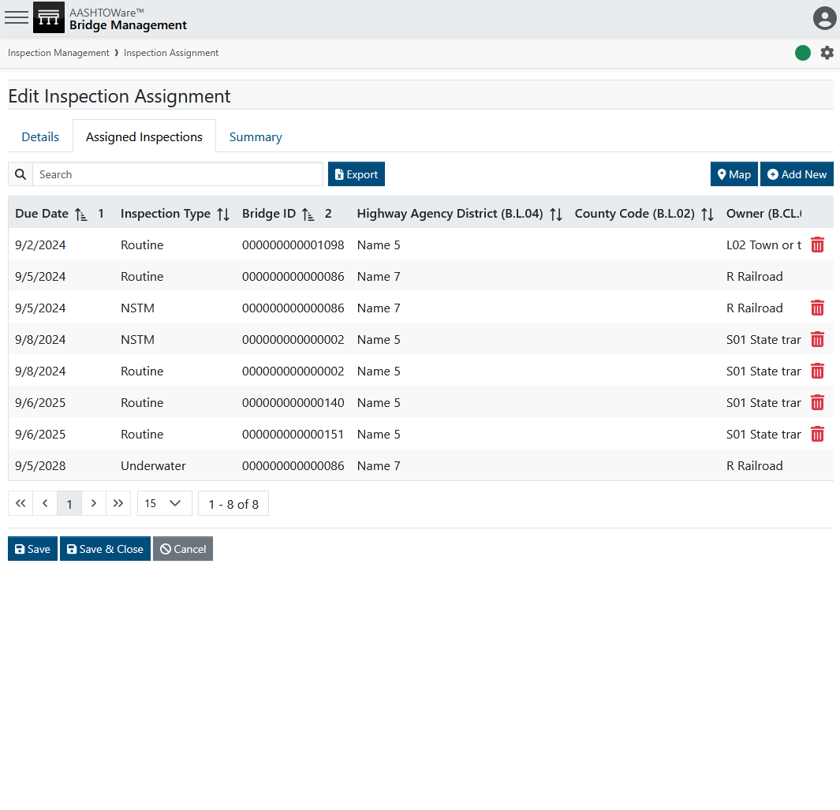
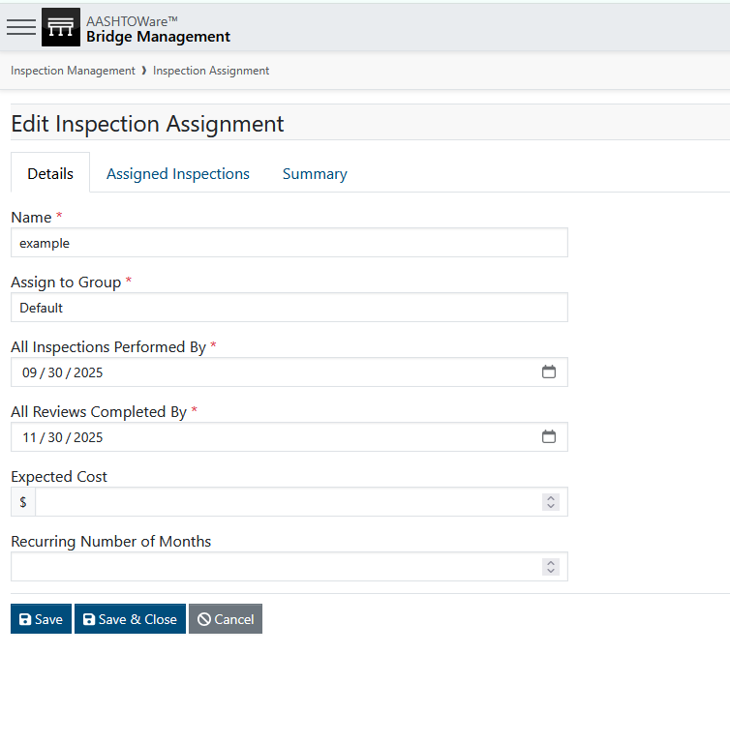
Inspection Assignment

Slide 31
Inspection Assignment

Slide 32
Inspection Assignment
Same bridge, two inspection types

Slide 33
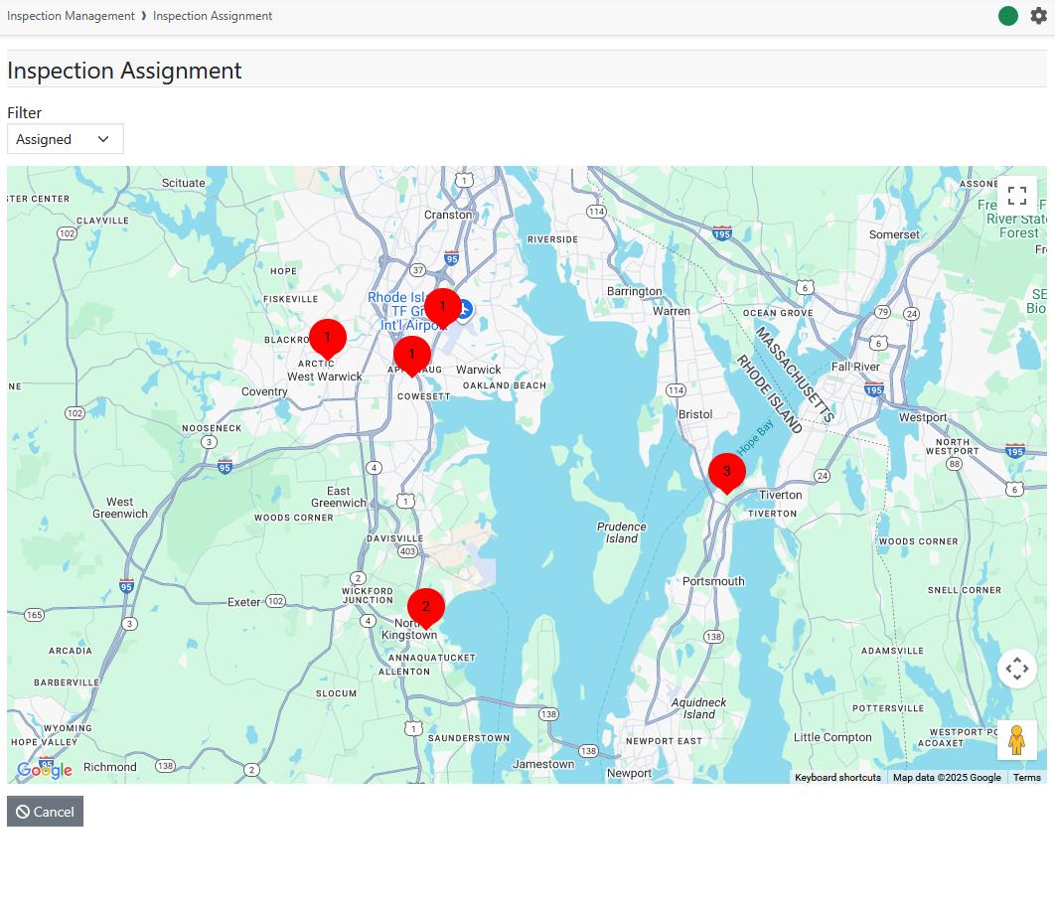
Inspection Assignment

Slide 34
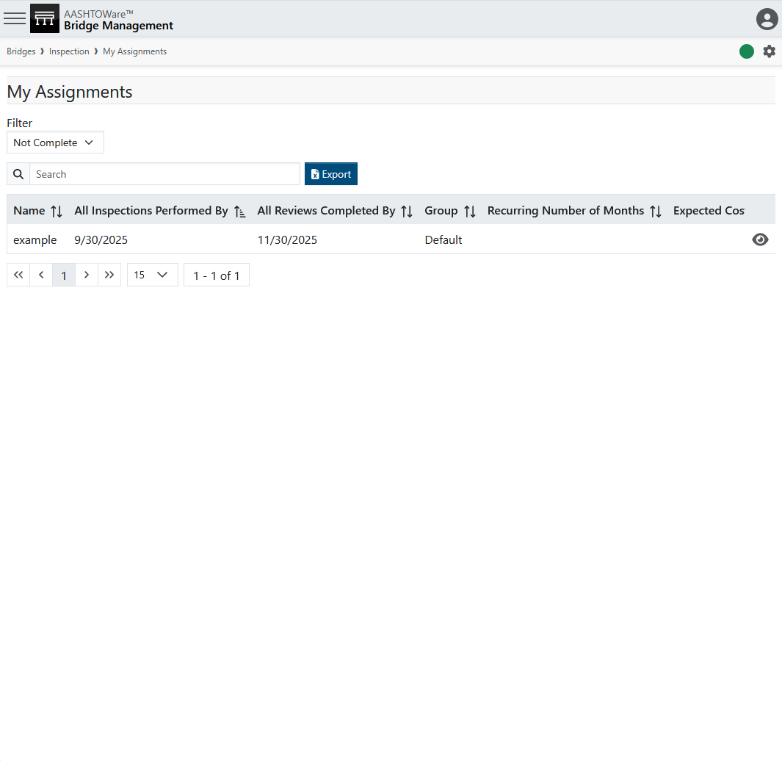
Inspection Assignment

Slide 35
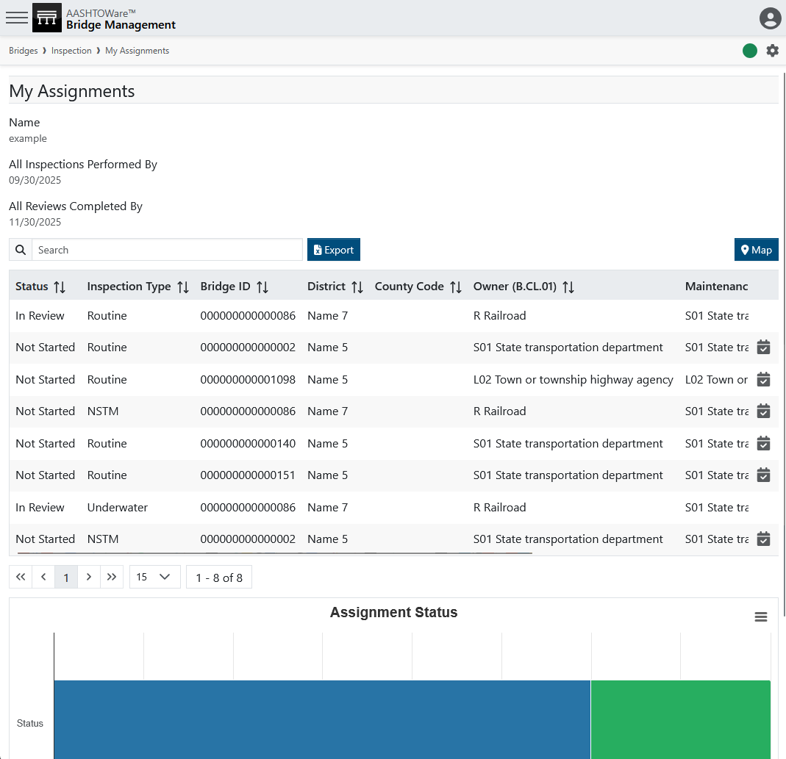
Inspection Assignment

Slide 36
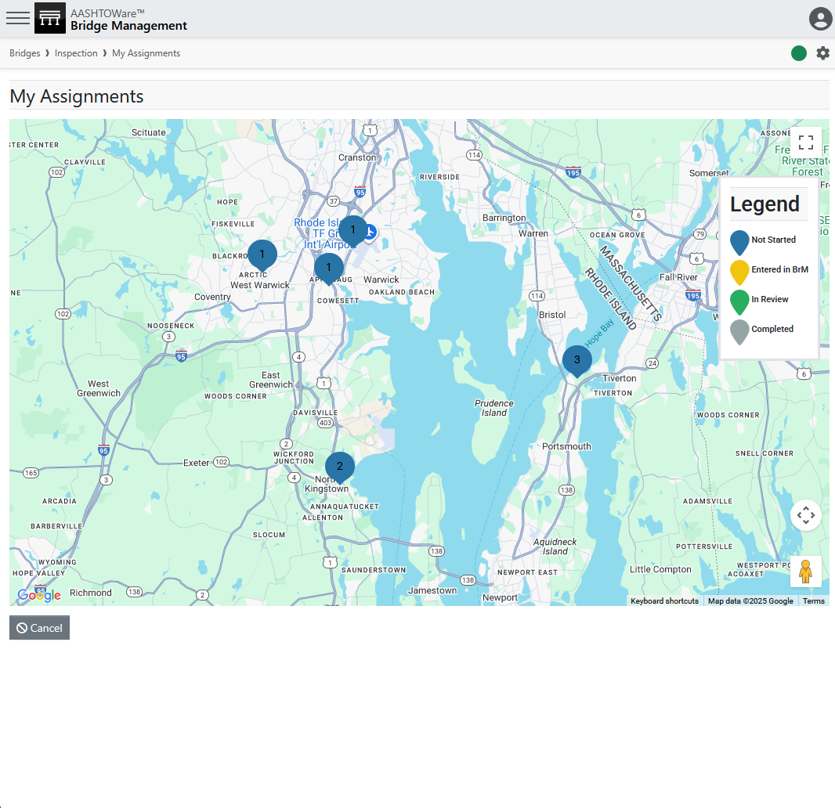
Inspection Assignment
Start an inspection
Already started
(maybe by someone else)

Slide 37
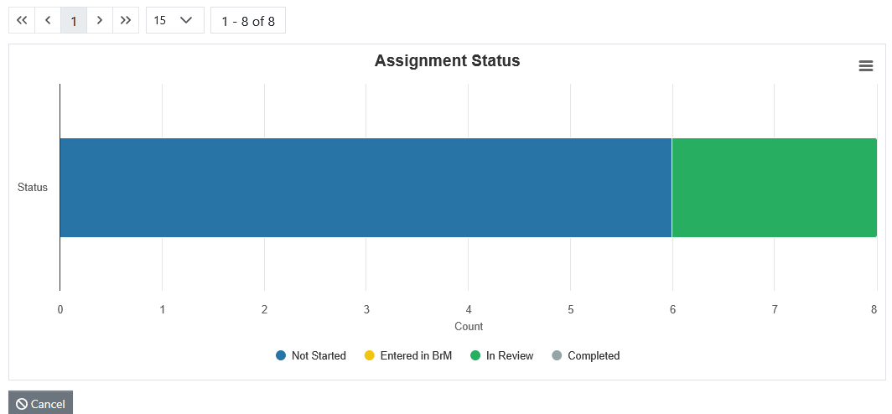
Inspection Assignment

Slide 38
Inspection Assignment

Slide 39

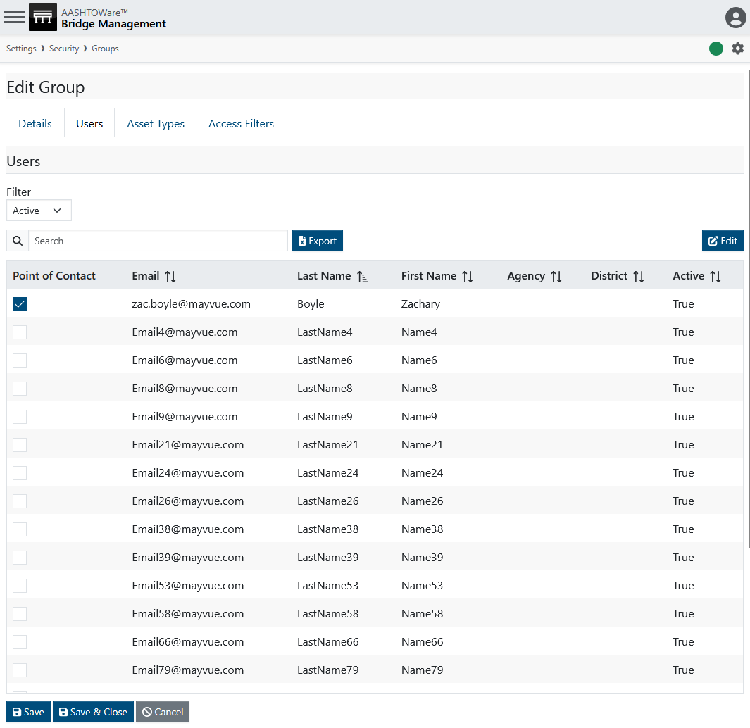
Inspection Assignment
Request
reassignment

Slide 40
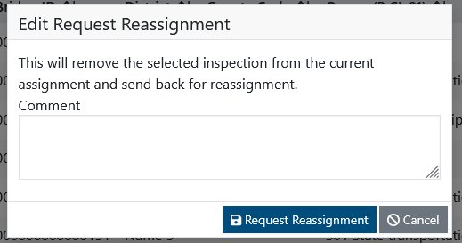
Inspection Assignment
Request
reassignment

Slide 41
Validation
Photo by Evan Leith on Unsplash

Slide 42
Validation
Assignment
Assignment
Reassignment
Inspection
Start Inspection
End Inspection
Review
Validation
Review
Repeats
Photo by Evan Leith on Unsplash

Slide 43
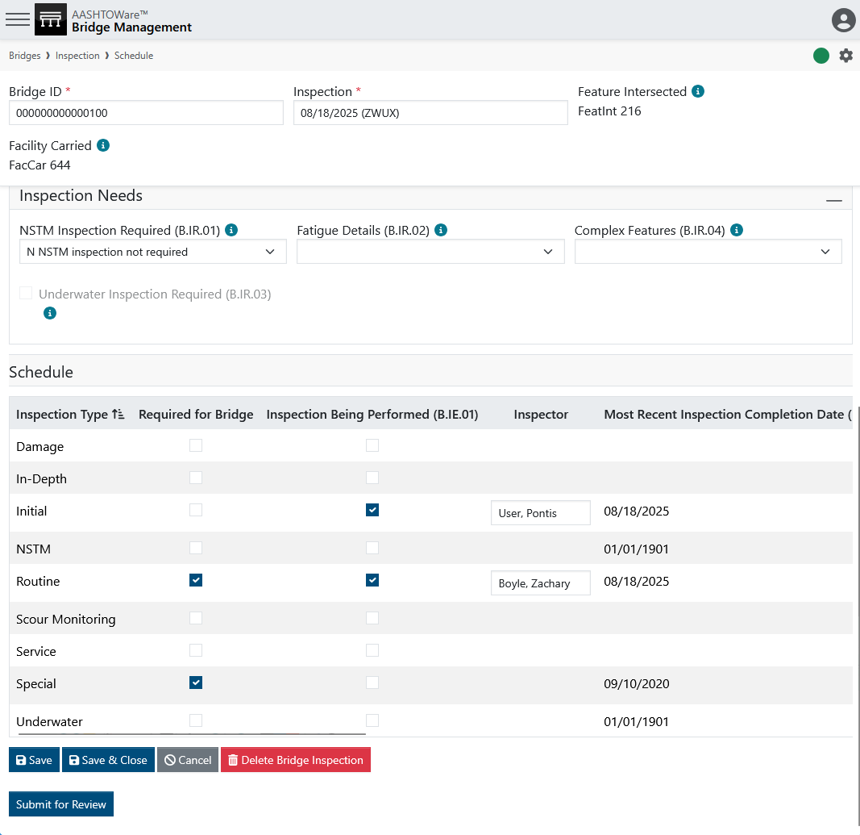
Validation
End inspection
Photo by Evan Leith on Unsplash

Slide 44
Validation
Assignment
Assignment
Reassignment
Inspection
Start Inspection
End Inspection
Review
Validation
Review
Repeats
Photo by Evan Leith on Unsplash

Slide 45
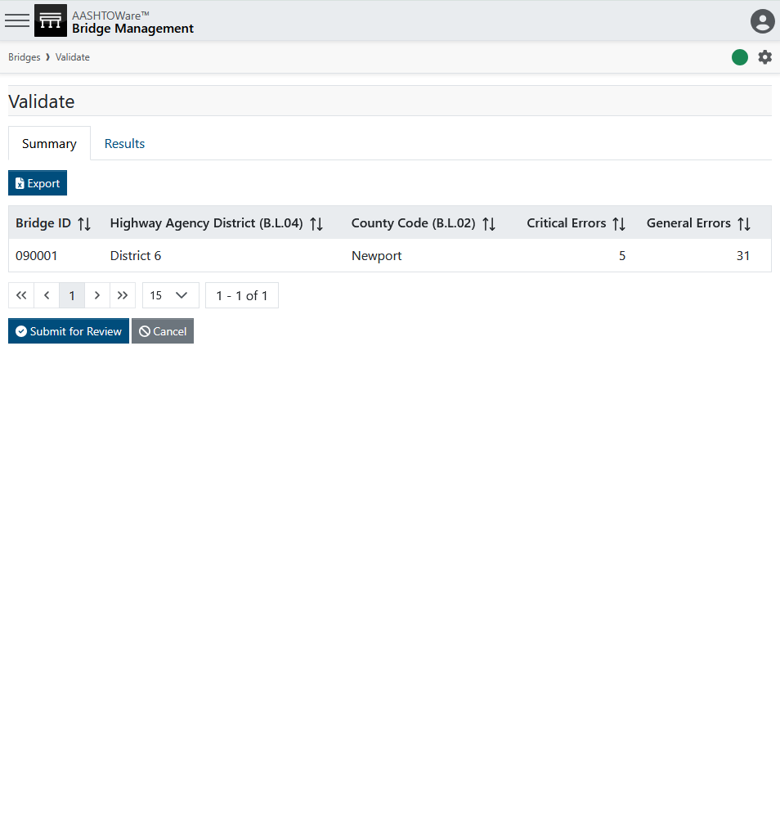
Validation
Photo by Evan Leith on Unsplash

Slide 46
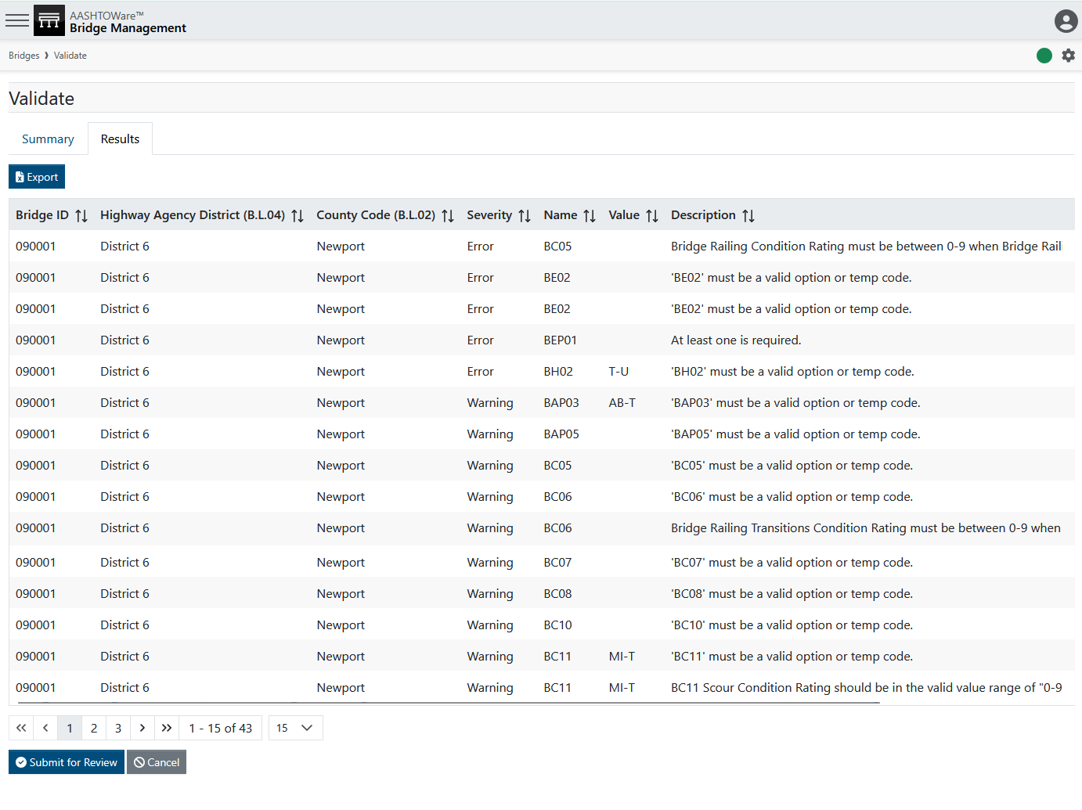
Validation
Photo by Evan Leith on Unsplash

Slide 47
Validation
Photo by Evan Leith on Unsplash

Slide 48
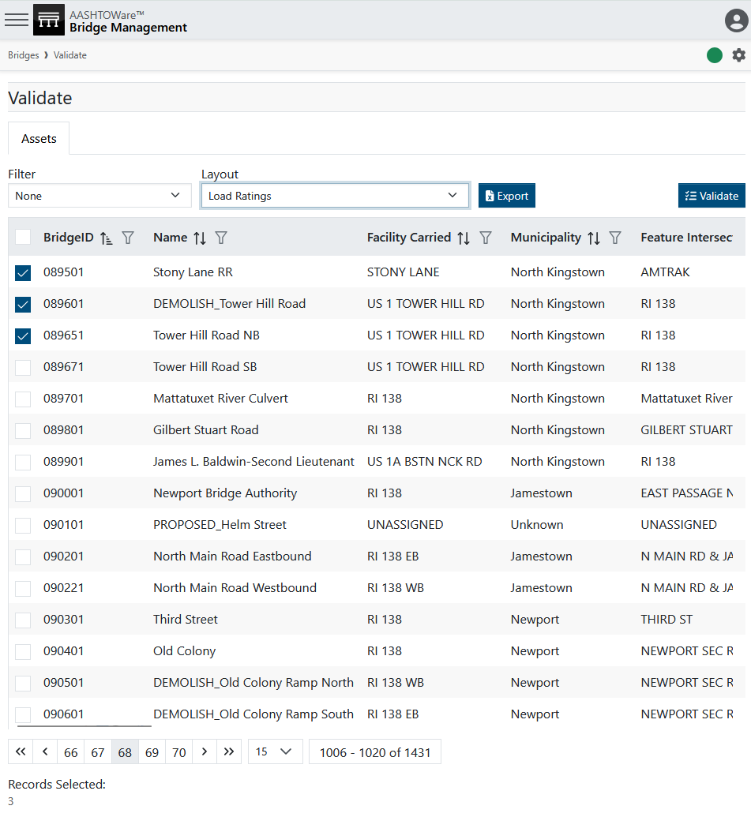
Validation
Photo by Evan Leith on Unsplash

Slide 49
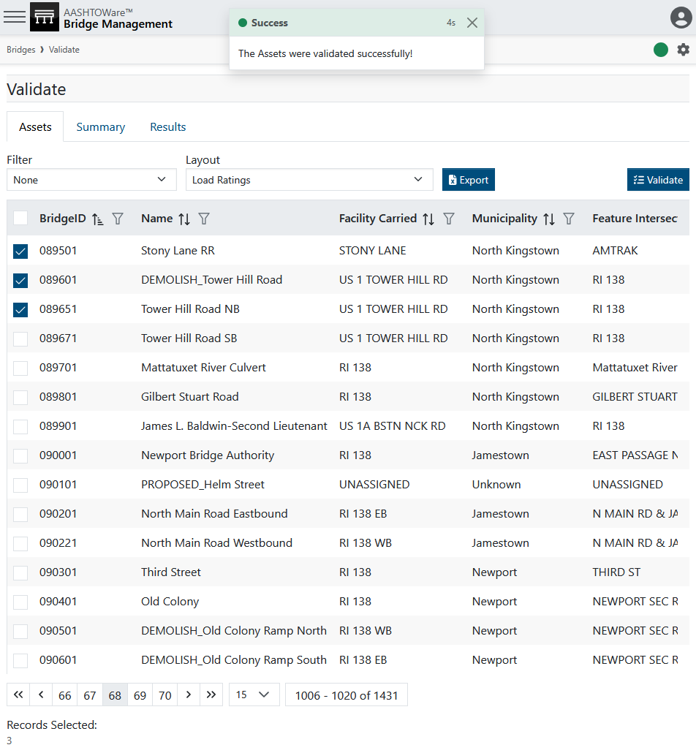
Validation
Photo by Evan Leith on Unsplash

Slide 50
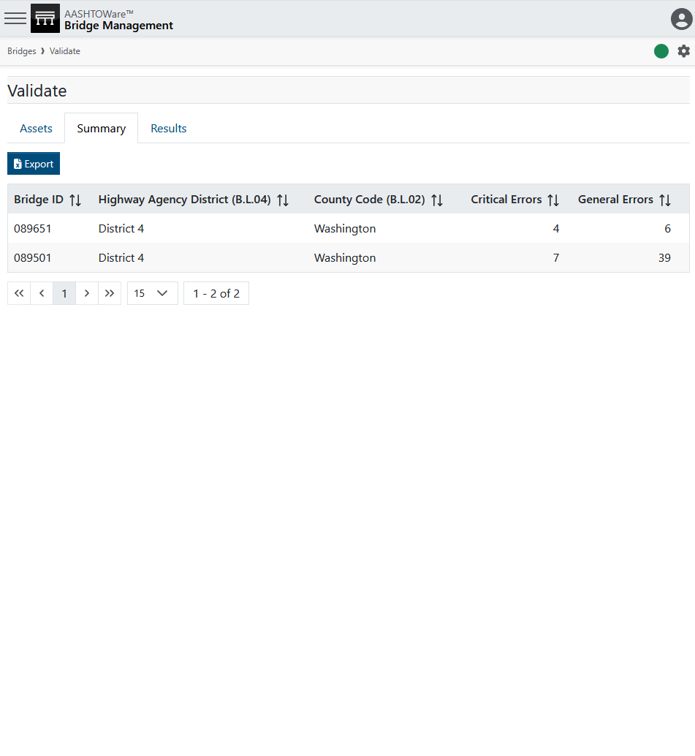
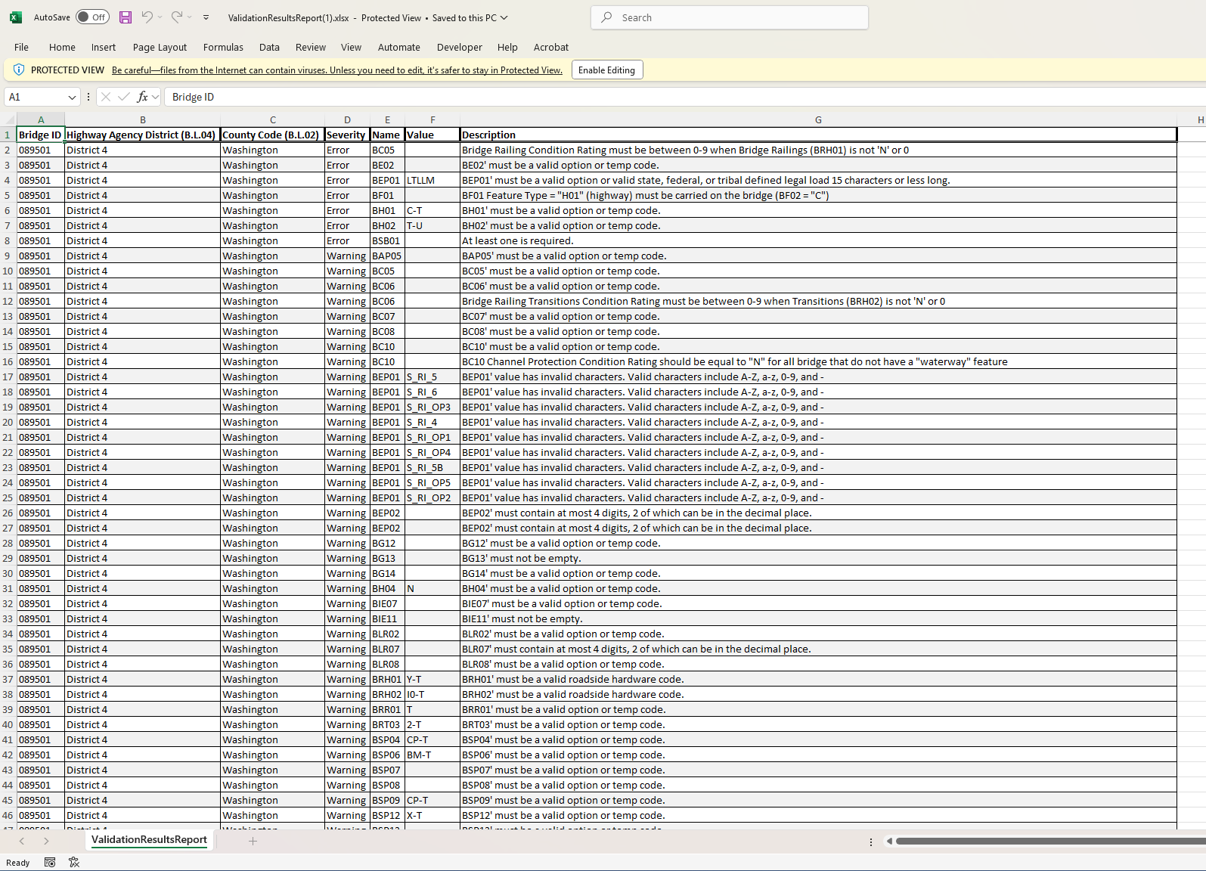
Validation
Photo by Evan Leith on Unsplash

Slide 51
Inspection Assignment
Photo by Evan Leith on Unsplash

Slide 52
Inspection Review
Photo by Evan Leith on Unsplash

Slide 53
Inspection Review
Process
What is your process for inspection review. Who reviews which inspections? When is an inspection picked for review?
MAYDOT
Review
5%
QA
Review
Inspection
Complex
Review
5%
Consultant
Review

Slide 54
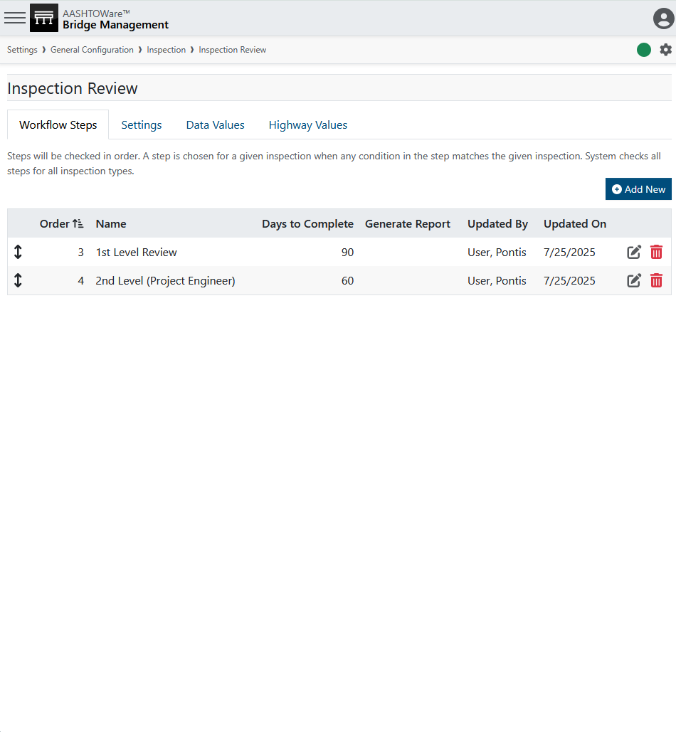
Inspection Review
MAYDOT
Review
5%
QA
Review
Inspection
Complex
Review
5%
Consultant
Review

Slide 55
Inspection Review
MAYDOT
Review
5%
QA
Review
Inspection
Complex
Review
5%
Consultant
Review

Slide 56
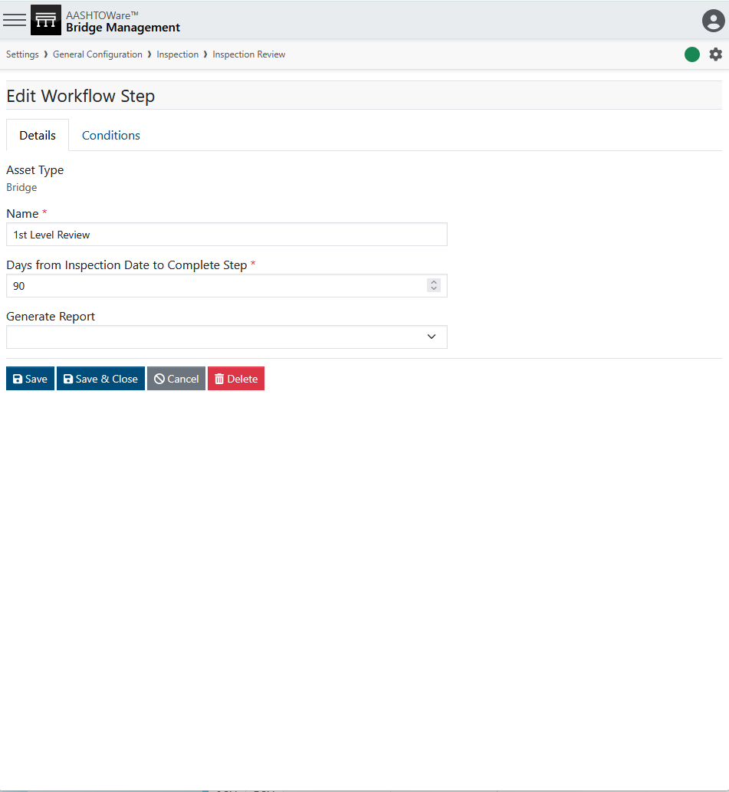
Inspection Review
MAYDOT
Review
5%
QA
Review
Inspection
Complex
Review
5%
Consultant
Review

Slide 57
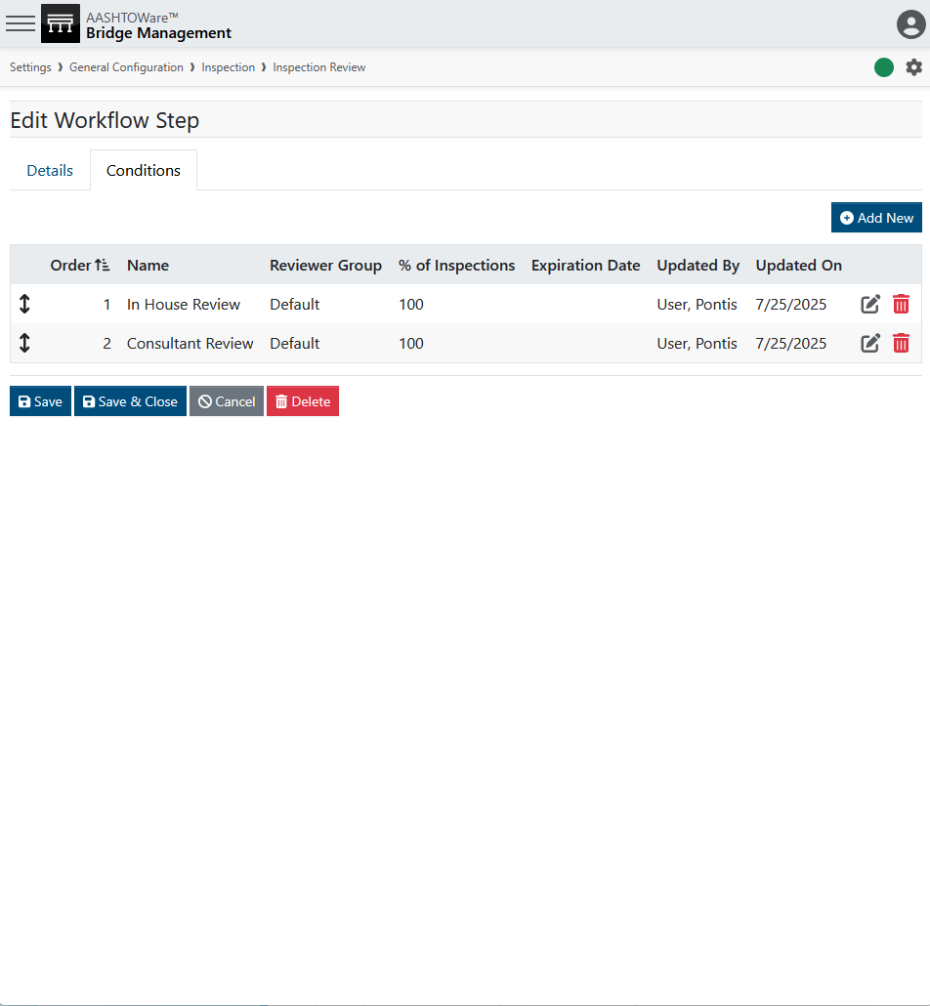
Inspection Review
MAYDOT
Review
5%
QA
Review
Inspection
Complex
Review
5%
Consultant
Review

Slide 58
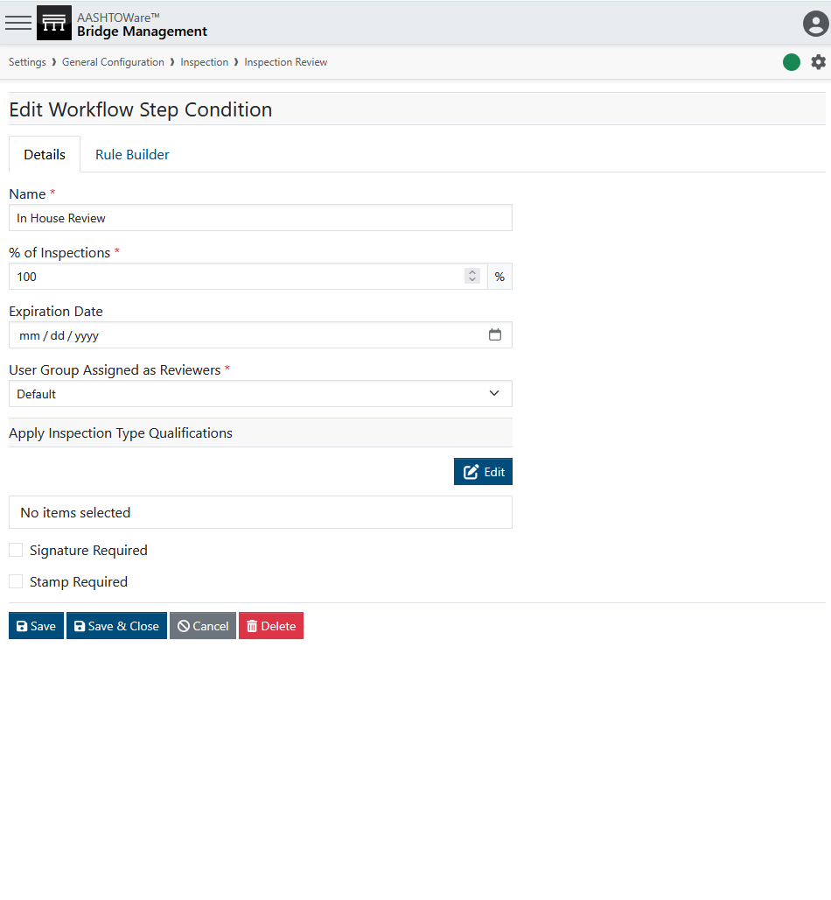
Inspection Review

Slide 59
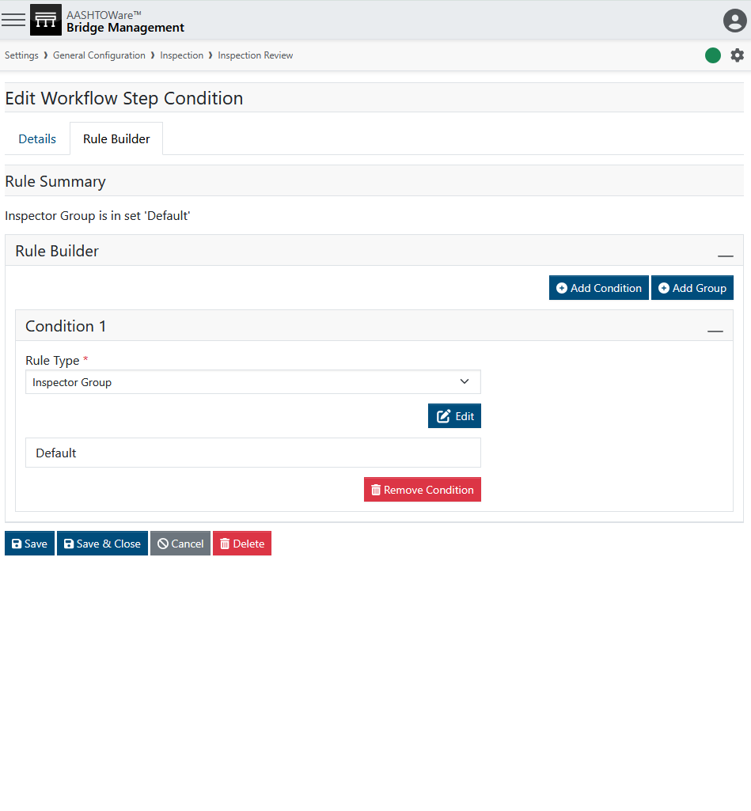
Inspection Review

Slide 60
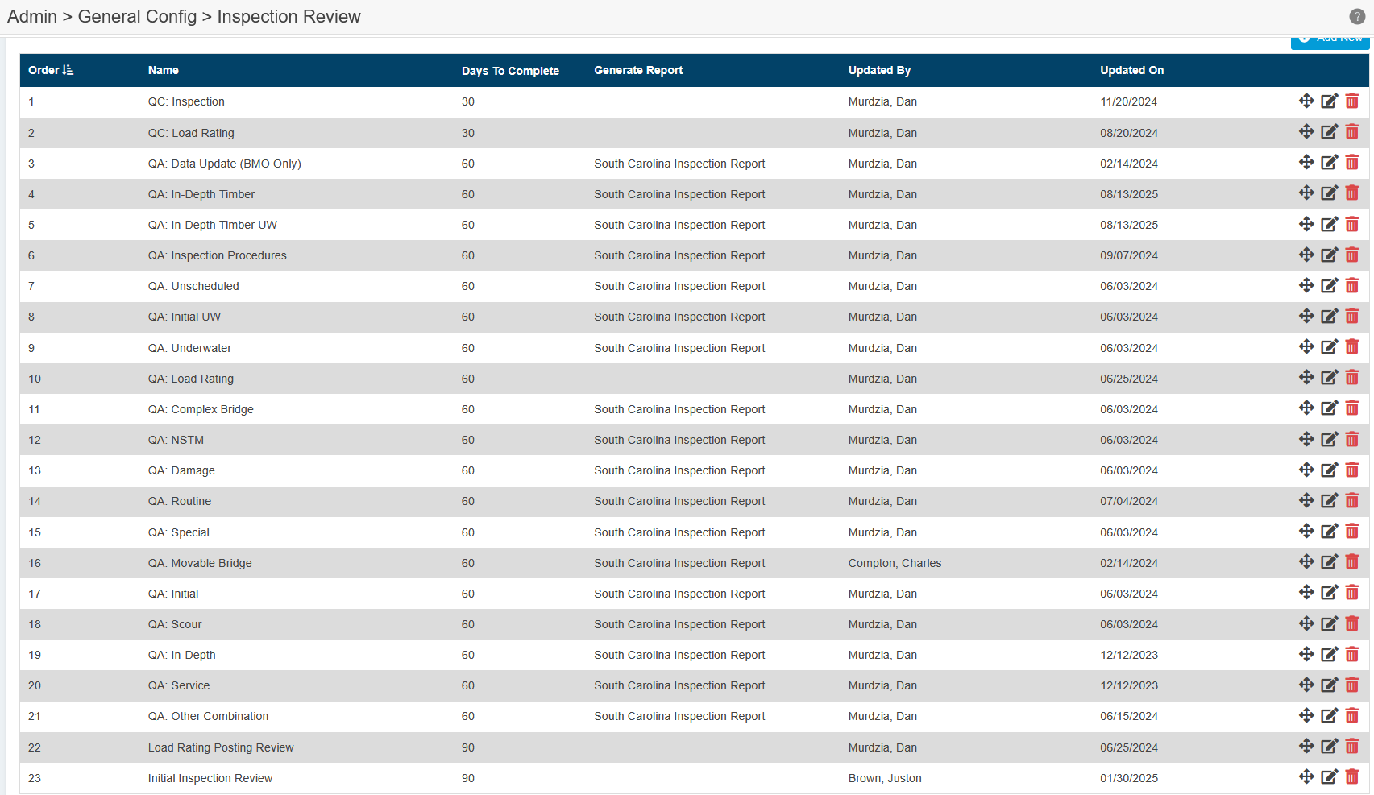
Inspection Review
SCDOT use case (2024):
Inspection general review step
Review of a load rating if it exists
QA samples for each inspection type

Slide 61
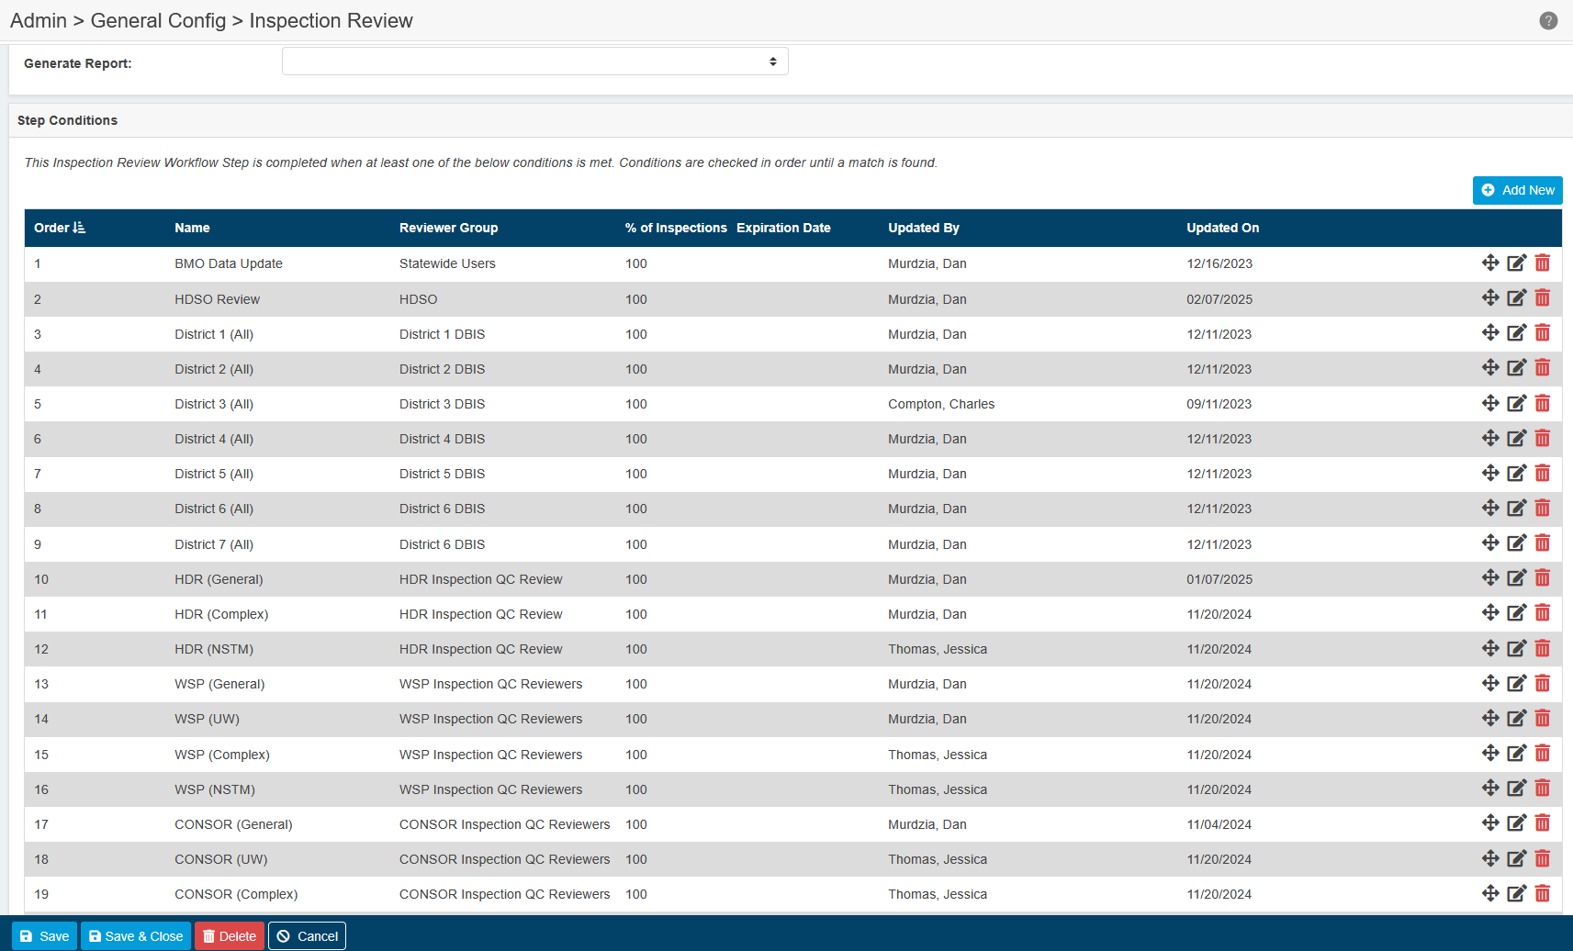
Inspection Review
SCDOT use case (2024):
Inspection general review step
Review of a load rating if it exists
QA samples for each inspection type

Slide 62
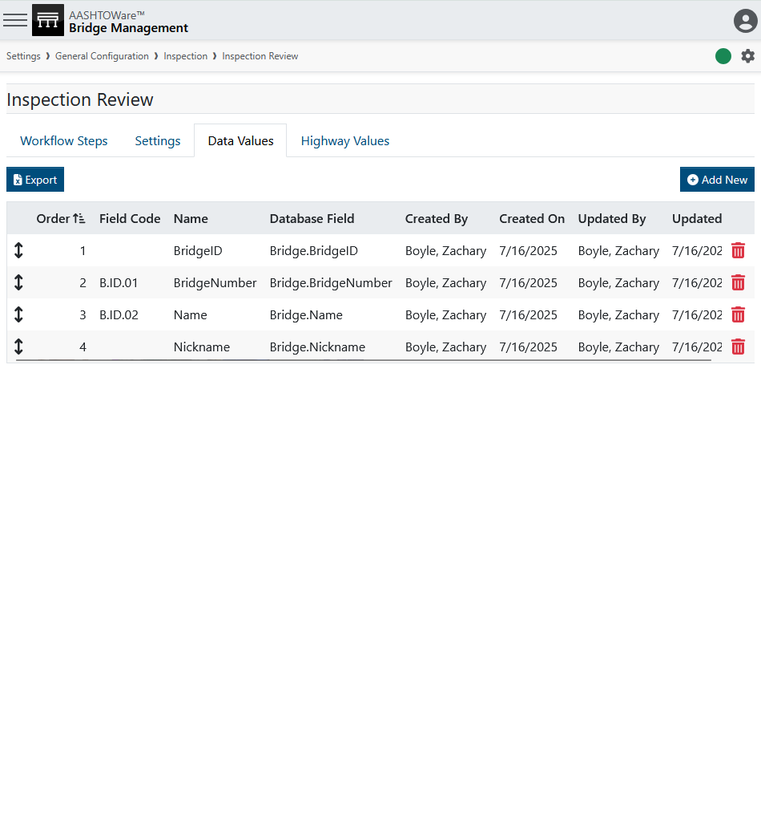
Inspection Review
Data Values
Which fields are reviewed in the QC module, and in which order.

Slide 63
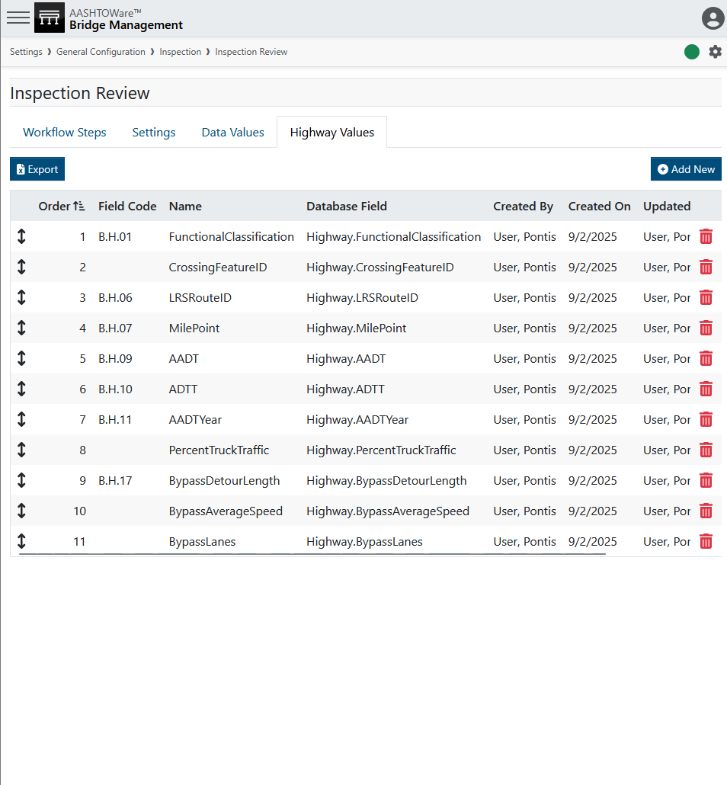
Inspection Review
Highway Values
Which roadway fields are reviewed in the QC module, and in which order.

Slide 64
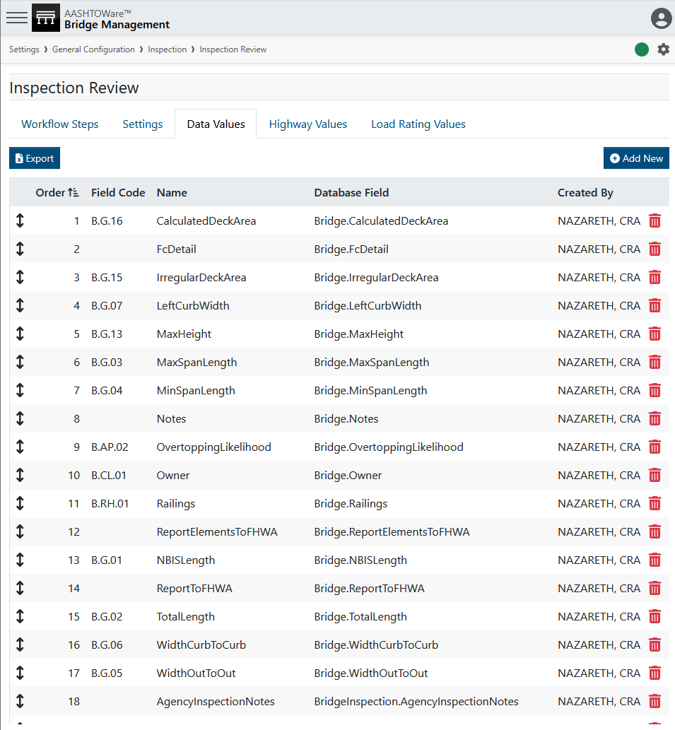
Inspection Review
RIDOT use case (2025):
Note the identification fields are not reviewed, the inspectors cannot change those fields. Structure name and number are not here.

Slide 65
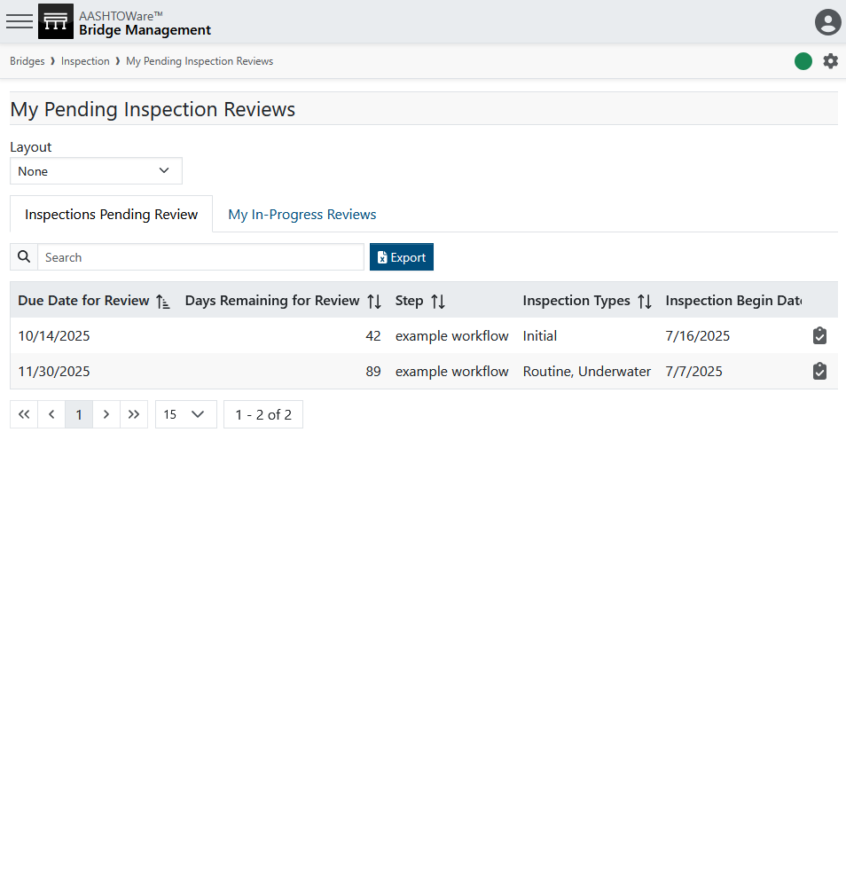
Inspection Review

Slide 66
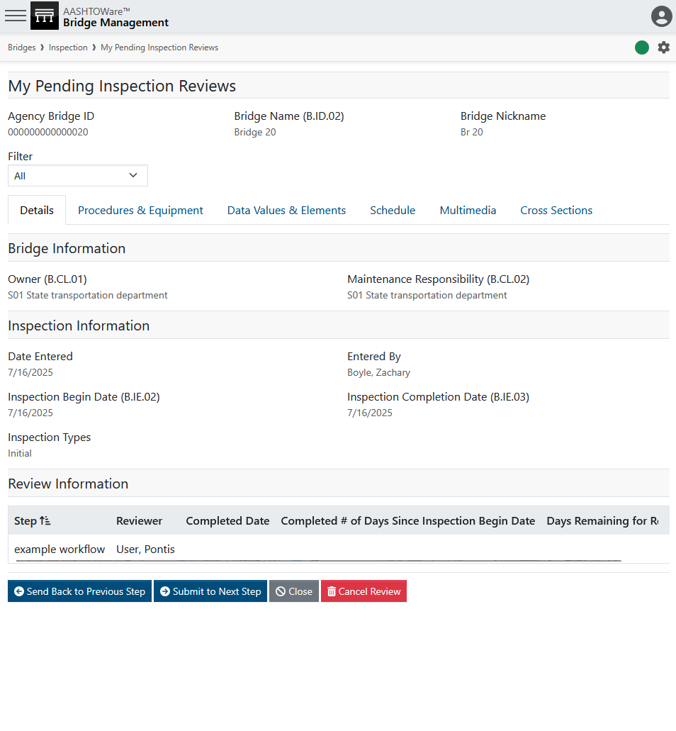
Inspection Review

Slide 67
Inspection Review
See just flagged or unreviewed steps

Slide 68
Inspection Review
Steps this review will go through

Slide 69
Inspection Review

Slide 70
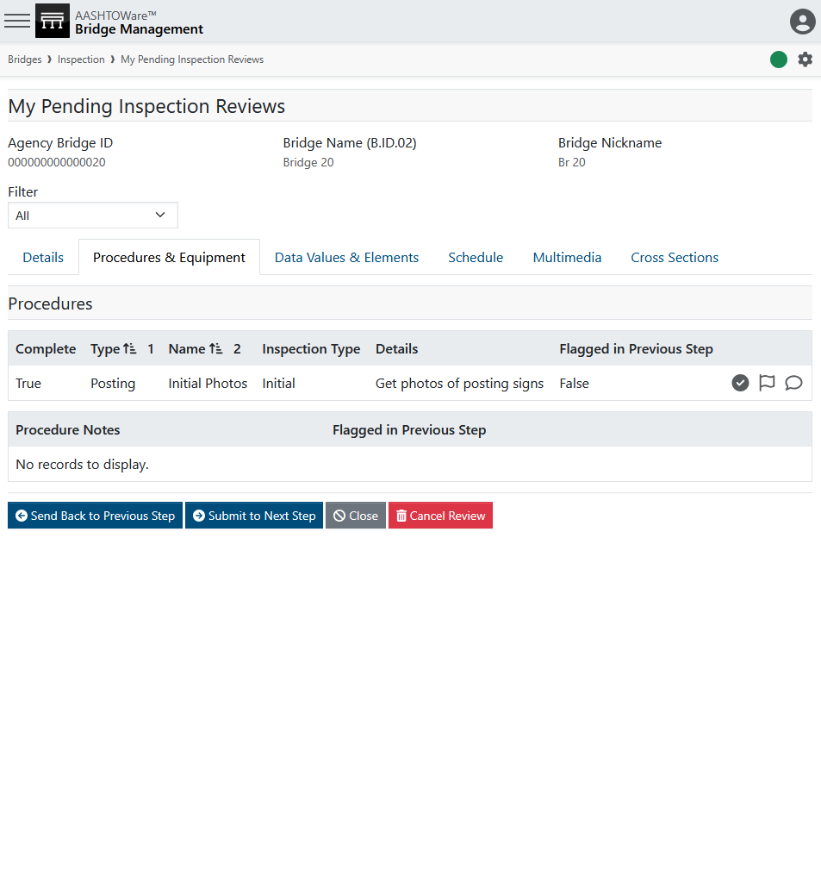
Inspection Review
Approve
Flag
Comment

Slide 71
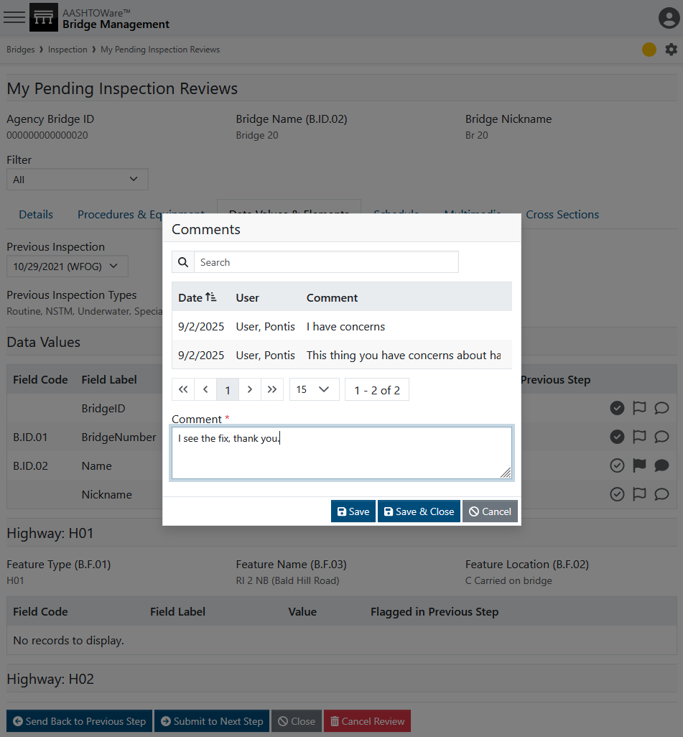
Inspection Review

Slide 72
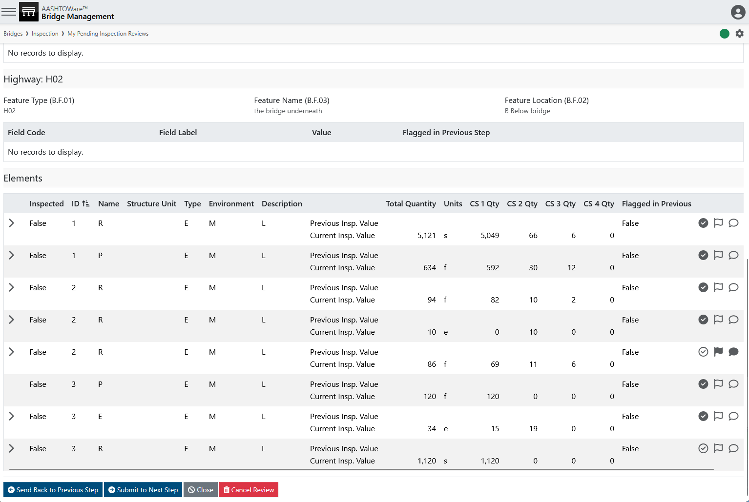
Inspection Review

Slide 73
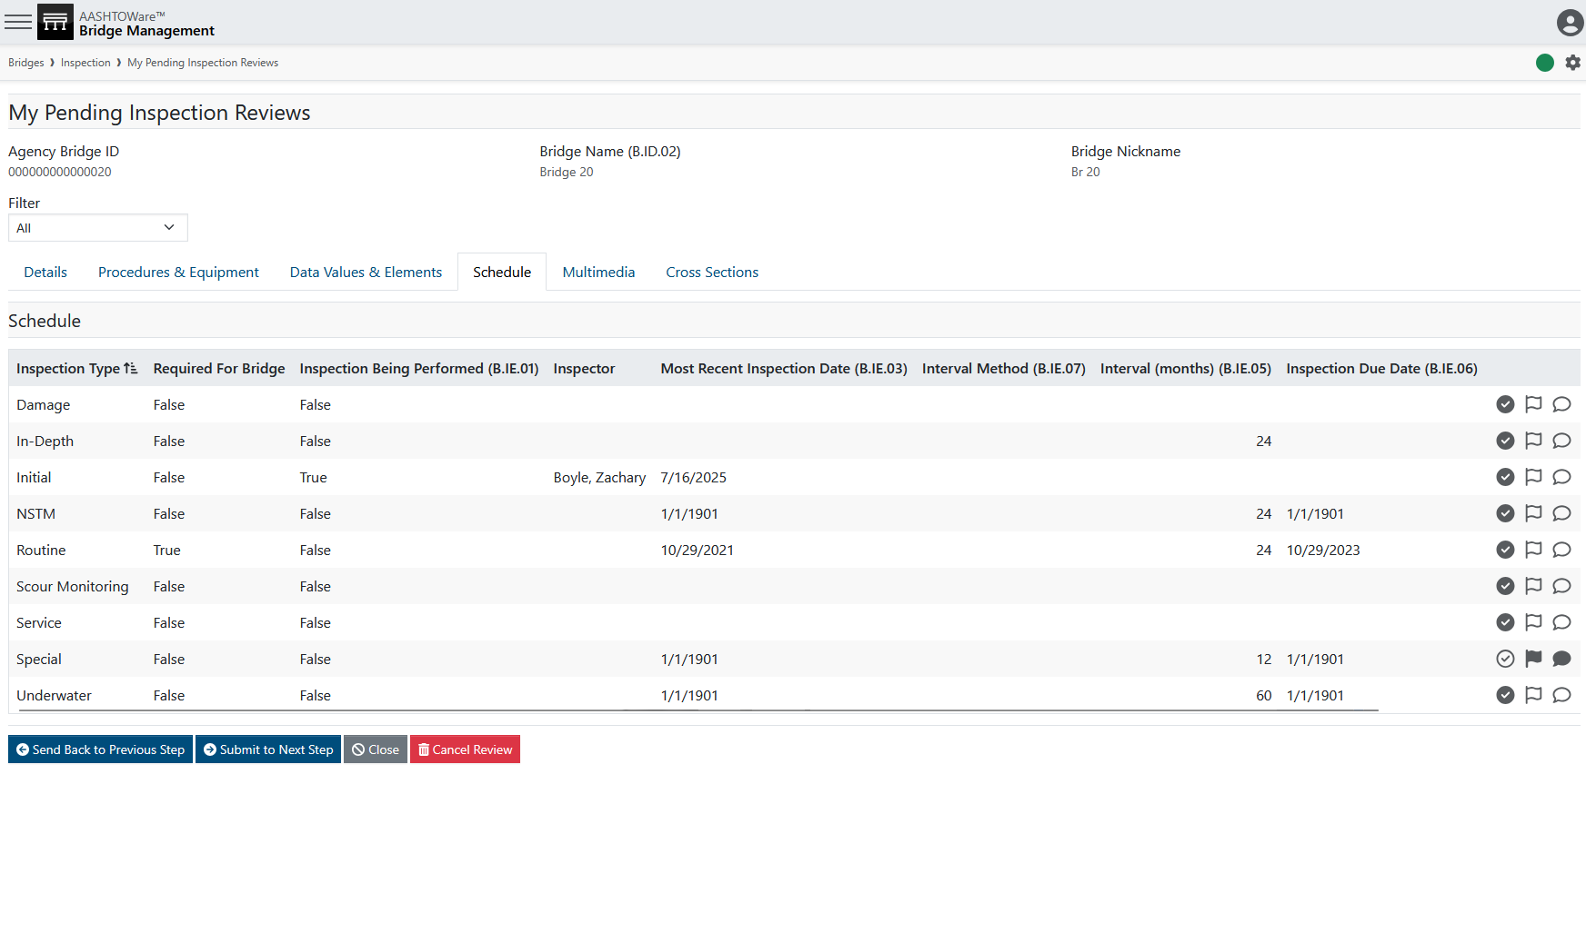
Inspection Review

Slide 74
Inspection Review
MAYDOT
Review
5%
QA
Review
Inspection
Complex
Review
5%
Consultant
Review

Slide 75
Inspection Review

Slide 76
Inspection Review
Use case examples for QC metadata:
Items flagged most often in the last quarter
Reviewers who have performed most reviews
Inspectors who have the most items flagged
Reviews approved in under 30 seconds
Percentage of reviews sent back from QA to QC

Slide 77
Future Planning
Photo by Evan Leith on Unsplash

Slide 78
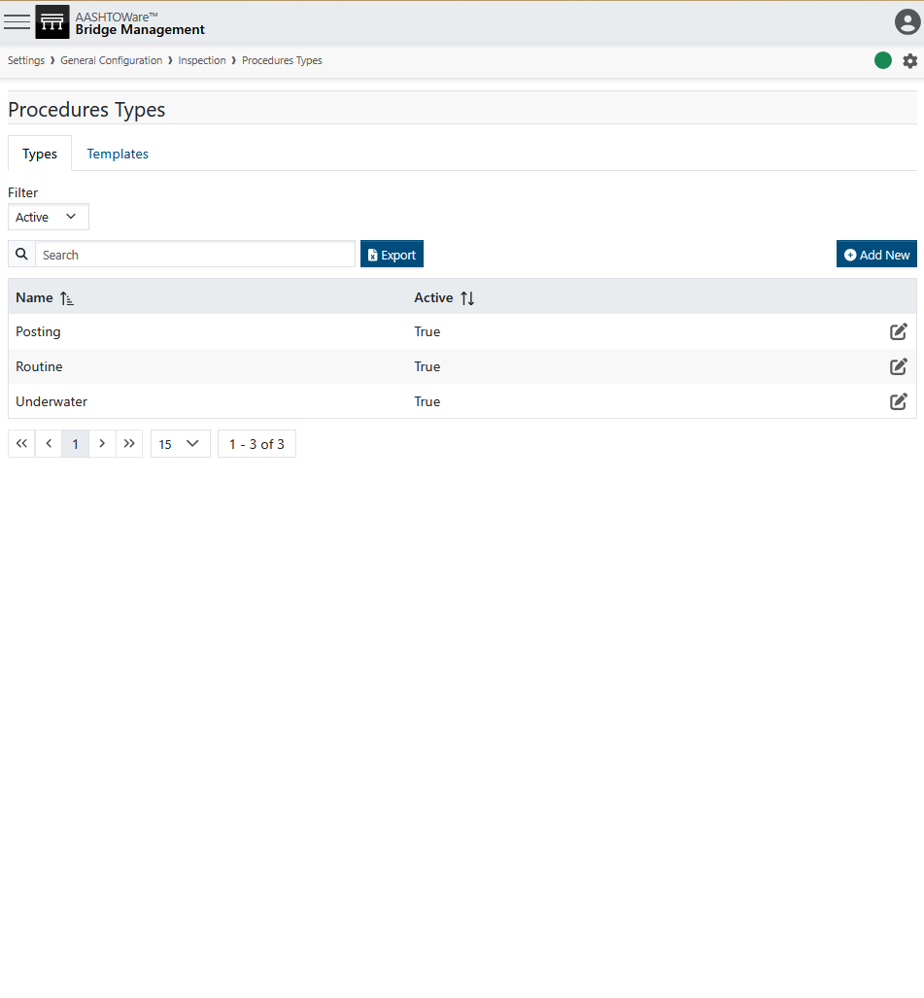

Future Planning
SCDOT Examples:
FHWA (for particular asset ID’s)
In-Depth
In-Depth Fatigue
In-Depth Timber
In-Depth Timber UW
Initial UW
Long-Span / Multi-Span
NSTM
Routine
SCDOT Bridge Insp Guide Doc
Special
Underwater
Review Inspection Plan in Inspection 101

Slide 79

Future Planning
Use Example 1:
See bridge specific inspection procedure included in the multimedia folder
Use Example 2:
Inspect Pin & Hanger assembly with ultrasonic testing.
Inspect truss bottom chord 1 at arms’ length.
Inspect truss bottom chord 2 at arm’s length.
Inspect truss bottom chord 3 at arm’s length.
Inspect truss bottom chord 4 at arm’s length.
Inspect truss top chord 1 at arm’s length.
Inspection truss top chord 2 at arm’s length.
Review Inspection Plan in Inspection 101

Slide 80
Future Planning
Your Decision:
Your agency needs to decide whether to add detailed inspection procedures to the procedures module. (Example: NSTM bridge-specific instructions)
Also decide on a pattern for reviewing the procedures. This could be after the last inspection, a month before a new inspection, or at another interval.

Slide 81


Future Planning
ALDOT Examples:
AX Other
  AX ATV
RIDOT Examples:
A02 Bucket lift vehicle
  A02 Aerial Lift
  A02 Rail Mount Bucket Truck
  A02 Rail Mount Elliot
A04 Rigging
  A04 Boatswain Chair
  A04 Scaffolding
A06 Boat
  A06 Float
AX Other
  AX Air Monitor
  AX Crash Truck
  AX Light Tower
Review Inspection Plan in Inspection 101

Slide 82

Future Planning
Your Decision:
Does your agency copy from the last inspection, or prompt for what equipment the inspectors should routinely expect to use?
And how often should that be reviewed and updated?

Slide 83
Course Overview
Photo by Evan Leith on Unsplash

Slide 84
Course Overview
TODAY
TOMORROW
Before Break (Insp 101)
Login
Roles & Groups
Bridge List
Inspection List
Scheduling
Inspection Plans
Inventory
Design
Features
After Break (Insp 102)
Condition & Elements
Load Posting
Multimedia
Sketches
Cross Sections
Before Break (Insp 201)
Work Candidates
Certifications
Inspection Assignment
Validation
Inspection Review
Future Planning
After Break (Insp 202)
Submittal
Critical Findings
Reports
Dashboards
API Calls
Photo by Evan Leith on Unsplash

Slide 85
BrM 7.0 Migration
CONTACT
The Abridged Version
Jira Service Desk
ZACHARY BOYLE
zac.boyle@mayvue.com
Text | Voicemail | (801) 450-9716
BrM@mayvue.com
1-877-462-9883
http://support.mayvue.com
BrMUG 2024 | Long Beach, CA | September 17-18
Photo by Evan Leith on Unsplash

Slide 86
BrM Inspection 202
The Un-Abridged Version
BrMUG 2025 | Providence, RI | September 17-18
Photo by Evan Leith on Unsplash

