Slide 1




BrM Inspection 102
The Un-Abridged Version
BrMUG 2025 | Providence, RI | September 17-18
Photo by Evan Leith on Unsplash

Slide 2

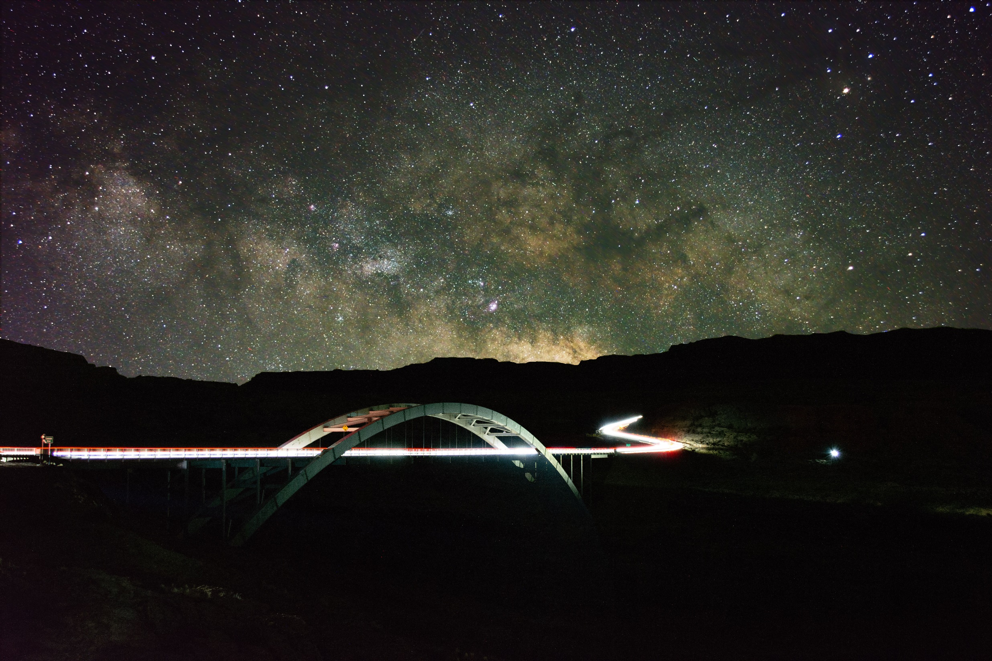



BrM 7.0 Migration
CONTACT
The Abridged Version
Jira Service Desk
ZACHARY BOYLE
zac.boyle@mayvue.com
Text | Voicemail | (801) 450-9716
BrM@mayvue.com
1-877-462-9883
http://support.mayvue.com
BrMUG 2024 | Long Beach, CA | September 17-18
Photo by Evan Leith on Unsplash

Slide 3

Course Overview
Photo by Evan Leith on Unsplash

Slide 4
Course Overview
TODAY
TOMORROW
Before Break (Insp 101)
Login
Roles & Groups
Bridge List
Inspection List
Scheduling
Inspection Plans
Inventory
Design
Features
After Break (Insp 102)
Condition & Elements
Load Posting
Multimedia
Sketches
Cross Sections
Before Break (Insp 201)
Work Candidates
Certifications
Inspection Assignment
Validation
Inspection Review
Future Planning
After Break (Insp 202)
Submittal
Critical Findings
Reports
Dashboards
API Calls
Photo by Evan Leith on Unsplash

Slide 5
Condition & Elements
Photo by Evan Leith on Unsplash

Slide 6
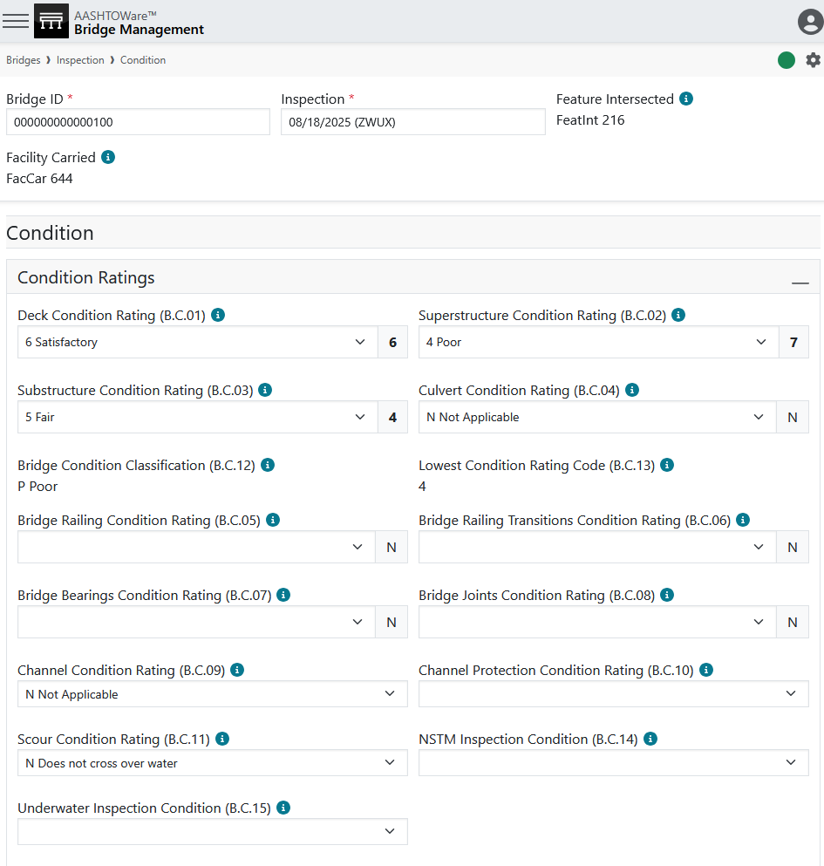
Condition & Elements
Photo by Evan Leith on Unsplash

Slide 7
Condition & Elements
General
Condition
Ratings
Photo by Evan Leith on Unsplash

Slide 8
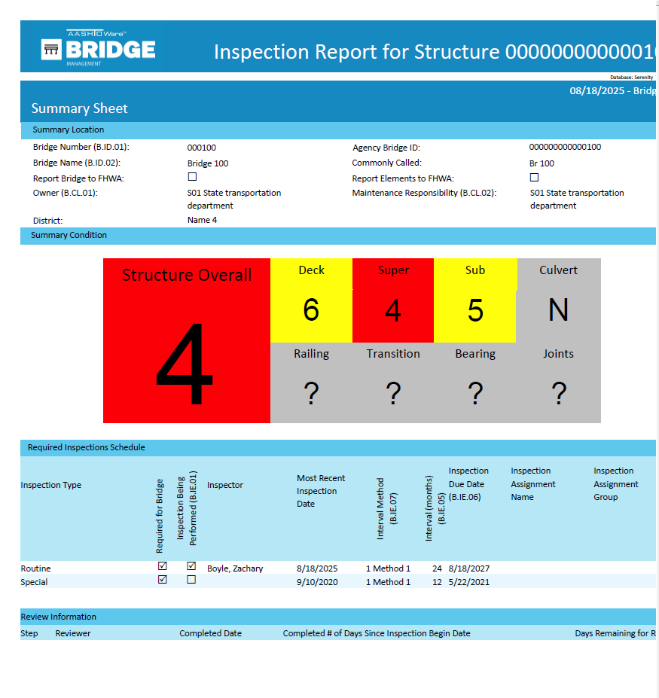
Condition & Elements
General
Condition
Ratings
? Specialized
– Other – New
Condition
Ratings
Other
Condition
Ratings
Photo by Evan Leith on Unsplash

Slide 9
Condition & Elements
General
Condition
Ratings
? Specialized
– Other – New
Condition
Ratings
Photo by Evan Leith on Unsplash

Slide 10
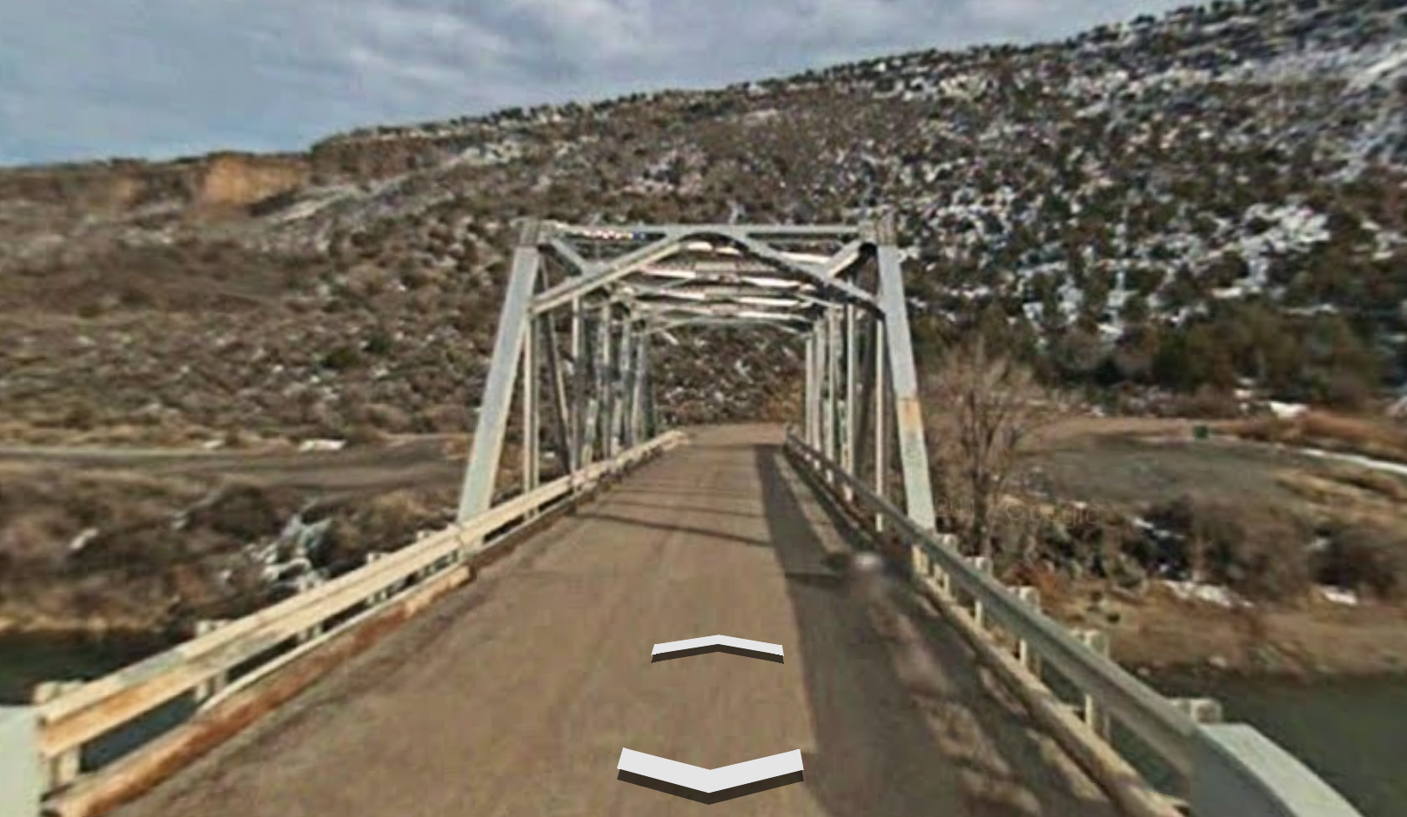
Condition & Elements

Slide 11
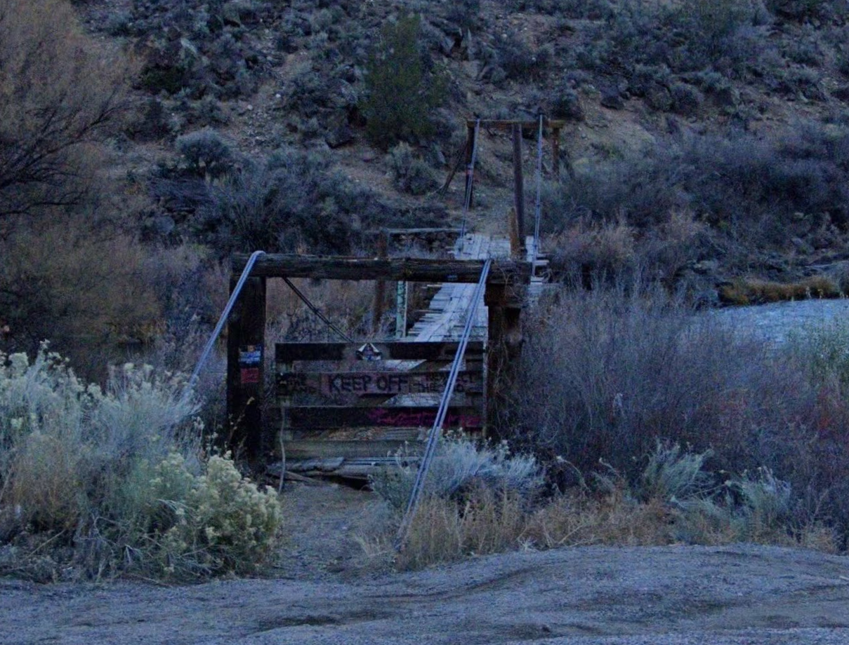
Condition & Elements

Slide 12
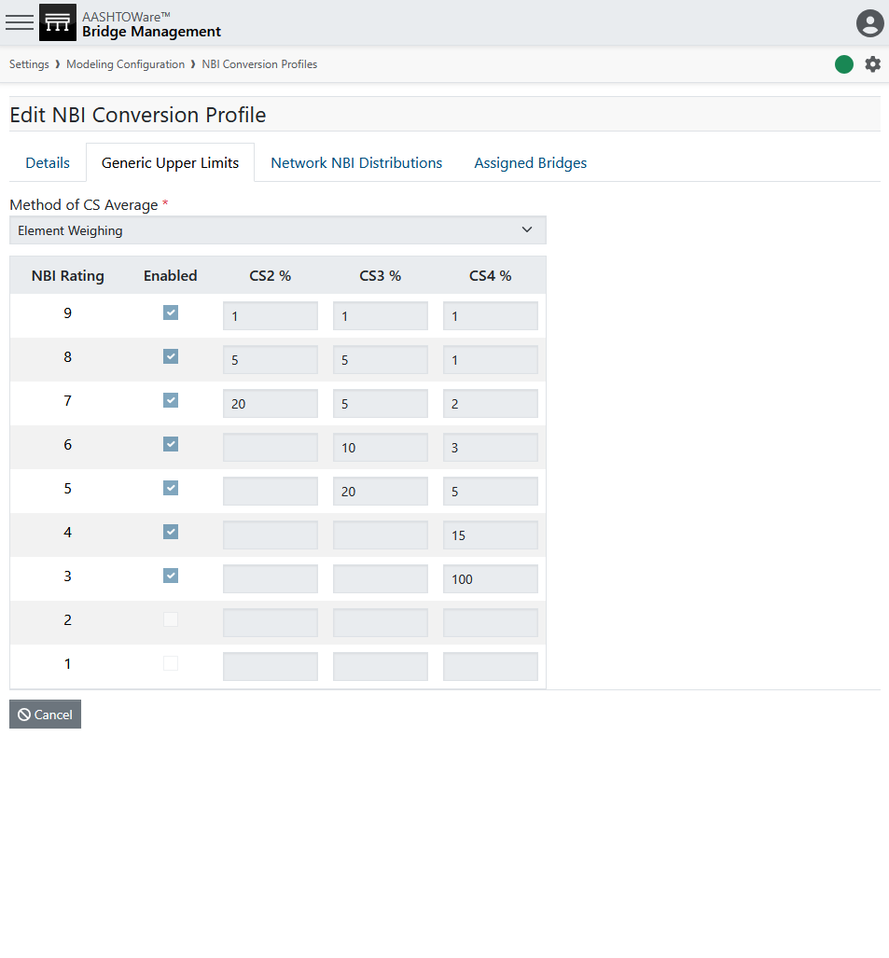
Condition & Elements
Photo by Evan Leith on Unsplash

Slide 13
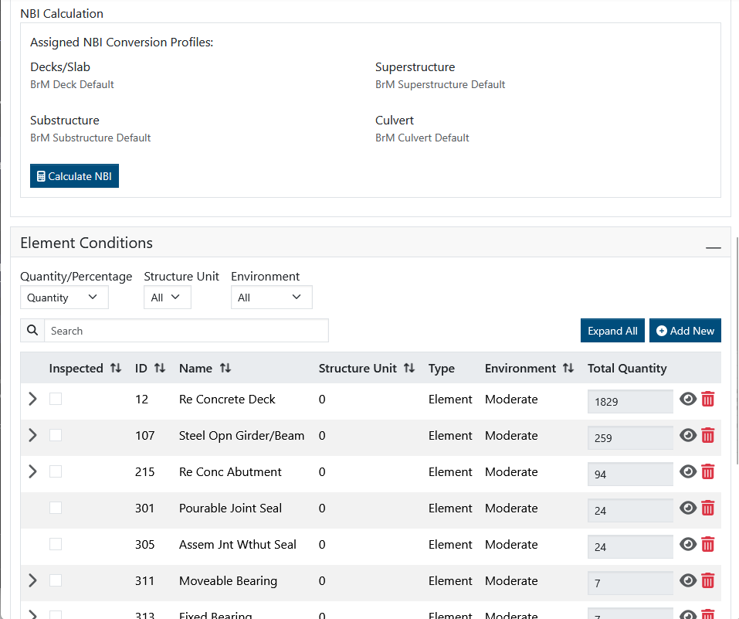
Condition & Elements
Photo by Evan Leith on Unsplash

Slide 14
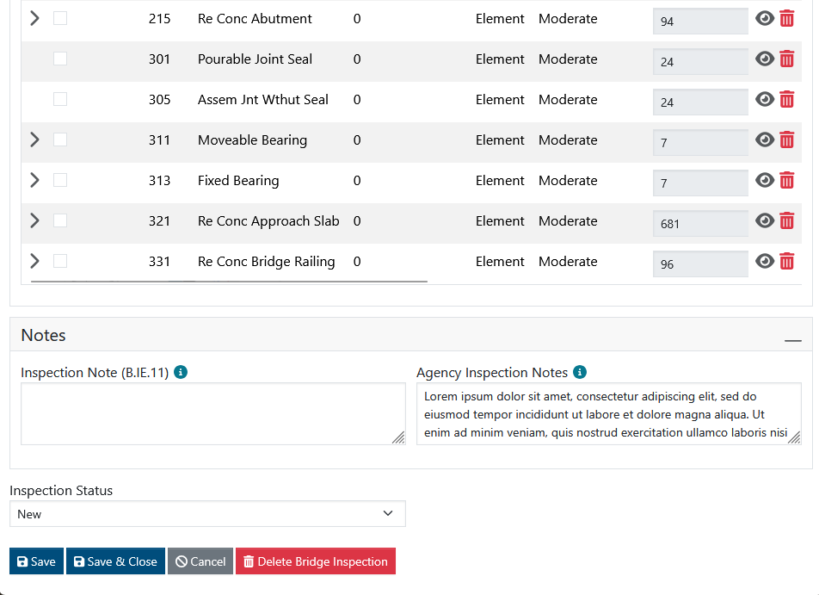
Condition & Elements
Photo by Evan Leith on Unsplash

Slide 15
Condition & Elements
Photo by Evan Leith on Unsplash

Slide 16
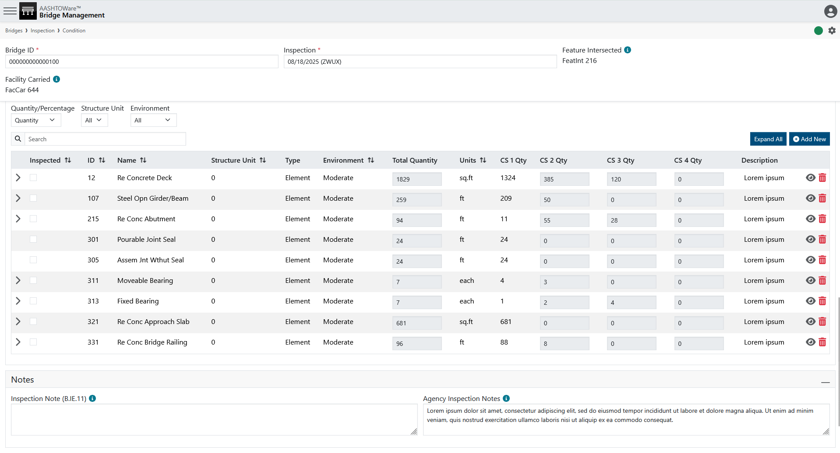
Condition & Elements
Photo by Evan Leith on Unsplash

Slide 17
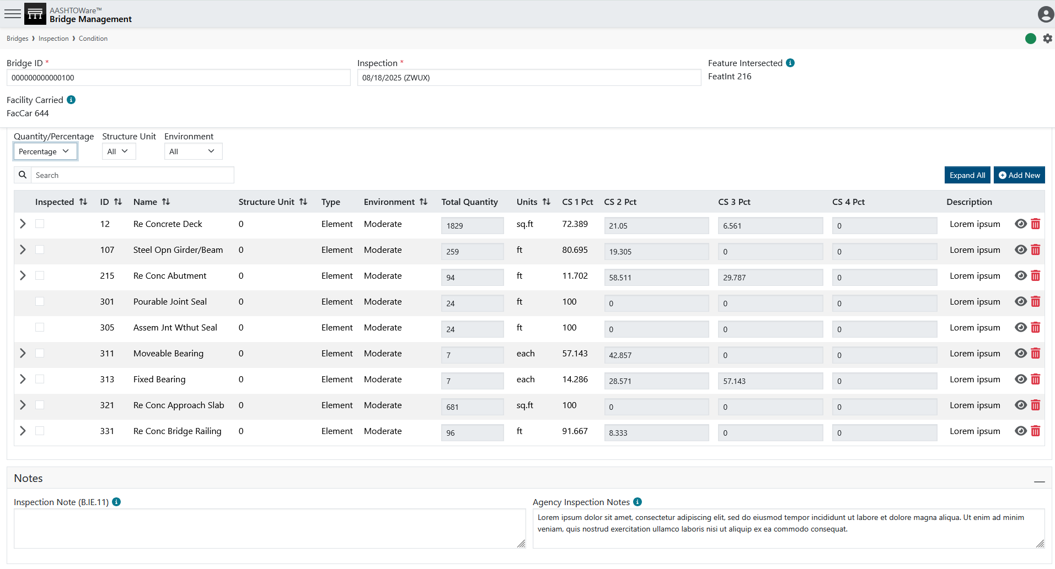
Condition & Elements
Photo by Evan Leith on Unsplash

Slide 18
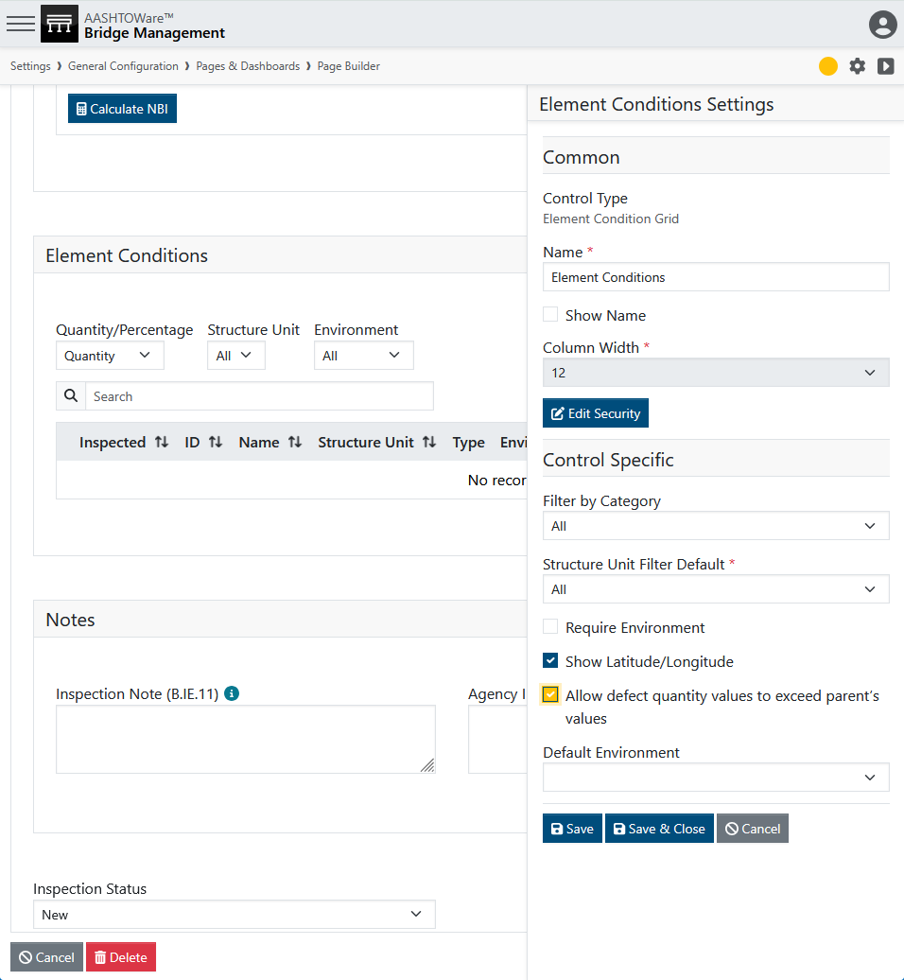
Condition & Elements
Photo by Evan Leith on Unsplash

Slide 19
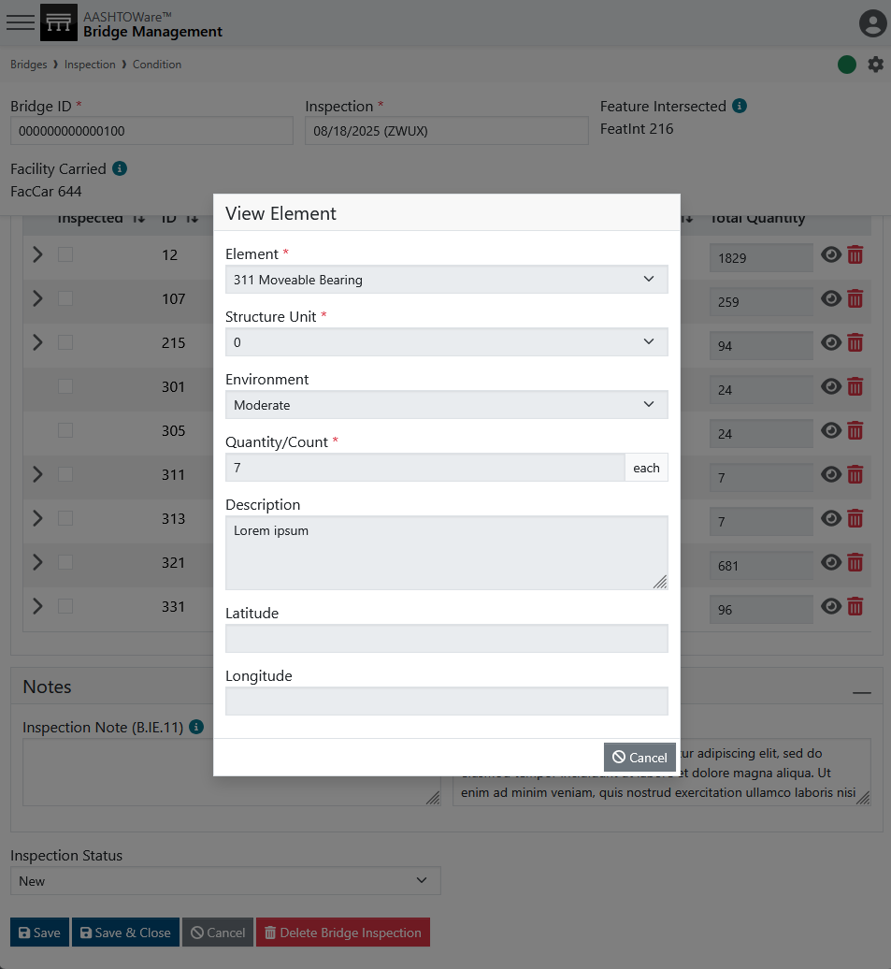
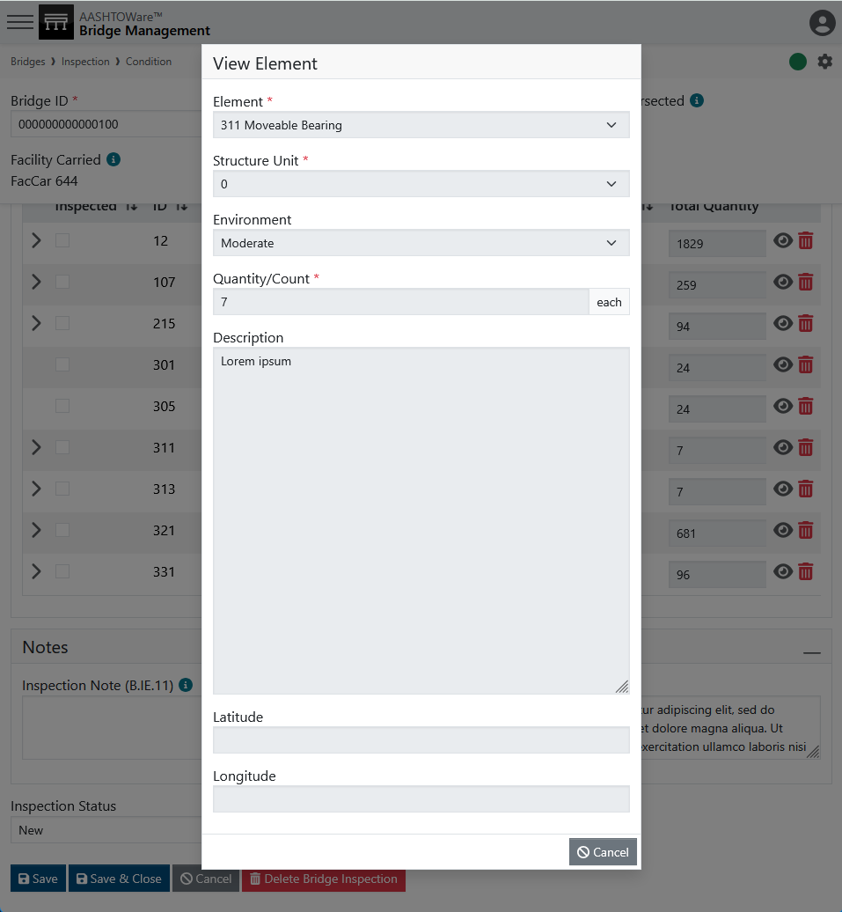
Condition & Elements
Photo by Evan Leith on Unsplash

Slide 20
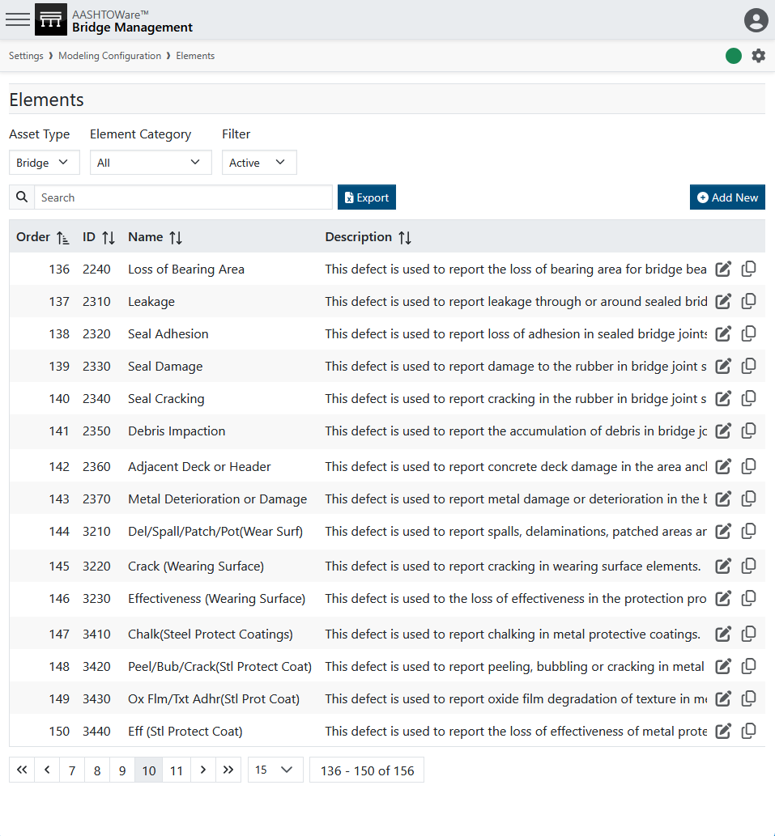
Condition & Elements
Agency Defined Elements (ADE’s)
Elements tracked internal to the agency. They can be set to roll up to FHWA elements or excluded from reporting.
Used for tracking:
  Particular repair types
  Particular material types
  The old “flags” elements
  Controlled conversions
Use Case Examples:
Beam ends
Bearing Pedistals
Joint Seal & Joint Headers
Lead paint vs. Non-lead paint
Endangered Plants / Animals present
Wingwall (Culv) vs Wingwall (Sub)
Photo by Evan Leith on Unsplash

Slide 21
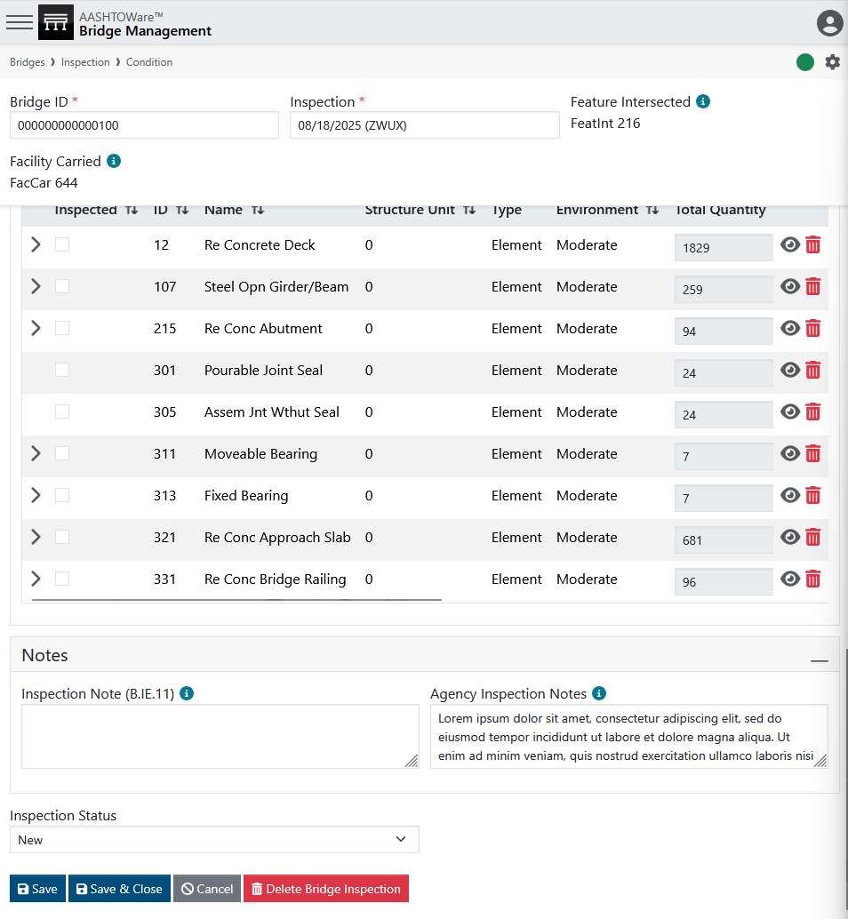
Condition & Elements
Photo by Evan Leith on Unsplash

Slide 22
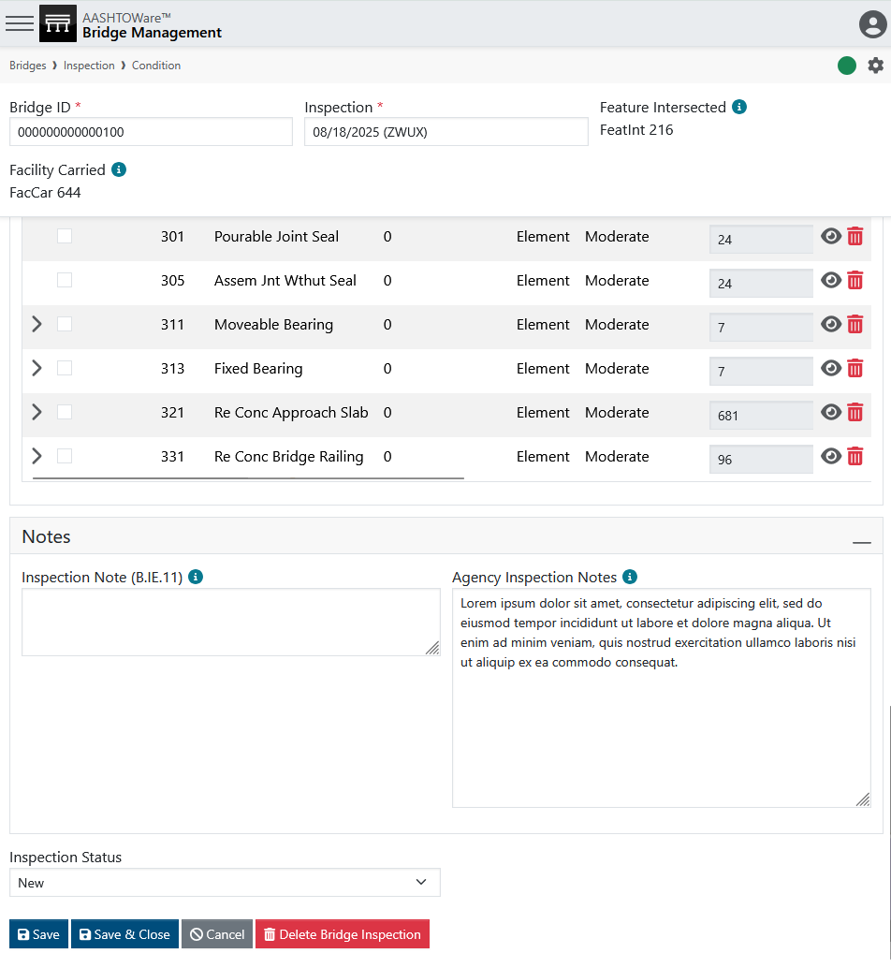
Condition & Elements
Photo by Evan Leith on Unsplash

Slide 23
Load Posting
Photo by Evan Leith on Unsplash

Slide 24
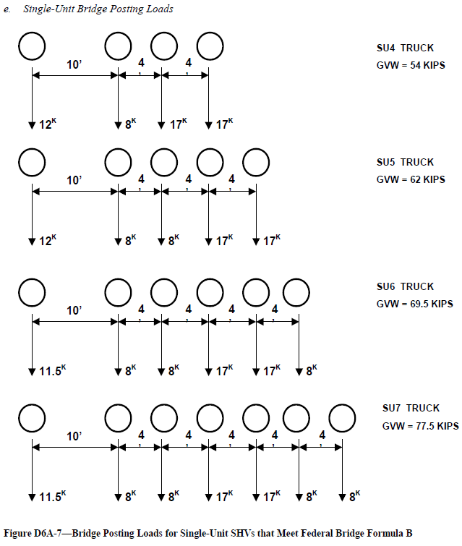
Load Posting
Step 1: Know your vehicles
Step 2: Know your signs
Photo by Evan Leith on Unsplash

Slide 25
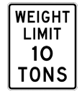
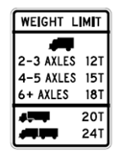
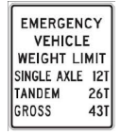
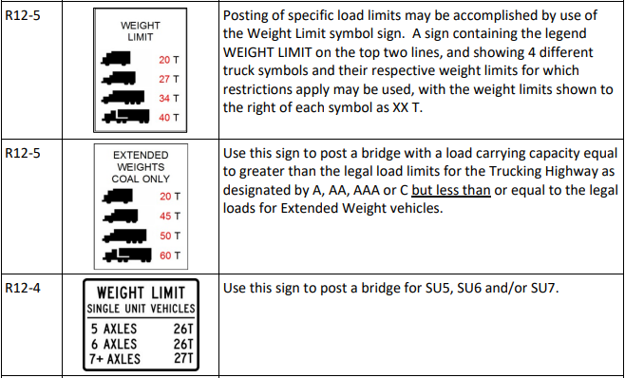
Load Posting
Step 1: Know your vehicles
Step 2: Know your signs
Step 3: Know the codes
Photo by Evan Leith on Unsplash

Slide 26
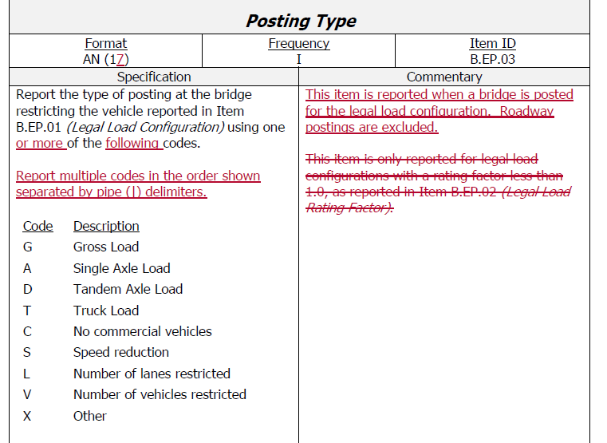
Load Posting
Step 1: Know your vehicles
Step 2: Know your signs
Step 3: Know the codes
Photo by Evan Leith on Unsplash

Slide 27
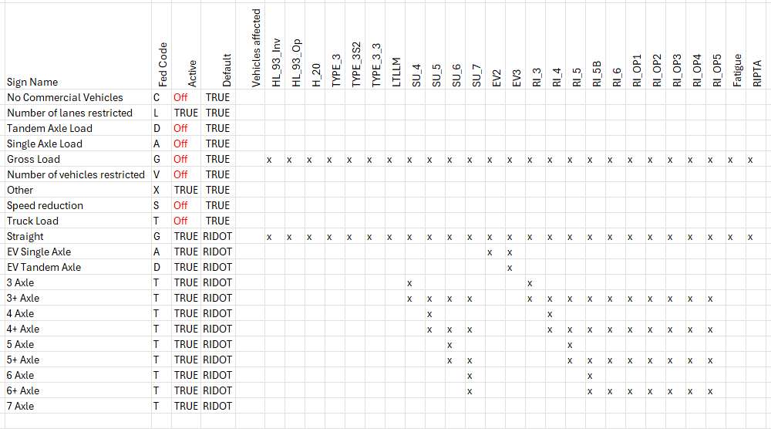
Load Posting
Step 1: Know your vehicles
Step 2: Know your signs
Step 3: Know the codes
Step 4: Make this grid
Step 5: Set up sign / Vehicles
Photo by Evan Leith on Unsplash

Slide 28
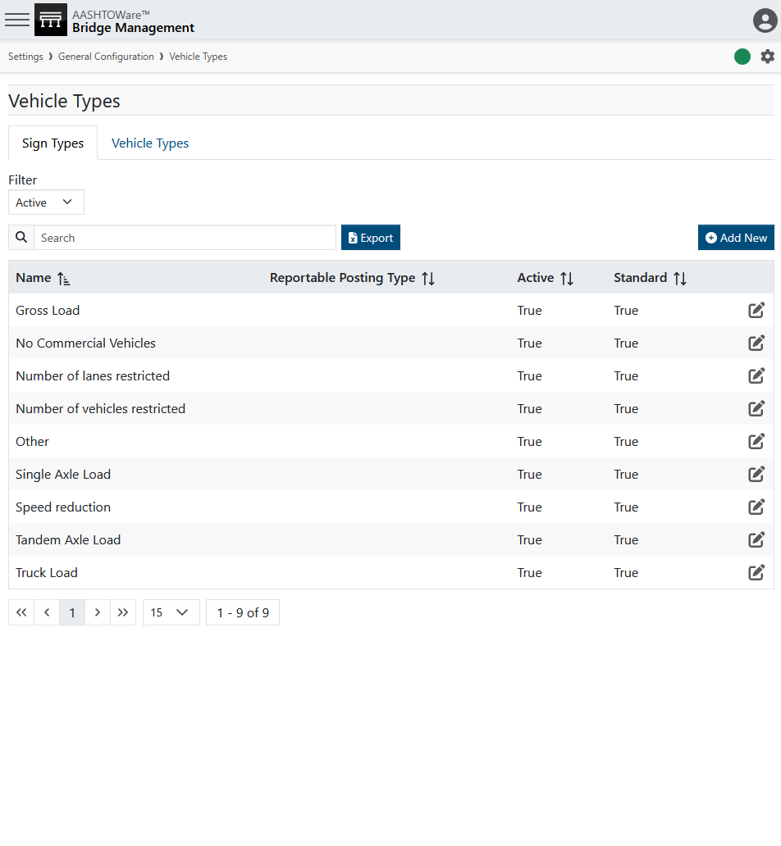
Load Posting
Step 1: Know your vehicles
Step 2: Know your signs
Step 3: Know the codes
Step 4: Make this grid
Step 5: Set up sign / Vehicles

Slide 29
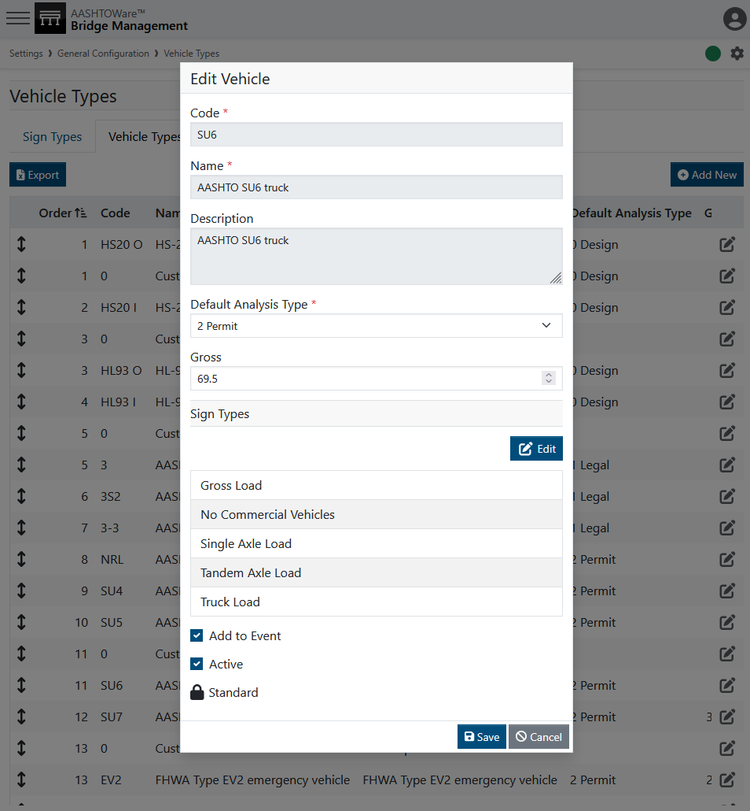
Load Posting
Step 1: Know your vehicles
Step 2: Know your signs
Step 3: Know the codes
Step 4: Make this grid
Step 5: Set up sign / Vehicles

Slide 30
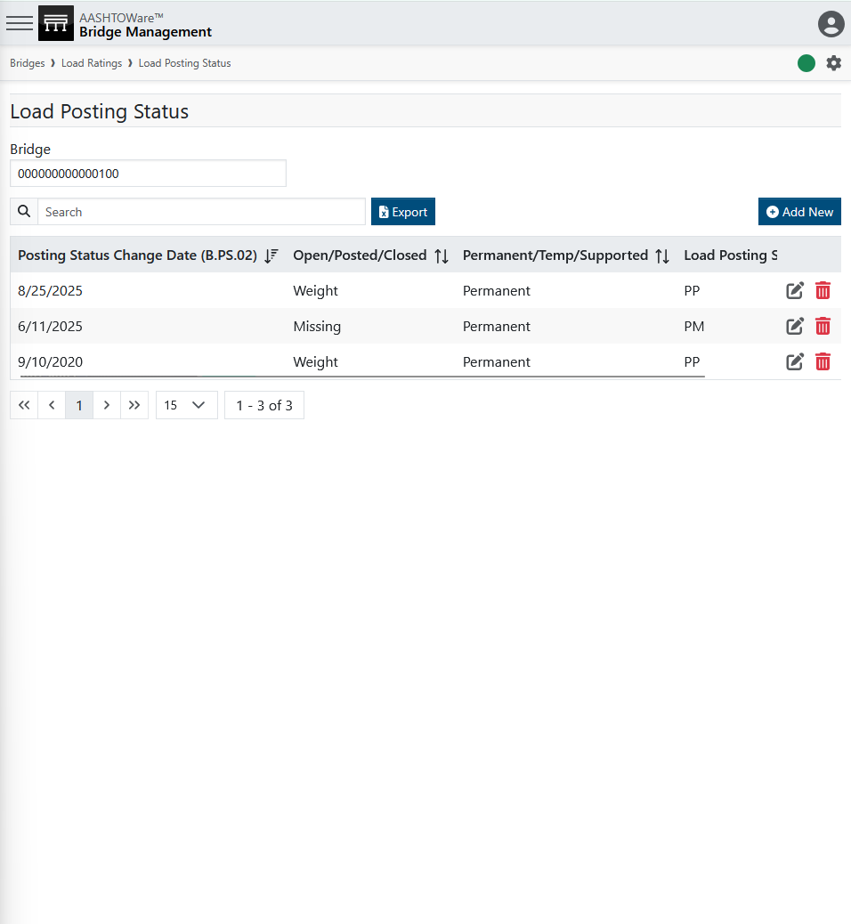
Load Posting
Step 1: Know your vehicles
Step 2: Know your signs
Step 3: Know the codes
Step 4: Make this grid
Step 5: Set up sign / Vehicles

Slide 31
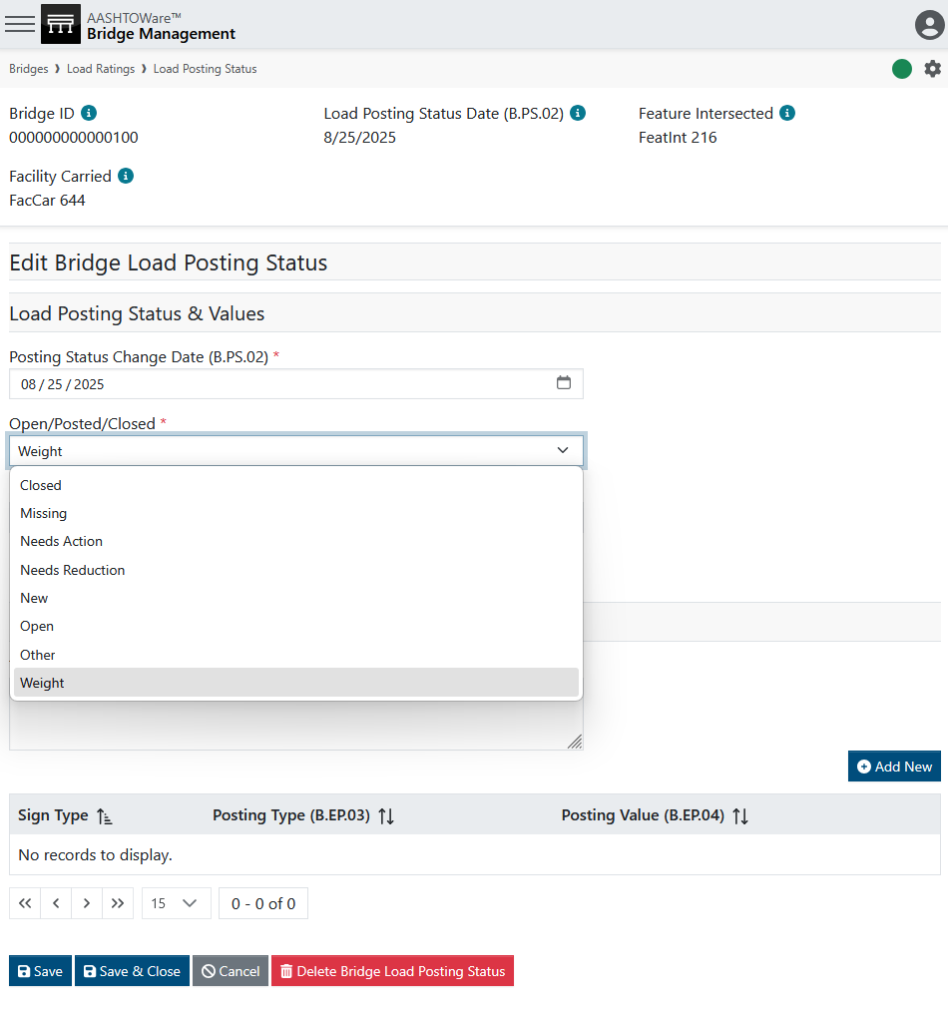
Load Posting
Step 1: Know your vehicles
Step 2: Know your signs
Step 3: Know the codes
Step 4: Make this grid
Step 5: Set up sign / Vehicles

Slide 32
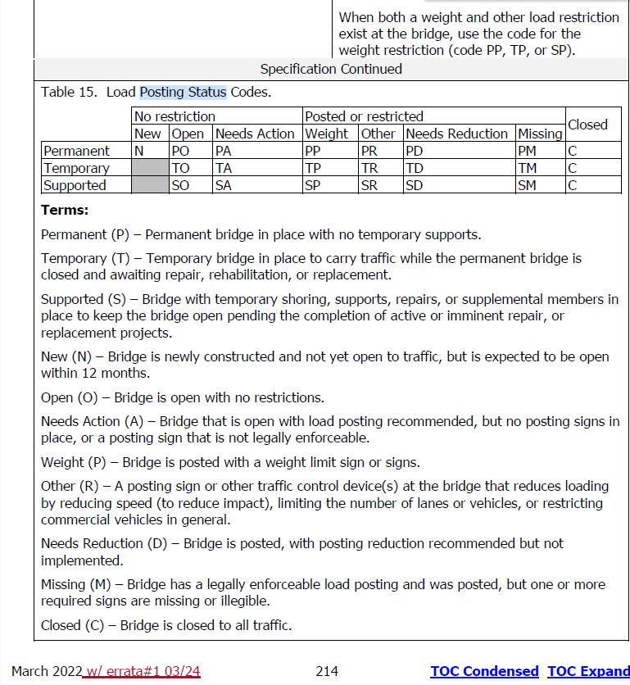
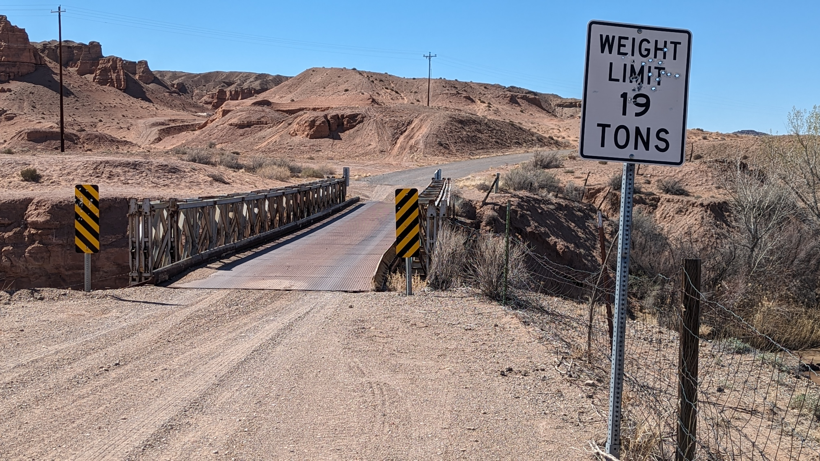
Load Posting

Slide 33
Load Posting

Slide 34
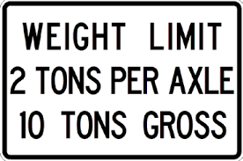
Load Posting
Photo by Evan Leith on Unsplash

Slide 35
Load Posting
Photo by Evan Leith on Unsplash

Slide 36
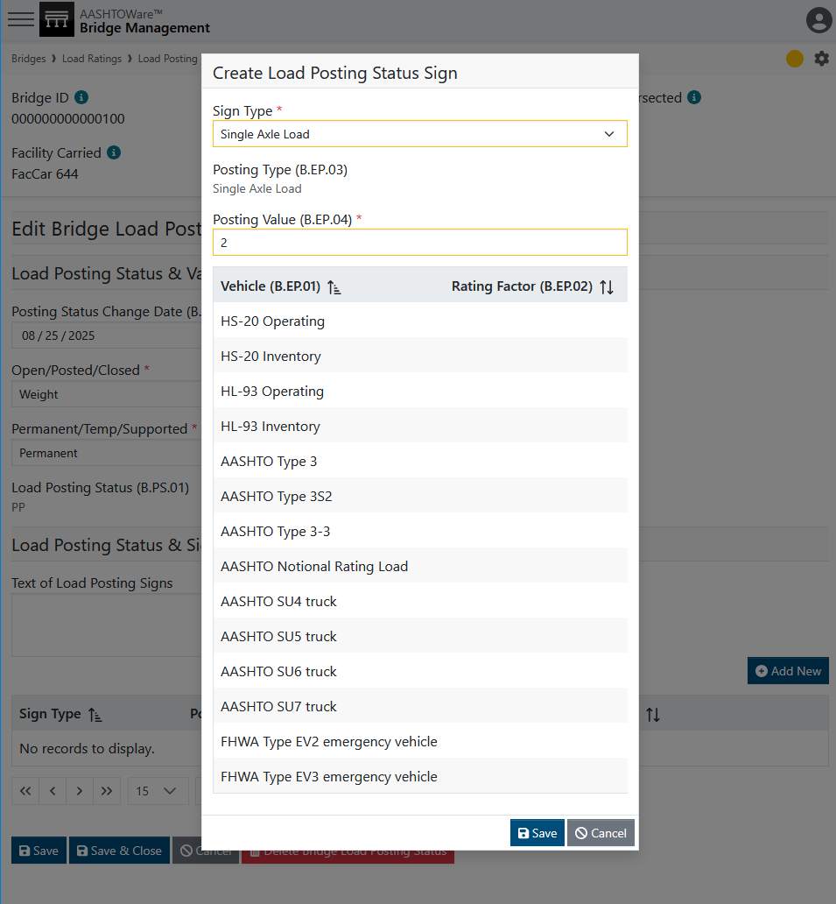
Load Posting
Photo by Evan Leith on Unsplash

Slide 37
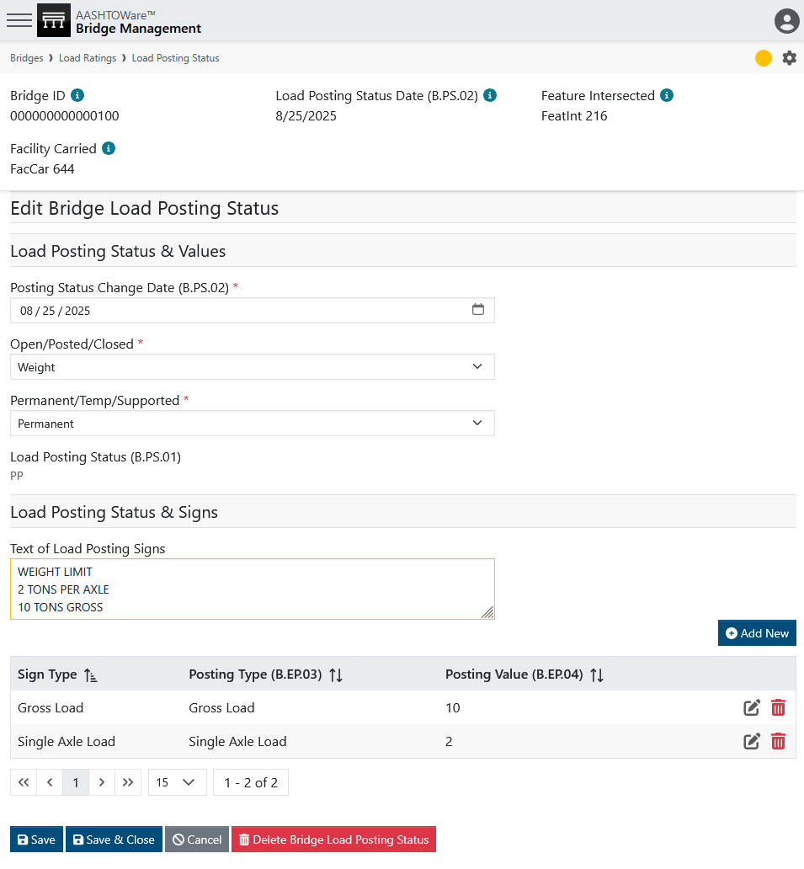
Load Posting
Photo by Evan Leith on Unsplash

Slide 38
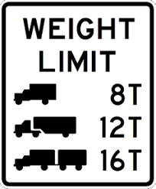
Load Posting
Photo by Evan Leith on Unsplash

Slide 39
Load Posting
Photo by Evan Leith on Unsplash

Slide 40
Load Posting
Note:
Truck Type 1
Truck Type 2
Truck Type 3
Are not default Sign types and will need to be added to your site.
Photo by Evan Leith on Unsplash

Slide 41
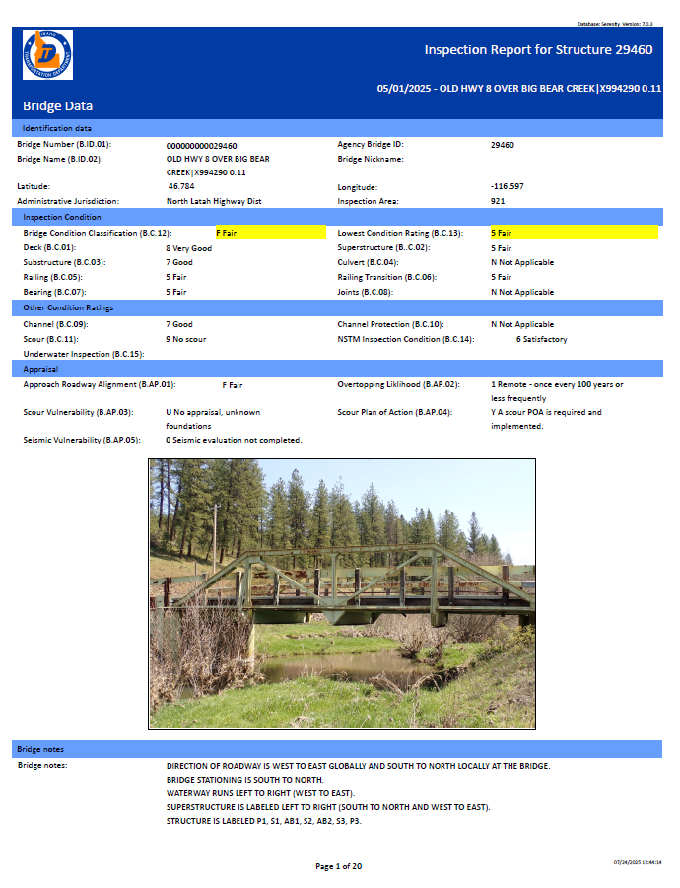
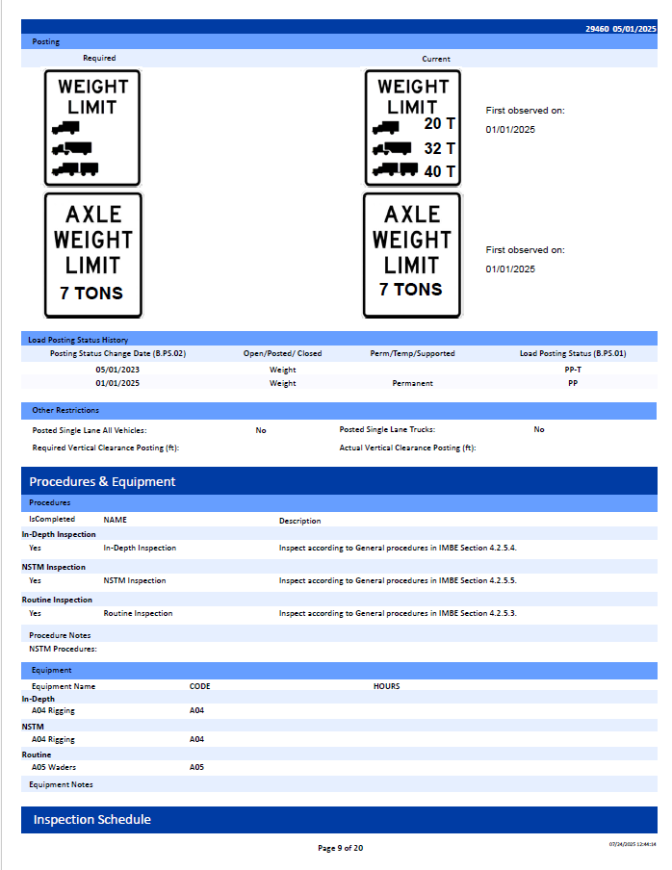

Load Posting
Photo by Evan Leith on Unsplash

Slide 42
Multimedia & Sketches
Photo by Evan Leith on Unsplash

Slide 43
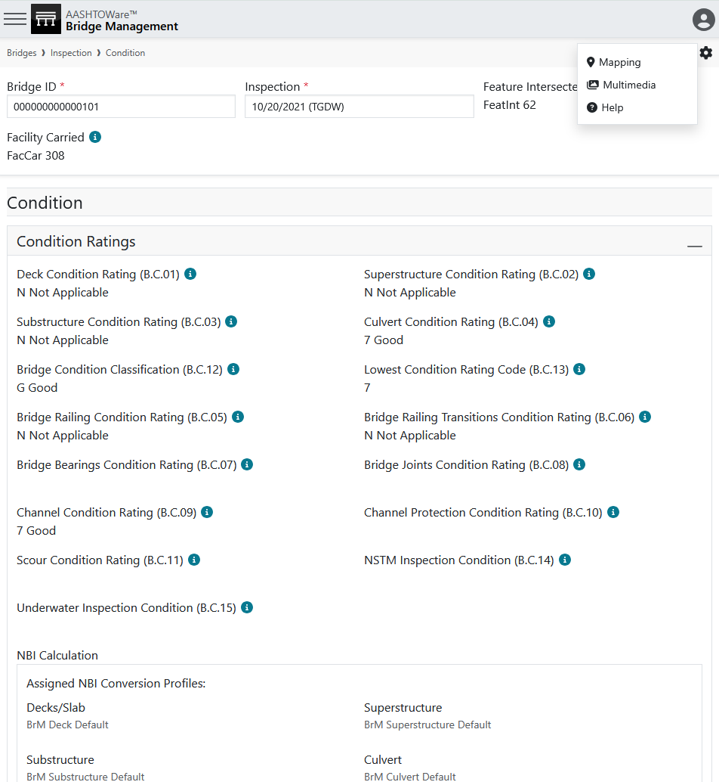
Multimedia & Sketches
Photo by Evan Leith on Unsplash

Slide 44
Multimedia & Sketches
Photo by Evan Leith on Unsplash

Slide 45
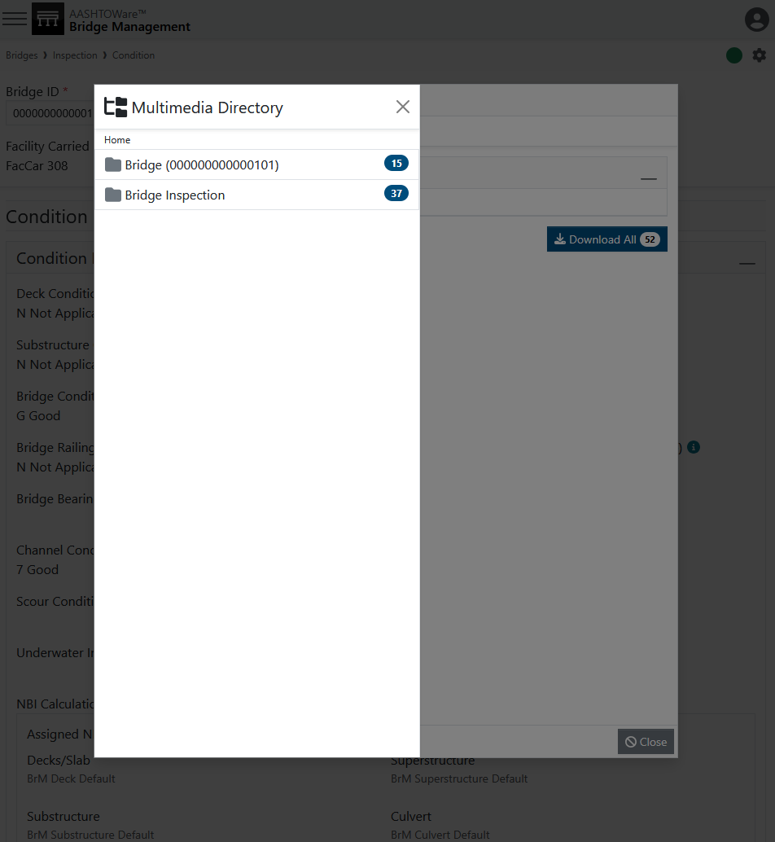
Multimedia & Sketches
Photo by Evan Leith on Unsplash

Slide 46
Multimedia & Sketches
Photo by Evan Leith on Unsplash

Slide 47
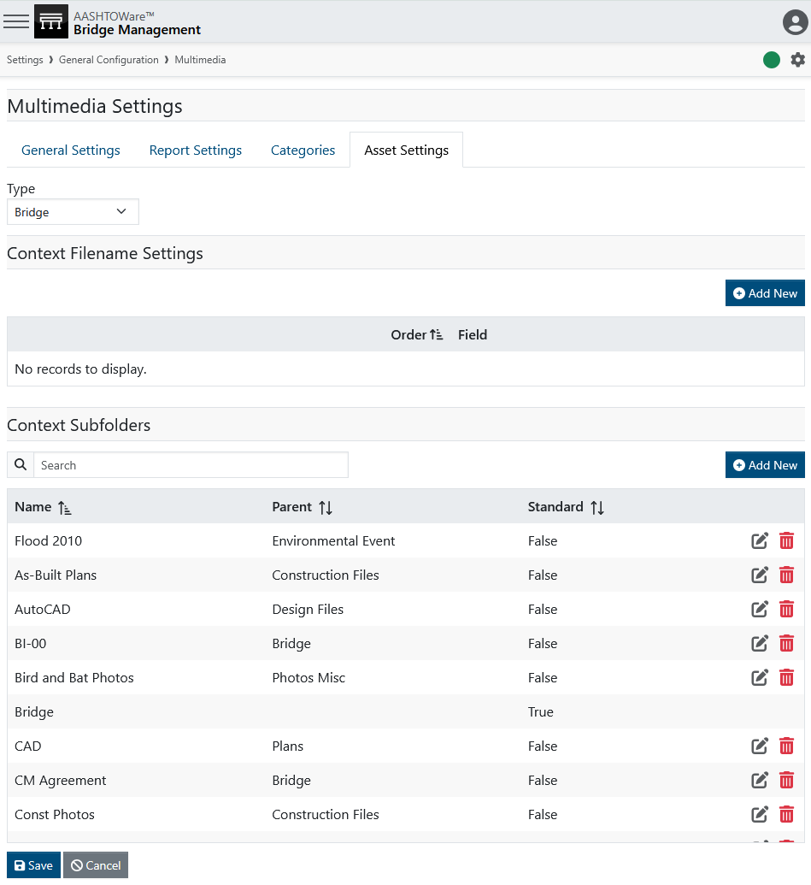
Multimedia & Sketches
Use case examples for folders:
Bridge
  Plans
  Load Rating Docs
  Scour Plans
  Contract Docs
Bridge Inspection
  Final Report
  Sketches
Photo by Evan Leith on Unsplash

Slide 48
Multimedia & Sketches
Use case examples for folders:
Bridge
  Plans
  Load Rating Docs
  Scour Plans
  Contract Docs
Bridge Inspection
  Final Report
  Sketches
Photo by Evan Leith on Unsplash

Slide 49
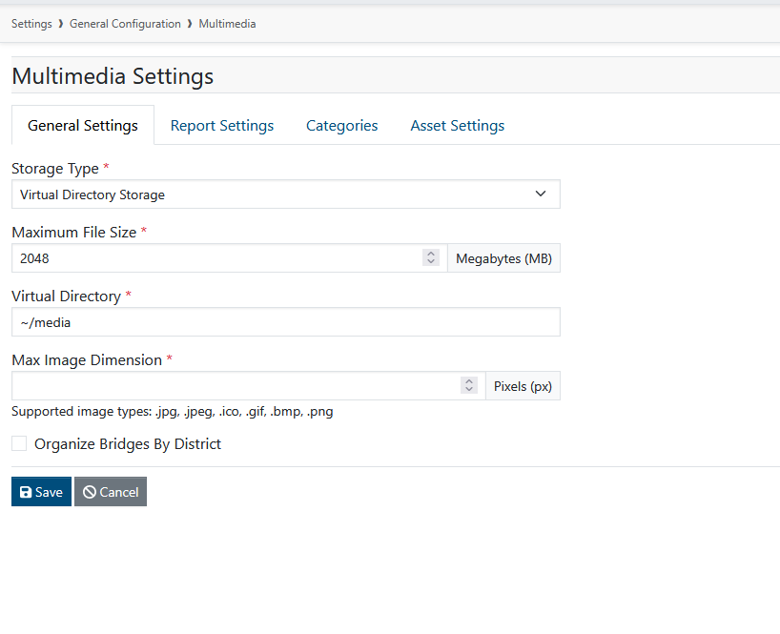
Multimedia & Sketches
Use case examples for folders:
Bridge
  Plans
  Load Rating Docs
  Scour Plans
  Contract Docs
Bridge Inspection
  Final Report
  Sketches
Remember you can downscale
Phones have amazing levels of pixels. Maybe you don’t need a 1.5 GB pdf of an inspection report. You can set a max dimension to downscale images.
You can also block uploads of files above a certain size. No more 2hr drone videos jamming up your multimedia.
Photo by Evan Leith on Unsplash

Slide 50
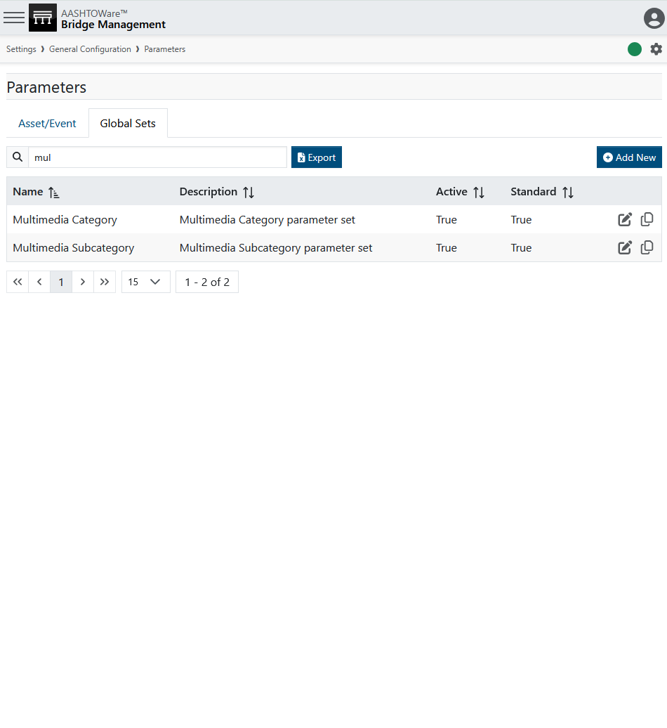
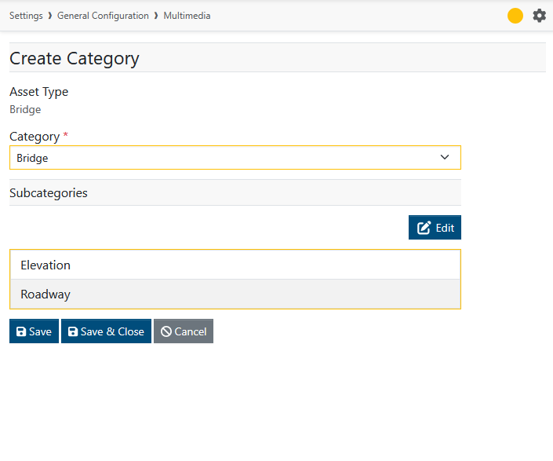
Multimedia & Sketches
Photo by Evan Leith on Unsplash

Slide 51
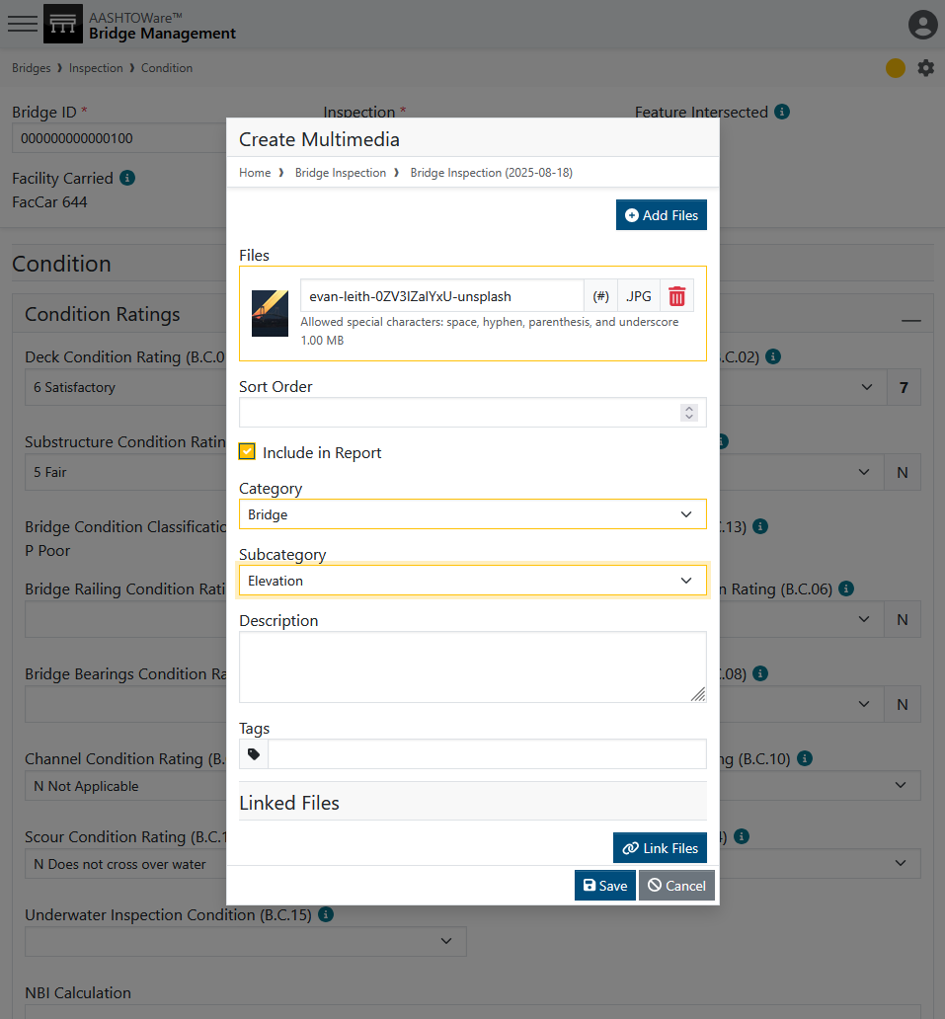
Multimedia & Sketches
Photo by Evan Leith on Unsplash

Slide 52
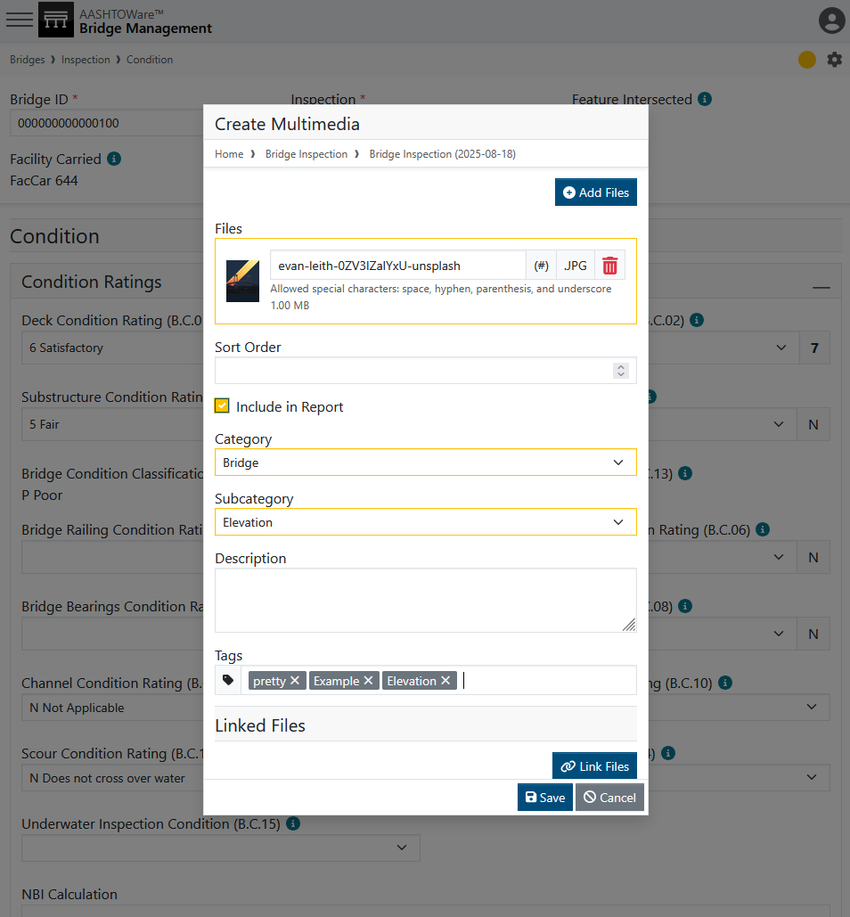
Multimedia & Sketches
Photo by Evan Leith on Unsplash

Slide 53
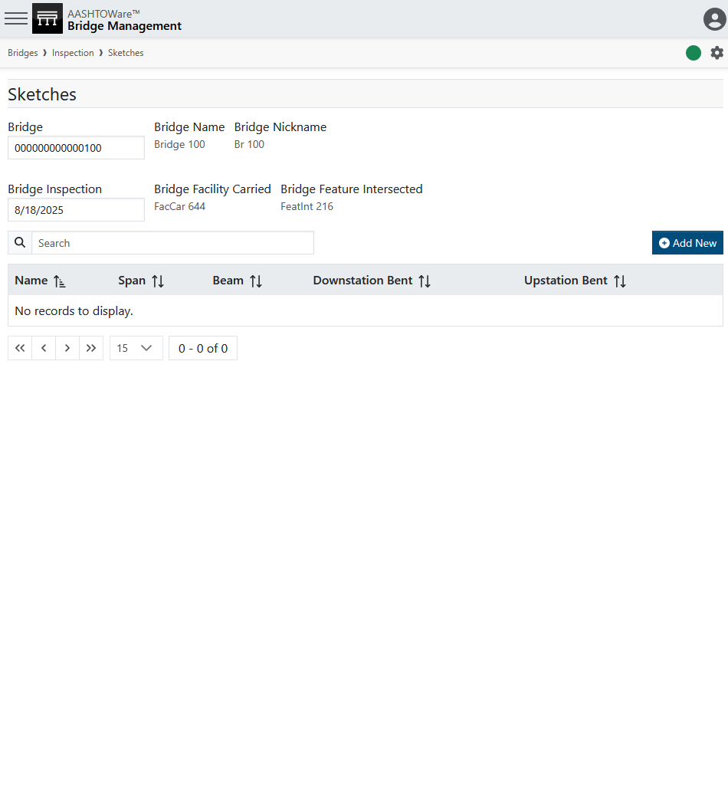
Multimedia & Sketches
Photo by Evan Leith on Unsplash

Slide 54
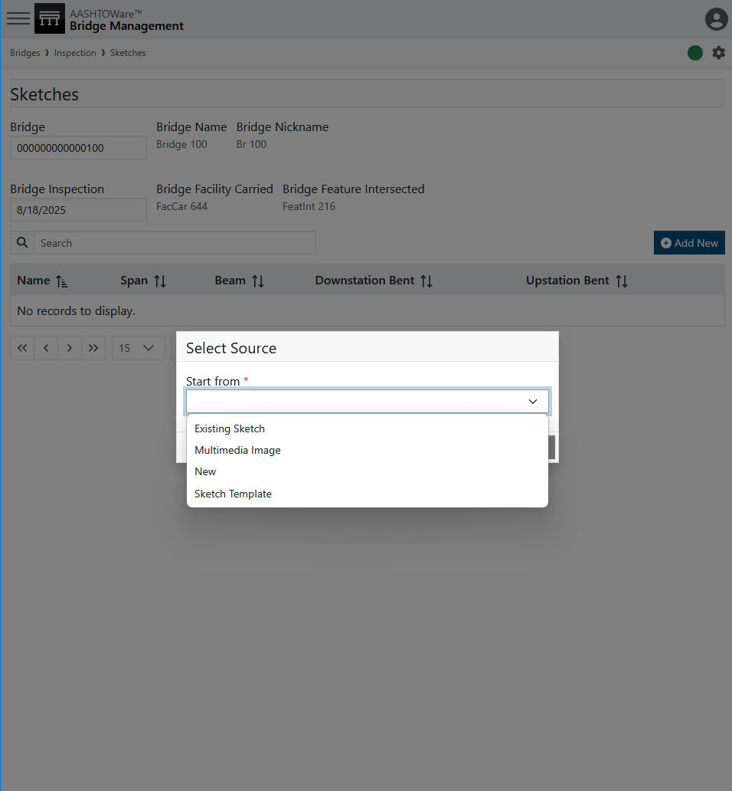
Multimedia & Sketches
Photo by Evan Leith on Unsplash

Slide 55
Multimedia & Sketches
Photo by Evan Leith on Unsplash

Slide 56
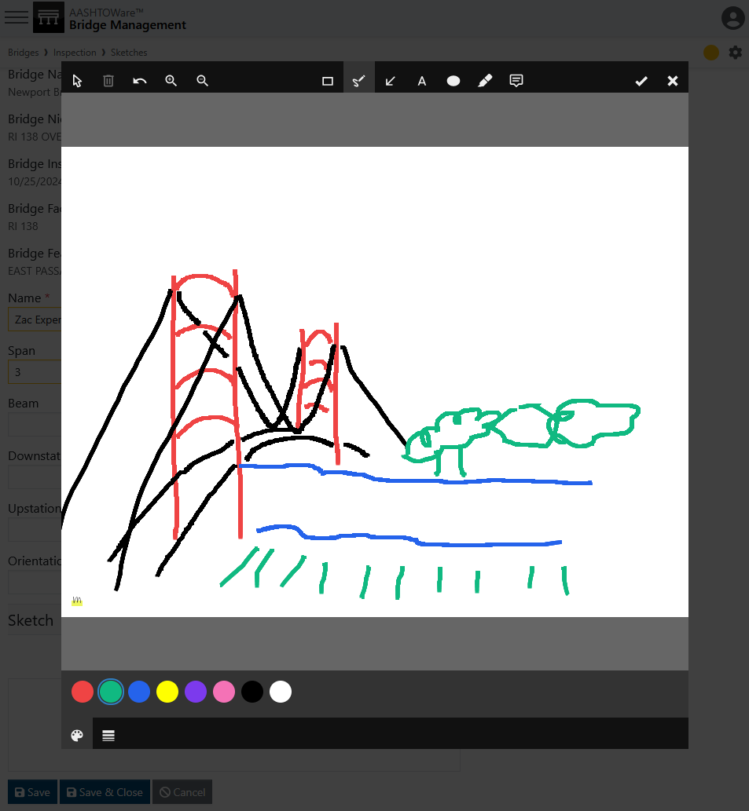
Multimedia & Sketches
Photo by Evan Leith on Unsplash

Slide 57
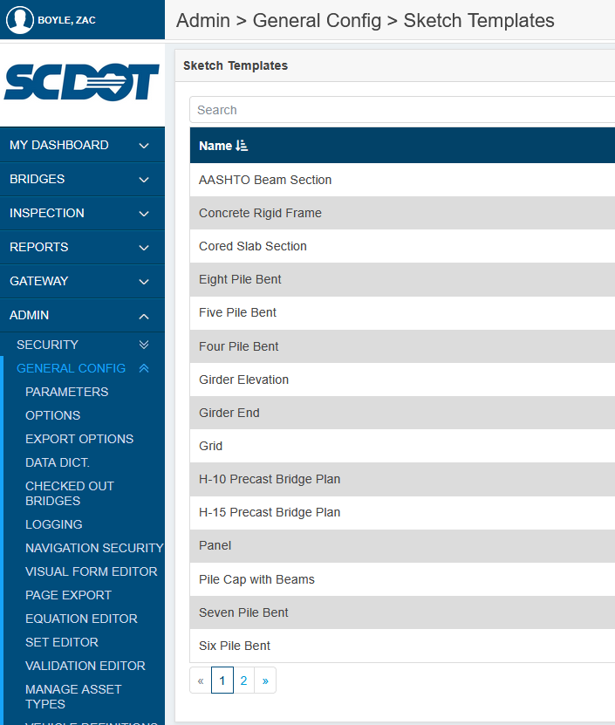

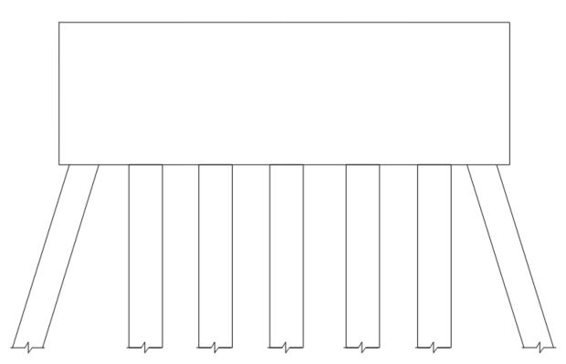
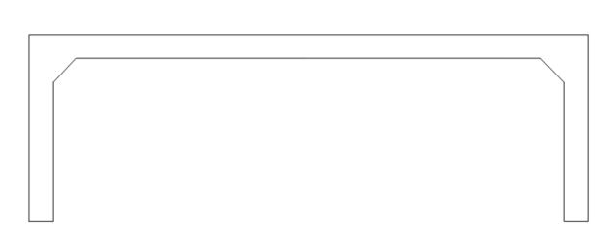
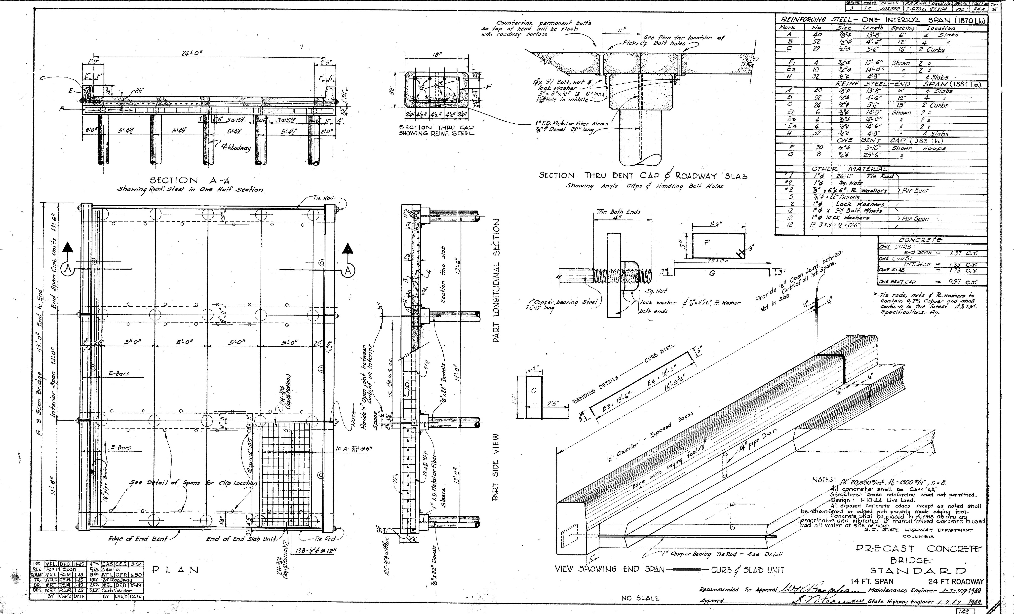
Multimedia & Sketches
Photo by Evan Leith on Unsplash

Slide 58
Cross Sections
Photo by Evan Leith on Unsplash

Slide 59

Cross Sections
Photo by Evan Leith on Unsplash

Slide 60

Cross Sections
Photo by Evan Leith on Unsplash

Slide 61

Cross Sections
Photo by Evan Leith on Unsplash

Slide 62


Cross Sections
Photo by Evan Leith on Unsplash

Slide 63

Cross Sections
Photo by Evan Leith on Unsplash

Slide 64

Cross Sections
Photo by Evan Leith on Unsplash

Slide 65
Cross Sections
Photo by Evan Leith on Unsplash

Slide 66

Cross Sections
Photo by Evan Leith on Unsplash

Slide 67

Cross Sections
Photo by Evan Leith on Unsplash

Slide 68




Cross Sections

Slide 69

Cross Sections
Photo by Evan Leith on Unsplash

Slide 70
Cross Sections
Left Side
Right Side
Photo by Evan Leith on Unsplash

Slide 71
Cross Sections
Left Side
Right Side
Photo by Evan Leith on Unsplash

Slide 72
Cross Sections
Left Side
Right Side
Photo by Evan Leith on Unsplash

Slide 73
Cross Sections
Left Side – Offset 100
Left Side – Offset 0
Right Side – Offset 0
Right Side – Offset 100
Photo by Evan Leith on Unsplash

Slide 74
Cross Sections

Slide 75

Cross Sections
Photo by Evan Leith on Unsplash

Slide 76

Cross Sections
Photo by Evan Leith on Unsplash

Slide 77

Cross Sections

Slide 78

Cross Sections
Photo by Evan Leith on Unsplash

Slide 79

Cross Sections
This session
The global base measure
Photo by Evan Leith on Unsplash

Slide 80

Cross Sections
Photo by Evan Leith on Unsplash

Slide 81

Cross Sections
The Required Minimum to Graph
To get a graph to display, you need a beginning and ending point with curb and deck points. These can all be zeroes except the end-stationing.
Photo by Evan Leith on Unsplash

Slide 82

Cross Sections
Photo by Evan Leith on Unsplash

Slide 83
Cross Sections
Curved deck
Detailed beam thickness
Every foundation type
Photo by Evan Leith on Unsplash

Slide 84

Cross Sections
Note lots of no-footing points to curve deck and beams
Photo by Evan Leith on Unsplash

Slide 85

Cross Sections
Photo by Evan Leith on Unsplash

Slide 86

Cross Sections
Photo by Evan Leith on Unsplash

Slide 87


Cross Sections
Structure Detail
thicknesses
Original ground line
Photo by Evan Leith on Unsplash

Slide 88
Course Overview
TODAY
TOMORROW
Before Break (Insp 101)
Login
Roles & Groups
Bridge List
Inspection List
Scheduling
Inspection Plans
Inventory
Design
Features
After Break (Insp 102)
Condition & Elements
Load Posting
Multimedia
Sketches
Cross Sections
Before Break (Insp 201)
Work Candidates
Certifications
Inspection Assignment
Validation
Inspection Review
Future Planning
After Break (Insp 202)
Submittal
Critical Findings
Reports
Dashboards
API Calls
Photo by Evan Leith on Unsplash

Slide 89

BrM 7.0 Migration
CONTACT
The Abridged Version
Jira Service Desk
ZACHARY BOYLE
zac.boyle@mayvue.com
Text | Voicemail | (801) 450-9716
BrM@mayvue.com
1-877-462-9883
http://support.mayvue.com
BrMUG 2024 | Long Beach, CA | September 17-18
Photo by Evan Leith on Unsplash

Slide 90
BrMUG 2025 | Providence, RI | September 17-18
Photo by Evan Leith on Unsplash

