Slide 1
Dashboards and Reports
Export and Imports files

Slide 2
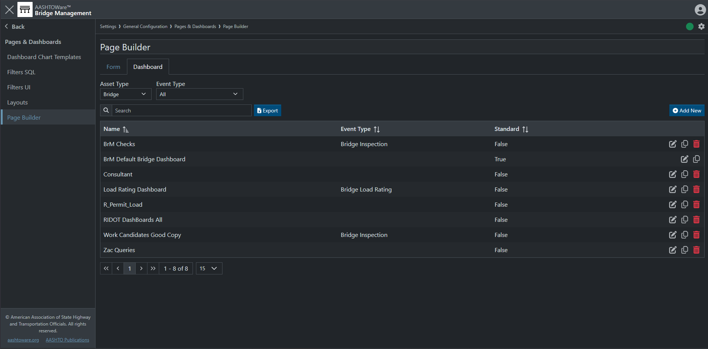
Dashboards

Slide 3
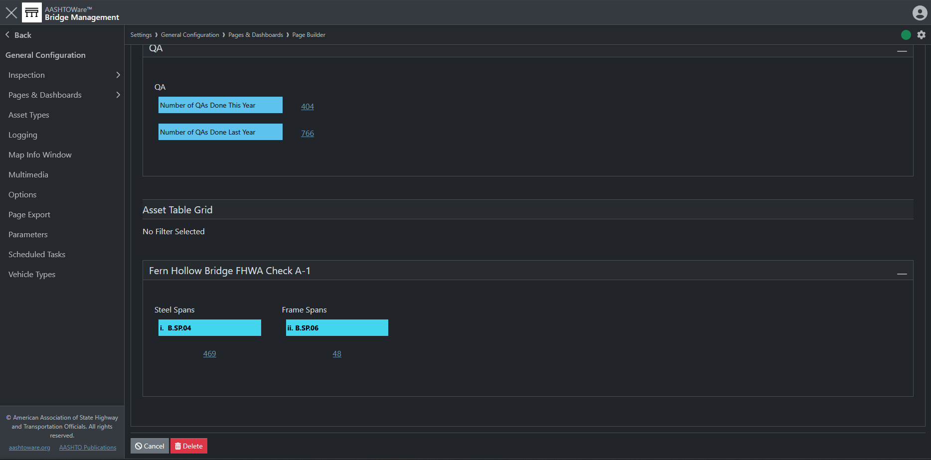
Dashboards

Slide 4
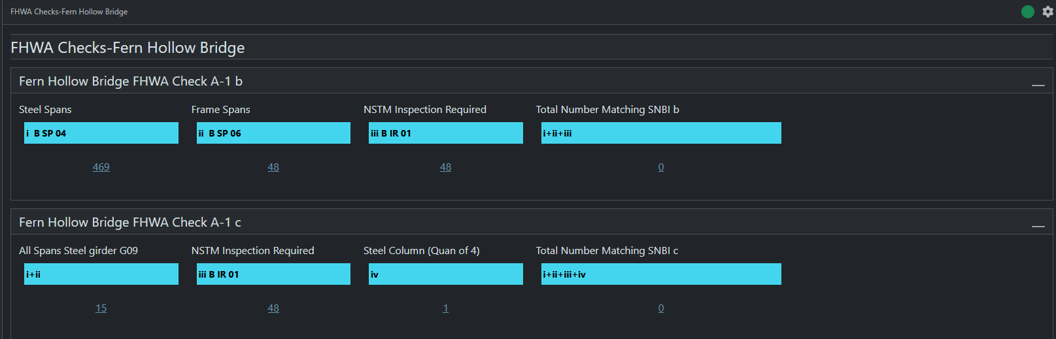
Dashboards

Slide 5
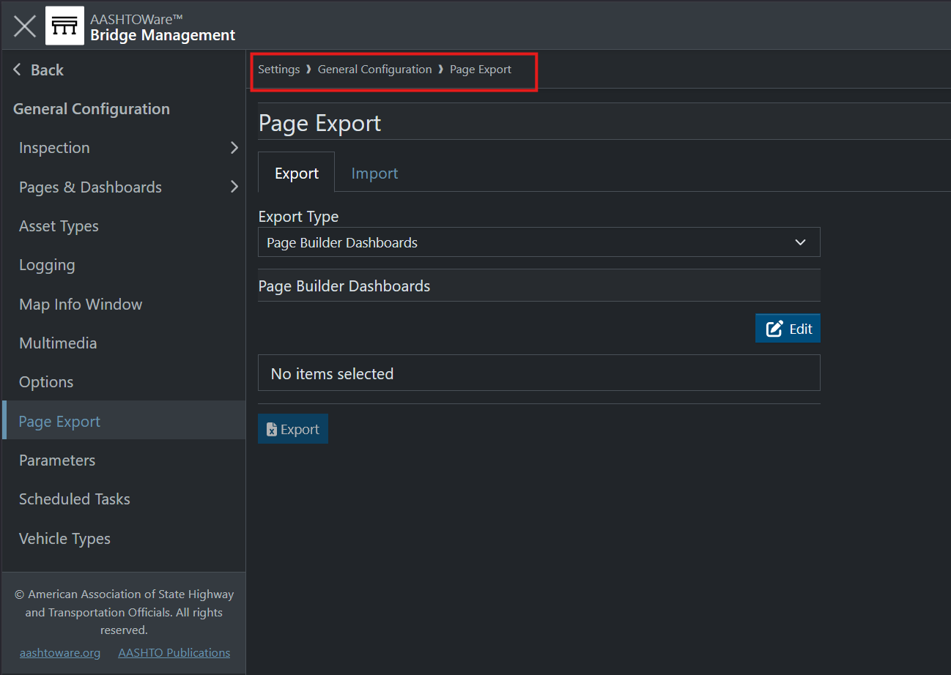
Dashboards

Slide 6
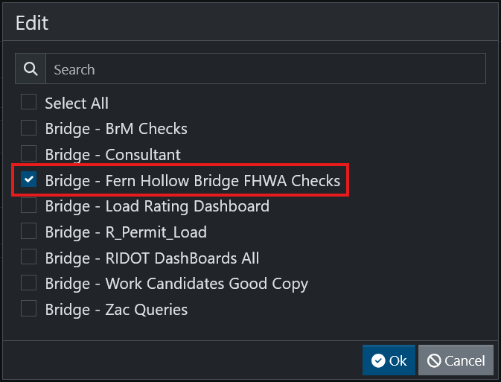
Dashboards

Slide 7
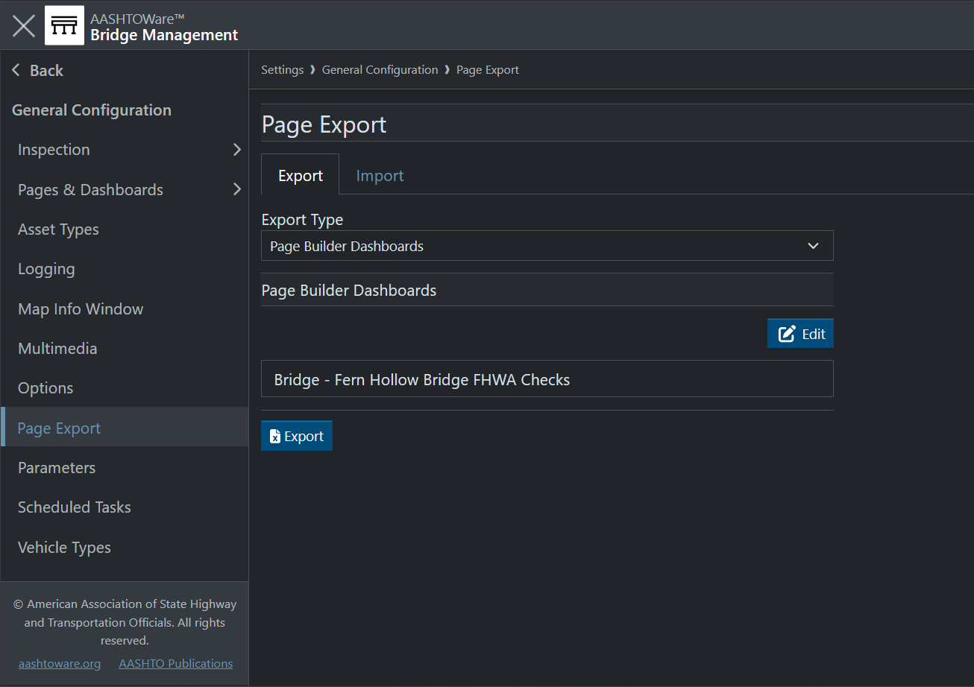
Dashboards

Slide 8
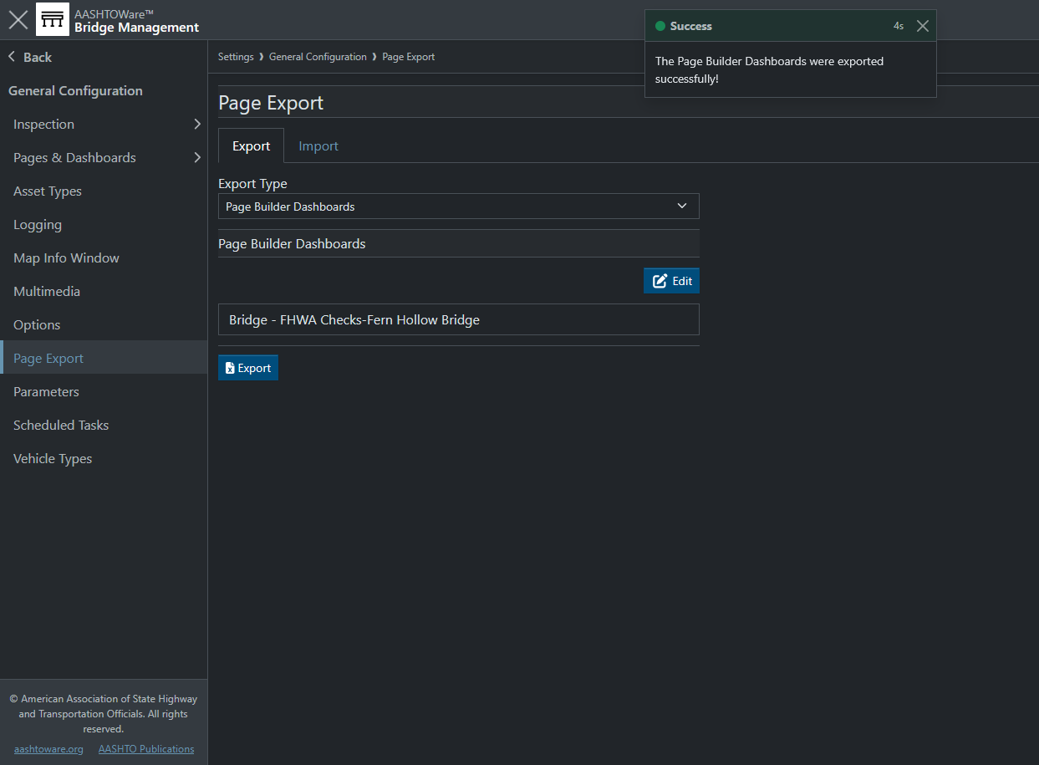
Dashboards

Slide 9
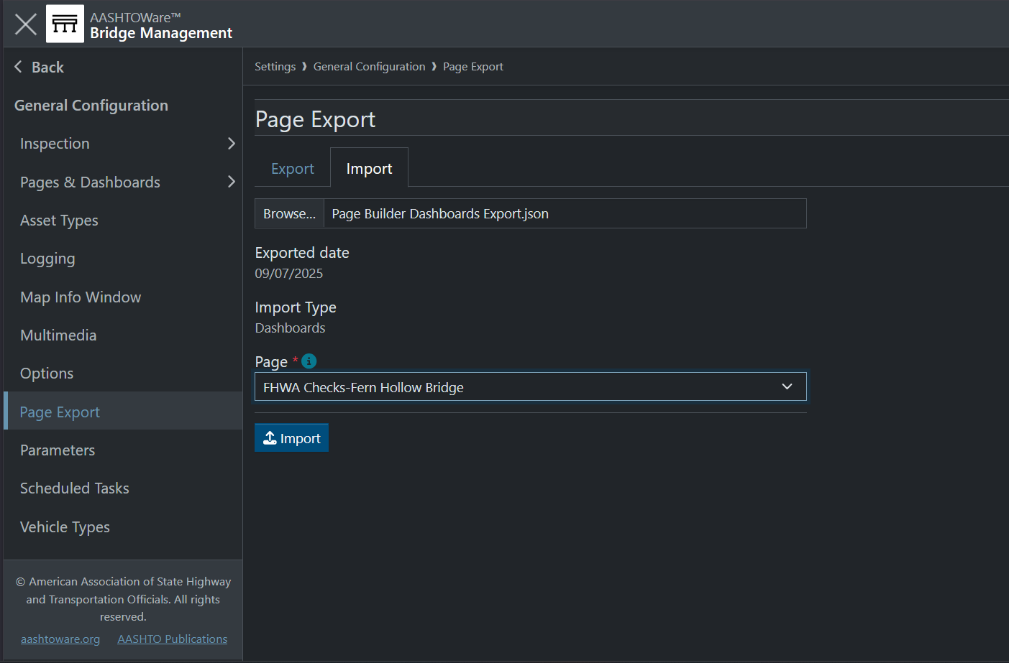
Dashboards

Slide 10
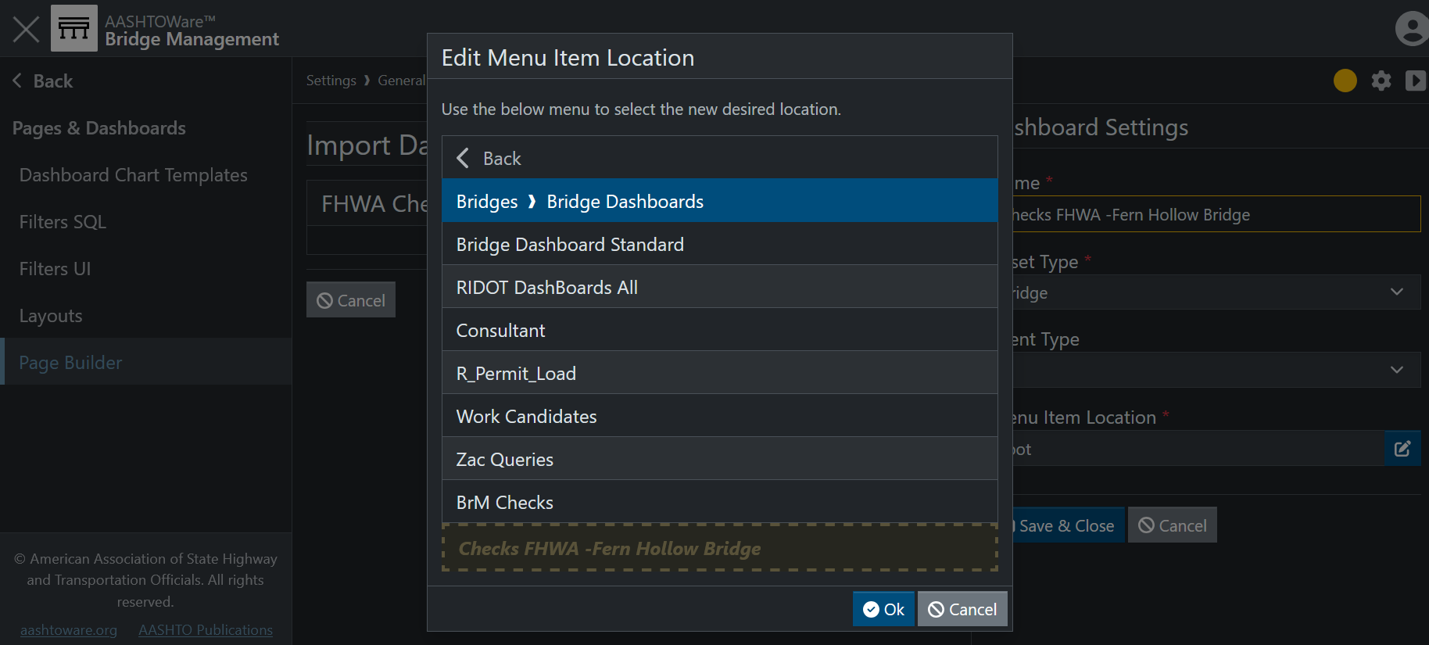
Dashboards

Slide 11
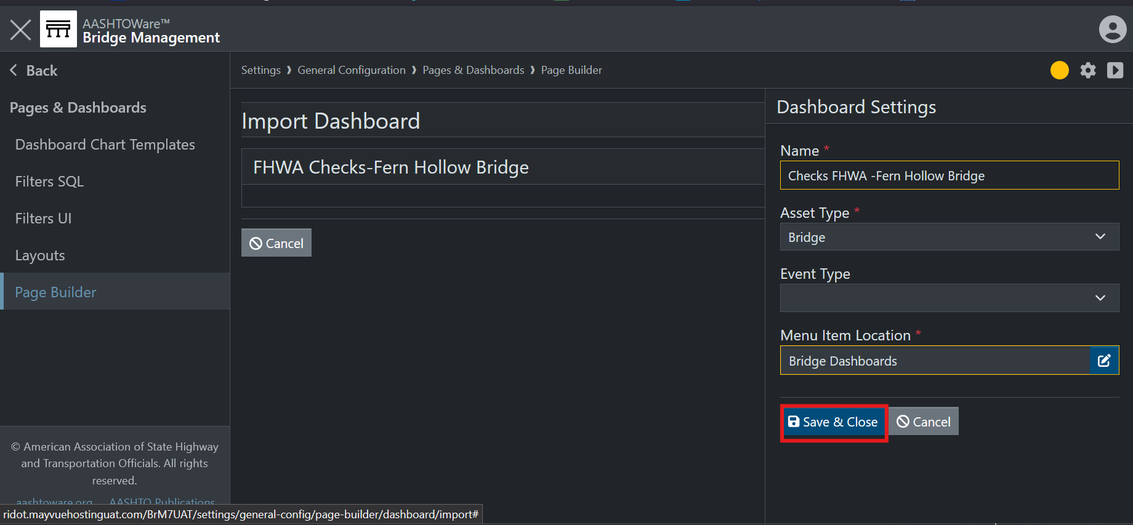
Dashboards

Slide 12
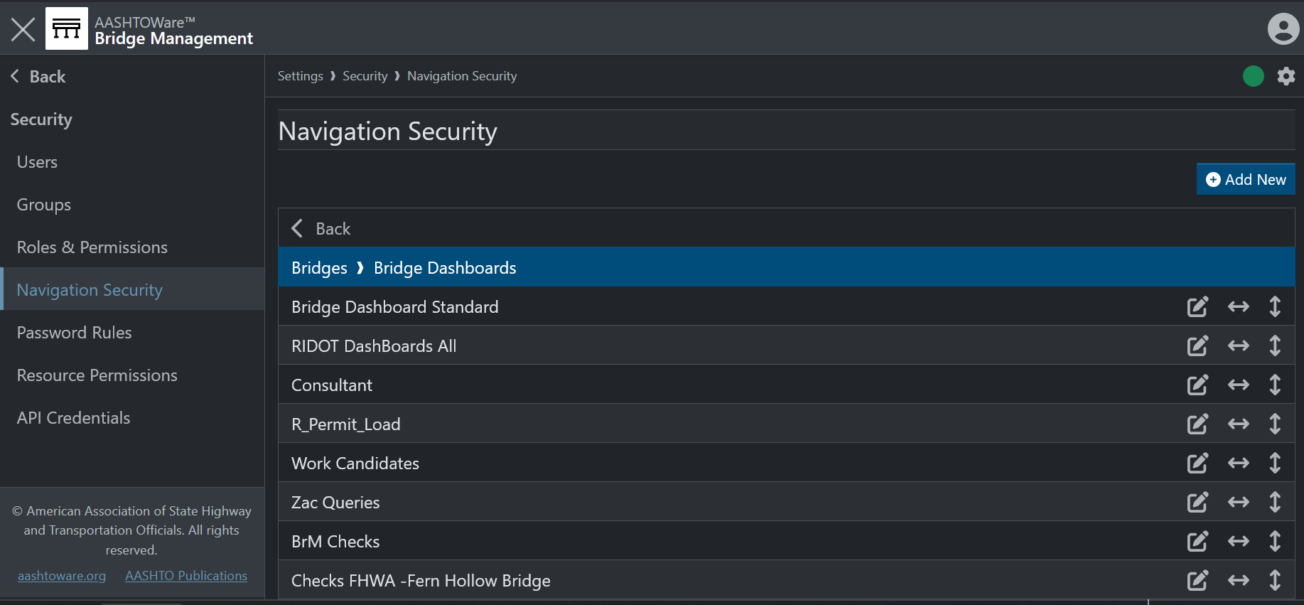
Dashboards

Slide 13
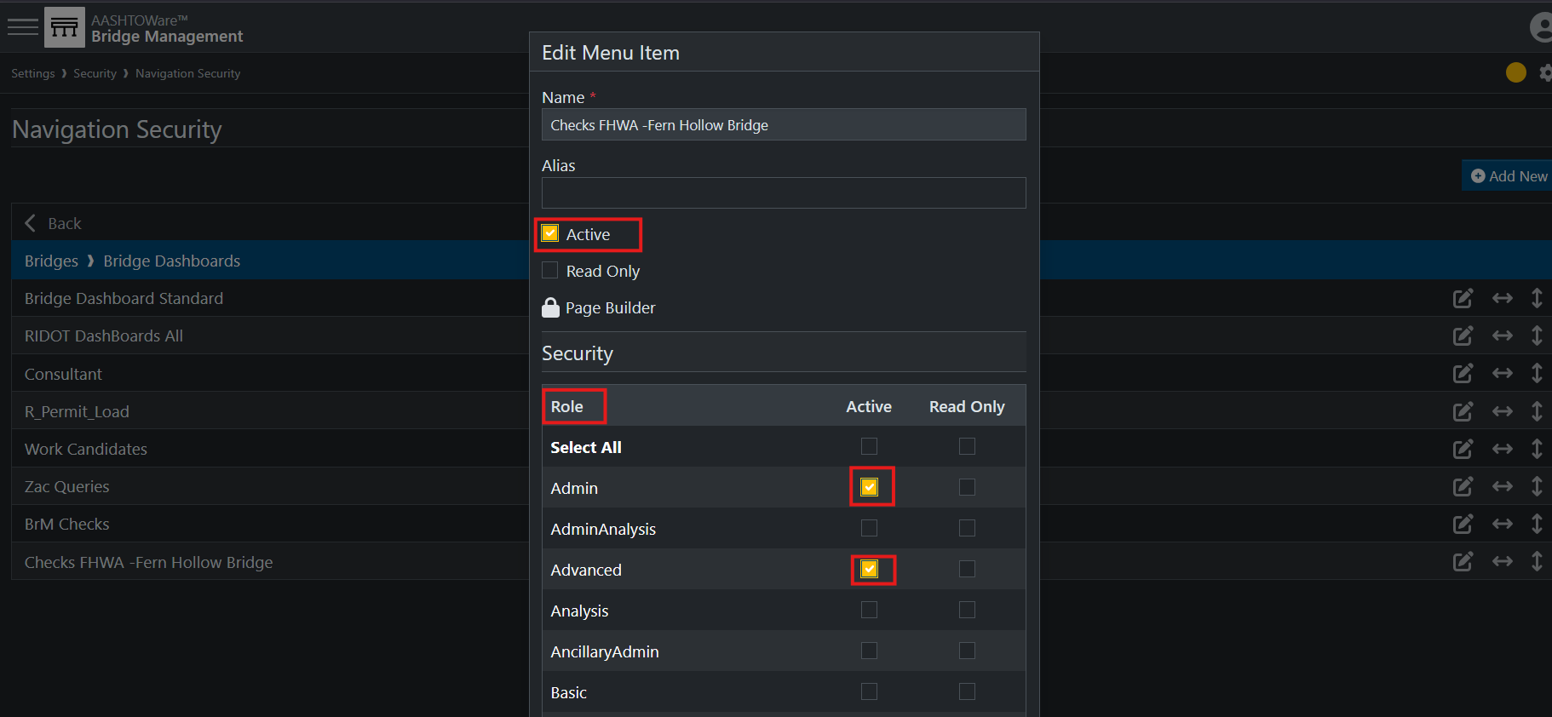
Dashboards

Slide 14
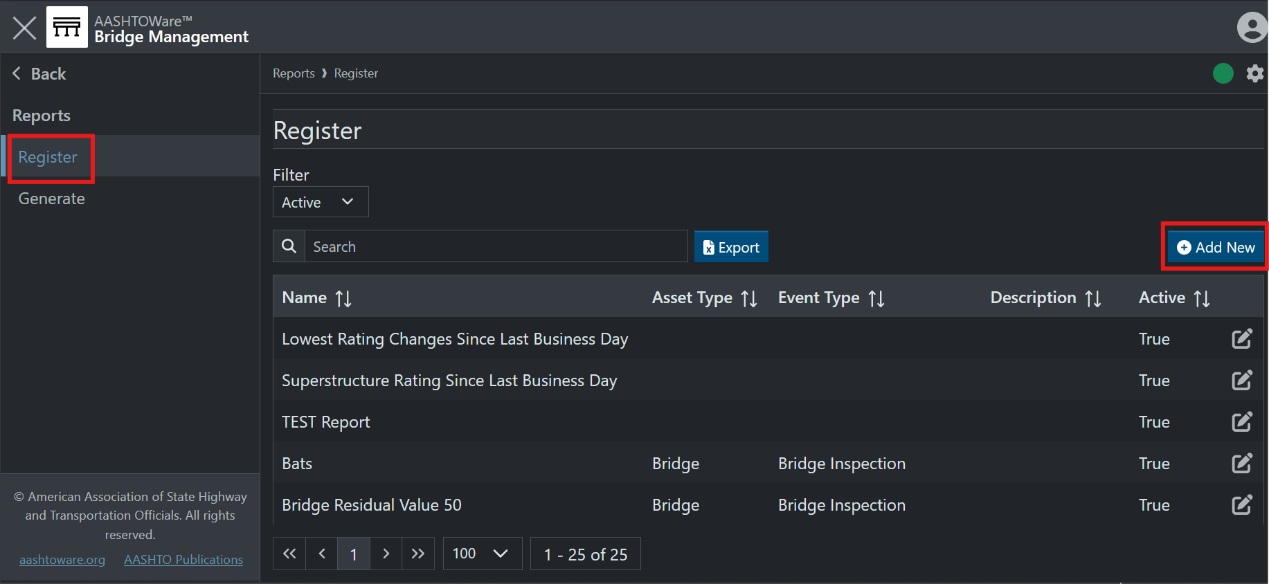
Reports

Slide 15
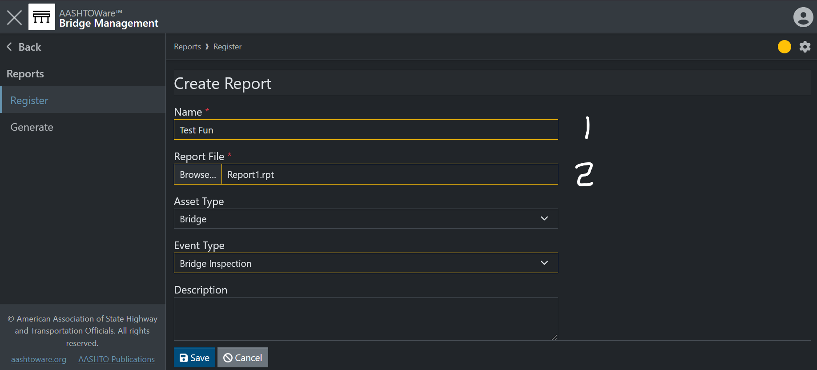
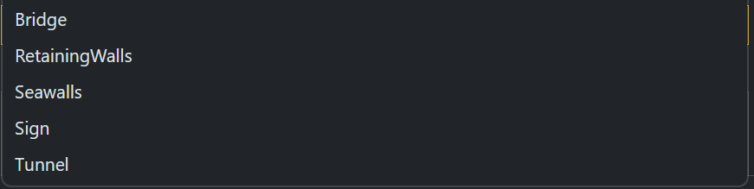
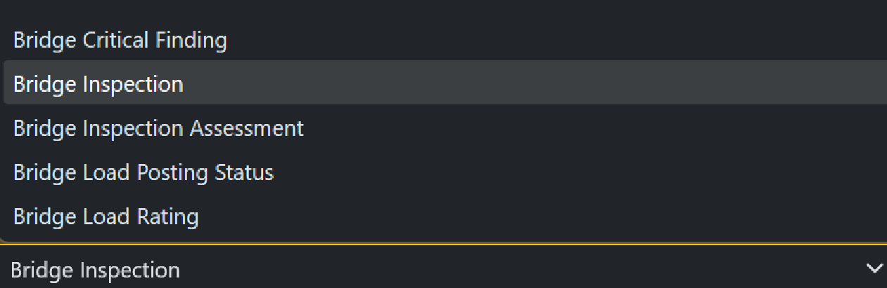
Reports

Slide 16
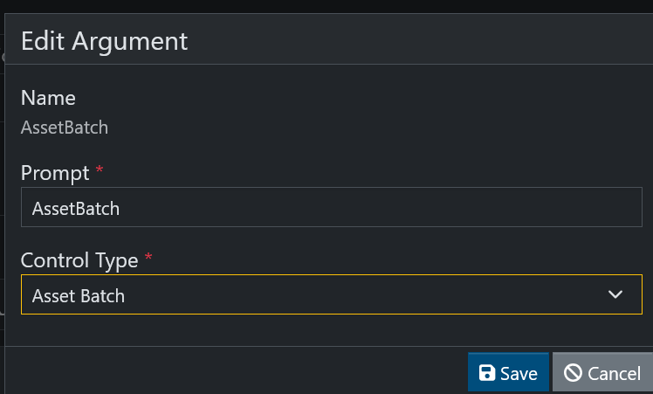
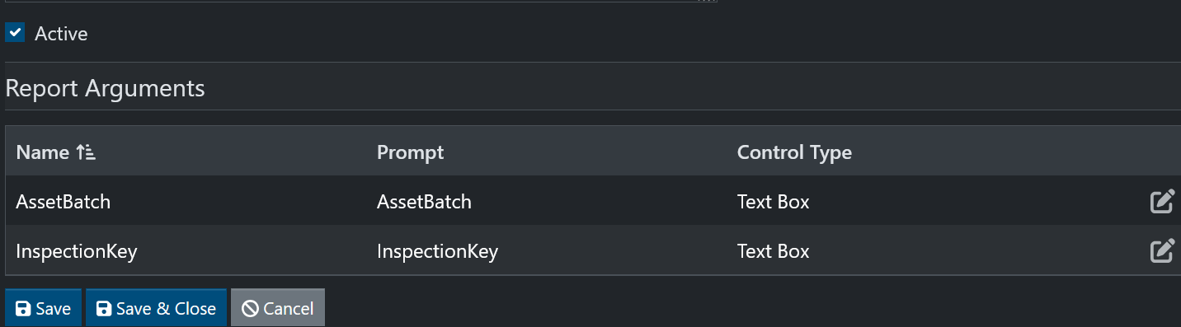
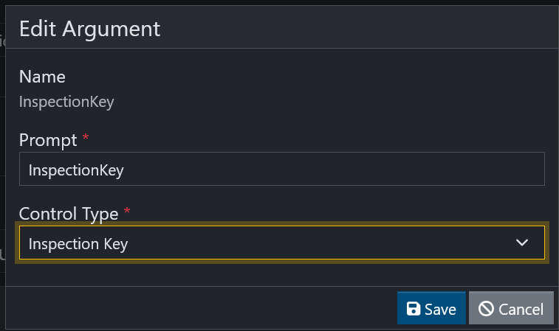
Reports

Slide 17
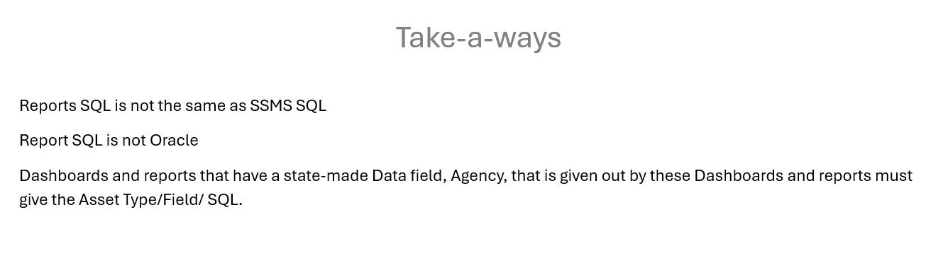
Reports

Slide 18
Reports
Question?
Craig Nazareth
Bridge Safety Inspection & Ratings Database Information Manager
Providence, Rhode Island, 02903
O: 401-563-4915
State Cell 401-408-1592
craig.nazareth@dot.ri.gov
http://www.dot.ri.gov

