Slide 1
Mayvue’s Testing Evolution
Raising the Bar for a Better BrM Experience
Notes:
Good morning.
I am Anthony Hutskow with Mayvue (the contractor for the BrM software).
Today I am going to discuss Mayvue's changes to our testing approach, which initiated by BrM 7.0's release and changes needed for BrM 7.1
I'll cover the lessons learned after BrM 7.0's release and swift actions Mayvue made to raise the bar for better quality.

Slide 2
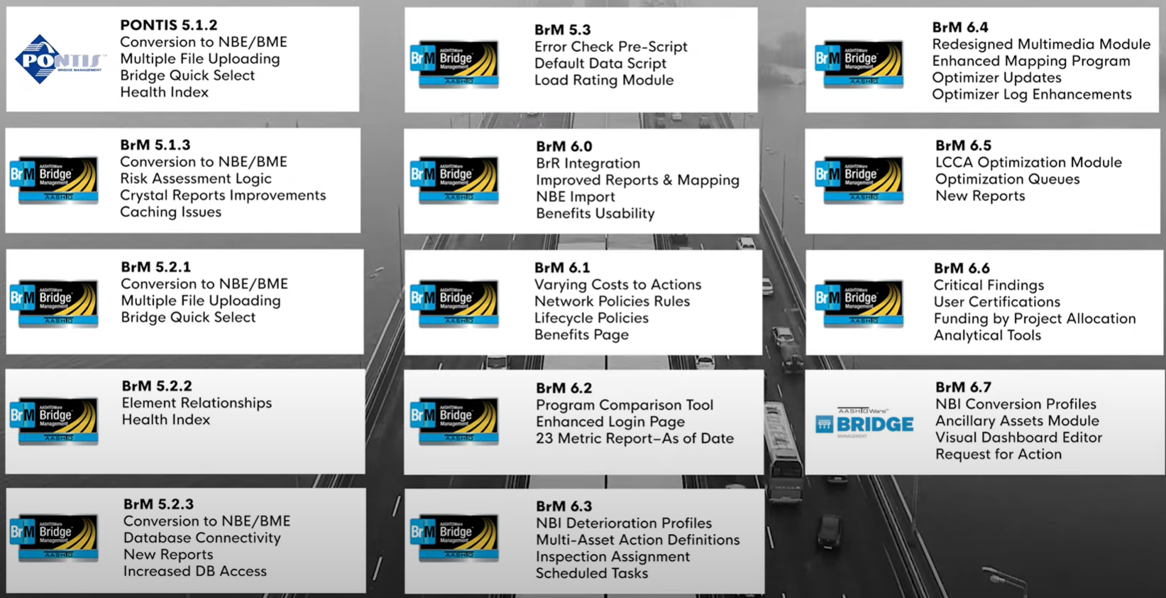
Our Proven Approach
Before BrM 7.0, the Mayvue team had completed 14 releases in 13 years.
BrM 7.0 was unique and unprecedented:
  Over 1.5M lines of code in 14 months
  Overhaul of the inspection features
  Removal of technical debt
  New database structure
  SNBI compliance
  AASHTOWare OpenAPI integration
  Migration script process (NBI -> SNBI data)
Notes:
As you’re all aware, BrM 7.0 was a complete overhaul of the software, and unprecedented in its size, scale, and impact. Essentially every nut and bolt was touched for this release. Over 1.5 million lines of code and countless development hours were completed in a span of 14 months. Mayvue built the new BrM software following our proven processes we had implemented over the years with great success.
BrM 7.0’s release was similar in size to all prior releases combined. It was delivered on time and within budget, just as prior releases before it.
In addition to a complete software overhaul, Mayvue delivered scripts to migrate agency’s historical NBI data to the SNBI format. A massive undertaking and challenge in and of itself.
Finally, the traditional beta testing process was revised to ensure BrM delivery within bounds of the work plan. In other words, BrM 7.0 was truly unique in all aspects of development, data, and testing required.

Slide 3

What Happened?
The BrM 7.0 release fell short in terms of quality for many. Too many bugs reached the users.
The timeline for the delivery of BrM 7.0 was very aggressive.
  Work Plan Signed: 7/6/2023
  100% Dev Complete: 9/12/2024
Our traditional testing approach wasn’t enough.
Mayvue didn’t look to make excuses…
We started making improvements.
Notes:
So what happened? Simply put, BrM 7.0 fell short in terms of quality for our users. Too many bugs were found by users after release and not during Mayvue’s testing, making the BrM 7.0 implementation more difficult for users. Mayvue makes no excuses or shifts blame. We own the results and looks to improve, understanding the root causes, so we could evolve the testing approach quickly for BrM 7.1, which would be released just months later.

Slide 4
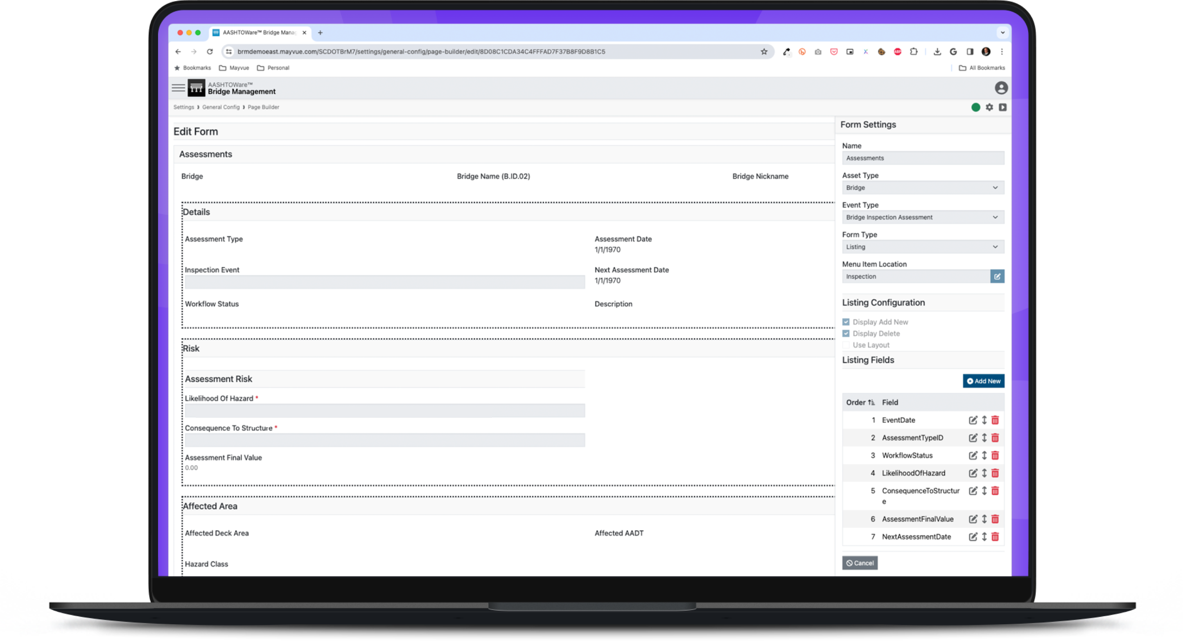
How Did We Respond?
Mayvue discussed the end-user experience with agencies that adopted BrM 7.0 and took time to self-reflect.
Our findings include:
  The migration process was a challenge.
  The data changed a LOT.
  The software contained too many bugs.
  The traditional testing approach proved insufficient for the size and scale of the release.
Quick action was needed because BrM 7.1 release was right around the corner.
Notes:
Mayvue looked internally and externally for areas where we could improve. I personally called early adopters to discuss pain points and where change was needed.
Our findings included a lot but here were some of the key points:
The migration process was challenge
The data changed a lot.
The software contained too many bugs.
The traditional testing approach proved insufficient for the size / scale of the BrM 7.0 release.
Quick action was needed as BrM 7.1’s release was right around the corner.

Slide 5
What was Learned about Testing?
Despite having proven testing processes and excellent quality-related scores, Mayvue needed to adapt and improve its testing approach.
Mayvue needed to review its testing processess.
Mayvue was too dependent on the Beta Testing TAG.
Mayvue needed more testing horsepower.
Notes:
Despite having a proven quality system in place, reviewed and tested against standards and guidelines, Mayvue needed to respond.
The three main lessons learned included an evolution to our testing approach was needed, Mayvue was too dependent on the Testing TAG, and Mayvue needed more testing horsepower.

Slide 6
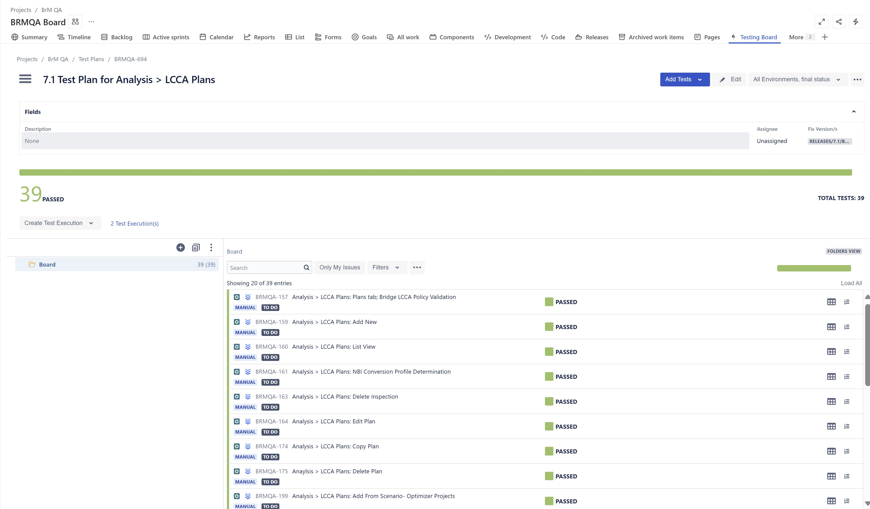
Lesson Learned:
Testing Processes
Immediate Actions Taken:
Mayvue implemented a new tool (Xray) for building and managing test cases.
Code freeze adherence was followed for BrM 7.1. No last-minute changes allowed under any circumstance.
Senior QA analysts now author all test cases and validate reported bugs, while QA analysts focus on executing the test cases and report findings.
  Mayvue reviewed all testing processes.
  Test cases need to be more clear, precise, and repeatable.
  Release readiness / code freeze adherence is a must.
Notes:
Mayvue reviewed all of its testing processes that had been used successfully for years.
We decided to invest in a new QA management tool: Xray which assists in building and managing test cases, as well as provides better visibility throughout the testing work flow.
Additionally, Mayvue needed to harden its code freeze for BrM 7.1, not adding additional items last minute and truly focusing all energy on regression testing and resolving findings prior to release.
Finally, Mayvue restructured the team’s responsibilities, requiring the Sr. QA analysis to define all test cases and focus more heavily on validating bugs and steps to reproduce. Simultaneously, the QA analysts are entirely focused on executing the test plans and reporting their findings…day in and day out.

Slide 7
Lesson Learned:
Dependency on Beta Testing TAG
Immediate Actions Taken:
Historically, beta testing yielded significant participation and findings over the years.
Beta testers have a significant day-to-day responsibilities.
Mayvue had grown too dependent on the Testing TAG’s findings.
Data points:
  136 user-reported bugs for 7.0 vs.
  507 Mayvue-reported bugs.
  1 user-reported bug for 7.1 vs.
  662 Mayvue-reported bugs
  ~150 user reported 7.0 bugs since its release.
Mayvue spent thousands of additional hours beta testing and regression testing BrM 7.1.
Mayvue called upon ALL team members to assist with testing the BrM 7.1 release.
Mayvue addressed every 7.0 bug submitted by the user community after release, while overhauling the BrM management modules and delivering direct API calls.
BrM 7.1 was released on time in August 2025 with immediate, positive feedback from the user community.
Notes:
The beta testing group has been a staple for the BrM user community and would identify bugs, data, and/or installation issues for the entire user community. Prior releases yielded dozens of findings, questions, and helped ensure a smooth release and migration to the newer version for all users.
While Mayvue completed its own testing, alpha, beta, and regression, Mayvue had become too dependent on the Testing TAG and their consistent findings before major releases.
Beta testers have day jobs, and it is Mayvue’s responsibility to find issues before users. Due to the size and scale of the BrM 7.0 release additional testing was required.
In response, Mayvue spent thousands of additional hours regression BrM 7.1, calling upon our entire team to join the testing. We addressed all bugs that had been identified and called upon our entire team to ensure BrM 7.1 was a better experience.
This additional testing focus proved to be successful as positive feedback has been received by the user community pertaining to BrM 7.1.

Slide 8
Lesson Learned:
More Horsepower Needed
Immediate Actions Taken:
Analysis showed Mayvue needed to increase QA velocity to ensure comprehensive coverage and provide ample time for regression testing.
Mayvue finished QA at the end of the development cycle without a hard freeze, leaving limited time to regression test and/or address issues found.
Last minute additions to a release creates issues and impacts quality.
Mayvue added 3 additional QA resources between BrM 7.0 and 7.1’s release, increasing throughput significantly.
Mayvue will maintain a higher QA to dev ratio as part of its new testing approach.
Mayvue has refined its development schedule for BrM 7.2 (in progress) to ensure additional weeks are available for regression testing.
Notes:
A simple, yet effective solution, was to increase our QA to dev ratio, but the needs were deeper than that. Mayvue reviewed timing of our testing and determined changes were also needed in approach.
Mayvue hired three additional resources who’s entire focus is testing BrM during development and prior to releases.
Code freezes, with reasonable timelines, are necessary to ensure last minute issues are not introduced and results in disruptions during regression testing. Mayvue honored the code freeze for BrM 7.1 without exception.
Mayvue also adjusted the timing of regression testing starting significantly earlier in the process than prior releases.

Slide 9
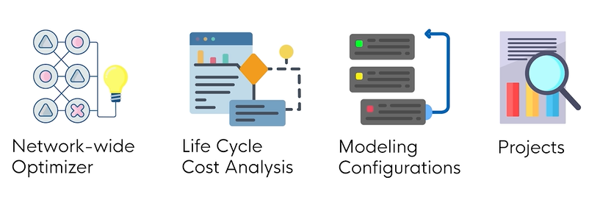
Current Testing Status
BrM 7.1 was released to the user community in August 2025, completing the overhaul of the new BrM software.
Changes to the testing approach are paying dividends...
ask the states that have migrated.
Mayvue’s testing changes are staying, and there’s additional changes coming in areas such as installation and other testing needs.
Notes:
BrM 7.1 was released in August 2025, completing the overhaul of the BrM software.
BrM 7.1 is an improved experience over 7.0. We hope to hear such from this week’s presenters and in our discussions in the hallway and during meals.
Mayvue plans to continue to evolve as additional testing challenges will be present including installation processes, ADA, and new features.
Reminder, no software is bug free and there will be issues with BrM 7.1 and beyond. BrM is a massive piece of software and is driven heavily by your data. Should you find an issue, please report as soon as possible and Mayvue will coordinate the resolution.

Slide 10
Mayvue’s New Testing Approach:
Better Experience, Better Outcomes
Recap: Mayvue’s new approach includes updates to our people, processes, and the BrM software:
People
  Mayvue will maintain the increased QA to dev ratio.
  Mayvue restructured QA management and QA responsibilities.
  Other disciplines will regression test prior to release (good practice).
  Mayvue completes ‘beta testing’ and Testing TAG completes ‘User Acceptance Testing’ (UAT)
Processes
  Xray will be used as our QA tool going forward.
  Freeze periods will remain firm / unmovable.
  New installation tool coming for BrM 7.2
Product (BrM)
  Major data migration efforts will not be required…one time pain.
  Mayvue will need to test for ADA findings as well in the future.
Notes:
BrM 7.0 initiated rapid growth and evolution in our testing approach.
These changes are beneficial and are here to stay….regardless of a release’s size/scope.
We have always had the mindset of finding all problems before its in the users’ hands…however, we reviewing the Testing TAG as UAT vs. Beta testing.
Mayvue will continue to refine our tools to improve the quality experience. A great example is the installation process updates coming in BrM 7.2! This will be much anticipated for self-hosted agencies.
More changes are on the horizon…ADA is one example. Additionally, there’s dozen of enhancements that will be discussed this week. We look forward to improving the BrM functionality but also ensuring quality remains top notch.

Slide 11
Mayvue’s Testing Evolution Continued
Mayvue is working to be more data-driven for testing and quality metrics.
  Example 1: Determine bugs per lines of code as opposed to more general thoughts/feelings about a release.
  Example 2: Statistical reporting on internal findings during regression testing.
Mayvue has implemented test-driven development on a small scale and is completing a cost-benefit analysis that it will be discussing with the Task Force.
BrM 7.2 testing includes a more traditional approach to user testing.
Mayvue may recommend onsite user acceptance testing for larger BrM releases, which has been highly successful in the past.
Notes:
In addition to people, processes, products, Mayvue is evolving to be more data driven, leveraging quality metrics vs. feelings.
one such example is baselining bugs per lines of code to comparable software.
Additionally, I believe there’s additional metrics and reporting that can be completed to gauge our success.
Mayvue is also investigating the cost vs. benefits of test driven development. It was implemented on a small scale for some deliveries with BrM 7.1.
Lastly, Mayvue will work with the Testing TAG to determine if future onsite beta testing can be accomplished in future major releases.

Slide 12
Mayvue’s Quality Pledge
We promise to:
Find and resolve issues before users.
Evaluate testing processes to raise the bar for a better BrM experience.
Continue to deliver on time and above user expectations.
If/when issues are found, quickly resolve them in coordination with the Task Force.
Notes:
Mayvue’s pledge is to continue to raise the bar for a better BrM experience.
Time, budget, and scope will not be impacted by our testing evolution.
When issues are found (and there will be issues) we pledge to respond as soon as possible.
We’re excited to support your journey to BrM 7.X and beyond.

Slide 13

Questions

Slide 14



Contact Information
Jira Service Desk
Anthony Hutskow
anthony.hutskow@mayvue.com
Text / Phone: 412-952-3771
BrM@mayvue.com
1-877-462-9883
http://support.mayvue.com
Notes:
As always, please feel free to reach out to me or the Mayvue team through any of these means.
I hope to have conversations with many of you this week.
Thank you for your time.

