Slide 1
BrM Strategic Direction and Task Force Update
Kent Miller P.E.
BrM Task Force Chair
Nebraska DOT Bridge Division
kent.milller@nebraska.gov

Slide 2
Some Topics to Discuss
How is it going?
Who is the Task Force anyway?
What does the Task Force even do?
How did we get here?
Task Force Priorities and Strategic vision
What do you need from BrM?
How can you be involved with BrM and the Task Force?
How can the Task Force assist you?
Notes:
How is it going? Give a summary of impressions from the introductions and where people are at with implementation
What do you need and how can we assist might be Mentimeter material. I will need assistance with managing that if we go that way.

Slide 3
How it is going
Notes:
This slide is blan

Slide 4

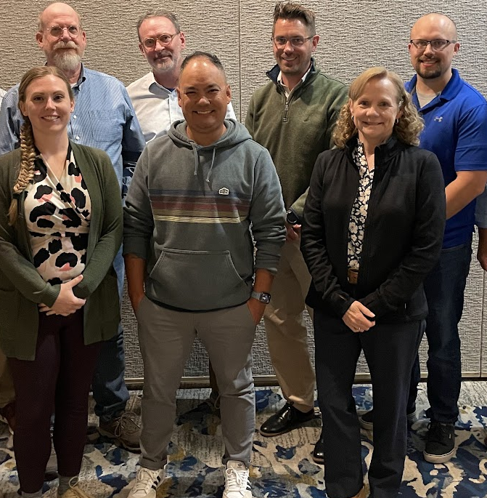


Who is the Bridge Management Task Force
Minnesota
Nebraska
Rhode Island
Michigan
South Carolina
California
Kentucky
Notes:
This is recycled from a slide I stole from David Hedeen and put into a deck for an NDOT Deputy Director who has to talk to some legislators this week. I wanted them to know that there are real people behind this work.
This is software built for the states by the states with coast-to-coast collaboration.
Maybe add something about who I am. Nebraska has been involved since the beginning of the development of PONTIS, the prior AASHTO Bridge Management software, which was replaced by BrM in 2014.
The BrM Business model of collaborative development controls costs and provides flexible design to meet agencies varying business practices.
The Task Force includes subject matter experts and also liaisons in supporting roles from other AASHTOWare groups.
In the front row, L to R
TF member from SC DOT, Emily Bickley,
TF member from CA DOT Justin Alameres,
Former T&AA Liason from Nebraska DOT, Lou Anne Daugherty
Back row L to R
TF member from RI DOT, Craig Nazareth
Yours truly, Current TF Chairperson from Nebraska DOT Kent Miller
Former TF Chairperson from MN DOT, David Hedeen who has since gone to heaven with a role with SCOA.
TF member and current TF Vice Chairperson, Jacob Armour.
This photo is a little out of date. Lou Anne has since moved to a liaison role with BrDR and the current T&AA liaison is Jim Remsey from SC DOT. That’s why she’s wearing shades.

Slide 5
What does the Task Force do?
Deliver on achievable User Group priorities
Meet online for an hour or so every two weeks
  These meetings are to provide guidance for the contractor
    Scheduled for an hour
Meet in person quarterly for two or three days (depending on what is going on).
  Discussion is time-limited, and the agenda often is juggled a bit to allow for the varying complexity of the topics
Notes:
Review UG priorities and how to deliver. Maybe add a slide about how that has gone.
How often and how long we meet. How we fit this into our working life obligations.

Slide 6
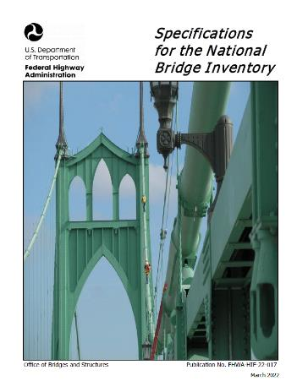
Where we’ve been – BrM: 7.0 (November 2024)
Fully SNBI compliant
Database and Application Overhaul
Sustainability
  Clear out old tech and bring in new
Configurability
  Visual Forms Editor Overhaul (now called Page Builder)
    Built in mind to improve the user experience

Slide 7
Add a recap of developments

Slide 8
Where we are now

Slide 9
Priorities
Short term
  SNBI implementation
  Cloud Migration
  Support stable and configurable UI to meet agency needs
  Create a Report and Dashboard exchange portal
  Support data integration
    Ideally consume and provide data from other sources without storing it
  Integrate with BrR and AW Project
  Implement Training Plans for
    Optimizer
    Configuration
    POA management, QA and other Inspection Management features
Notes:
This is from a discussion and a document that was started by Jacob Armour. The TF looks at priorities and strategic alignment with AASHTO every now and then to try to keep some perspective about where we are in the process of getting to where we want to be.

Slide 10
Priorities
Medium Term
  Use data analytics to identify performance
  Digital Twin Compatibility
  Added ESRI Mapping Integrations
  Dashboard and Reports Portal
Longer Term
  Multi-asset Optimization
  Location-based defect tracking
  NDT integrations
  Enhanced predictive modelling

Slide 11
What Do We Need from BrM?
How do we fulfill our duties to the trust the public has placed in us?
Provide a platform for Bridge Inventory and Inspection data that is:
    Easy to use for inspectors
    Supports bridge file documentation
    Has data validation and quality control checks for inspectors and owners
    Supports bridge owner needs with performance monitoring, work requests, inspection scheduling
Provide bridge programming optimization to assure that bridge condition performance targets are met at “the minimum practicable cost”
Provide accurate, responsible and timely reporting to “customers” (inspectors, owners, our agencies, other agencies and government entities).
Make compliance with State, Local and Federal requirements easy.
  Reports on demand
  The right data at the right time for the right users
State of the art tools for

Slide 12
How Can You Be Involved with the Task Force?
Notes:
Something on TAGS. And open position?

Slide 13
Contacts
Notes:
Add TF and Mayvue

Slide 14
One Sheet
Part 1: The Goal
  The Best Possible Alternatives not something we settle for because it is a safe bet
    They might include options we haven’t thought of yet
  We need challenging and realistic goals
  Stick to high expectations: expect more (and speak up for it) and get it
    Let’s talk. We are more likely to get what we want if we discuss our goal with someone else
Part 2: Summary
  Let’s get on the same page by listening and trying to really understand what other users need
  Demonstrate that you understand what another agency want by summarizing it.
    If you summarize what I want and you hear me say “yes, that’s right” what does that mean?
    If I summarize what I think you want and I hear you say “yes, that’s right” what does that mean?

Slide 15
One Sheet
Part 3: Let’s be sure we understand each other
  We should be able to label
    what is valuable to each other
    What we don’t like or value
    What makes or work easier
    What we don’t want to do or find difficult
Part 4: Asking better questions: Look beyond what we want
  What makes us want what we want?
  How is that worthwhile?
  What are the core issues?
  How does that effect other things?
  What is the biggest challenge we face with delivering what is worthwhile?
    How does that fit into our objectives?

Slide 16
One Sheet
Other considerations
  Is your agency on board with your vision?
  Is your agency providing the support you need?
  What does your agency see as their main challenges in this area?
  Does the work you do at your agency have autonomy?
    Does it have status?

Slide 17
Ranting and Raving
Unsustainable business model
  Low annual fees are great but not if they don’t capture cost of modernization
  Technical debt will always be accumulating
  How to handle it?
Costs of Customer Service is increased by working in multiple agencies enterprise environments

Slide 18
Jargon storage
To provide a flexible and transparent tool for supporting transportation agencies implementing an asset management plan and all FHWA requirements
Support ways of conducting your transportation agency’s business to deliver more value so that the transportation system performs best with the available resources.
Reduce risk exposure
  More benefit from every investment
  Improved coordination across agency planning and operations
  Improved accountability
    What is working? What is not going well? How will you improve?

Slide 19
Poll questions
Mentimeter poll questions
  How is your agency using Mulitmedia?
  How have you configured the UI?
  Do you do inspections by contract or in-house?

Slide 20
FHWA Introduces New Inspection and Reporting Protocol: The Specifications for National Bridge Inspection (May 2022)
Caused a complete rewrite of BrM
Database overhaul
New design for sustainability
  Cleared out old tech and bring in new
Improved Configurability
BrM for SNBI release was in two parts
  Part one for Inspections (Nov 2024)
  Part two for Optimization (Aug 2025)
The following slides show the new UI!
Notes:
Nebraska shut down the previous version on July 31, 2025, and opened up the current version on August 11, 2025, after a two-week configuration period.
Some pages of the UI that will be shown are still under review and development

Slide 21
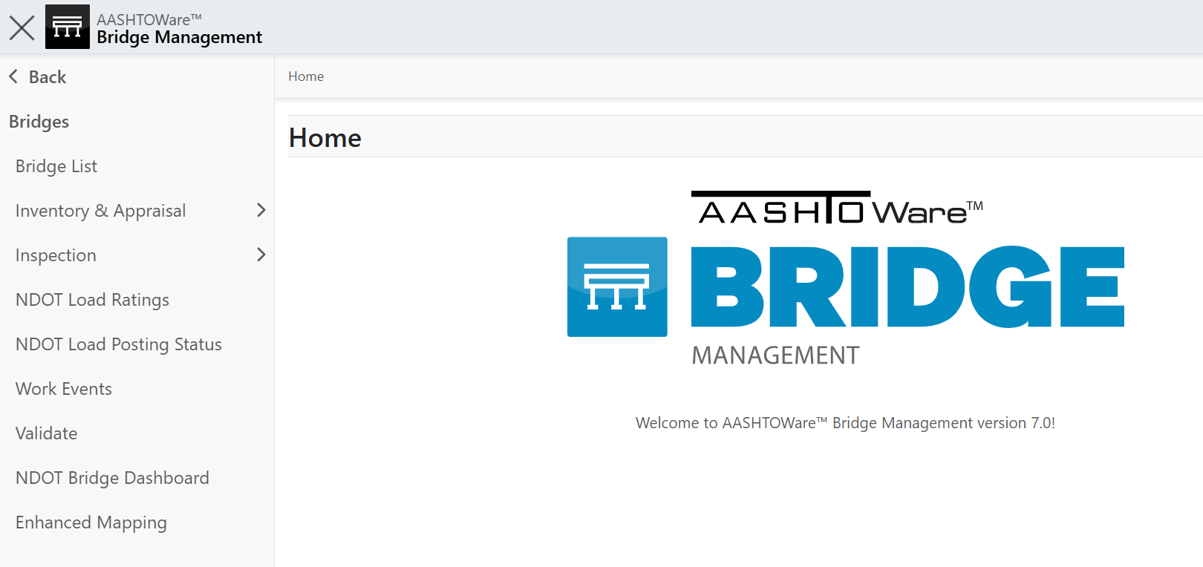
Notes:
Security and access are configurable by role.
Users can configure their landing page.
This page is a typical starting point for someone in and inspector role.

Slide 22
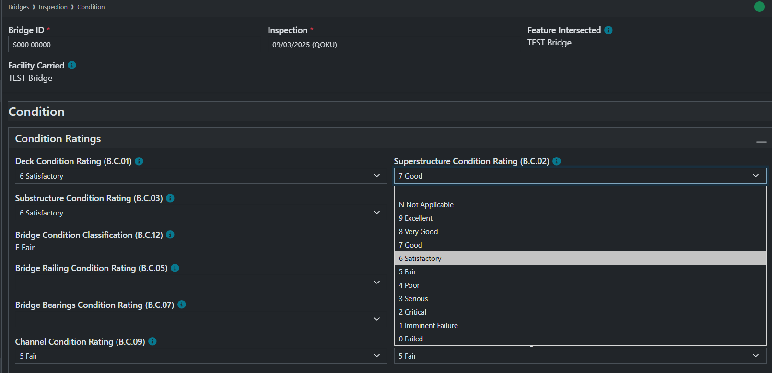
Notes:
It quickly flips between light and dark modes. This screen shows a condition reporting page.

Slide 23
Nebraska Bridge Inspection Cycles
Notes:
The inspection cycle is seasonal and kicking into full swing just as we roll out BrM 7.

Slide 24
Jargon storage
To provide a flexible and transparent tool for supporting transportation agencies implementing an asset management plan and all FHWA requirements
Support ways of conducting your transportation agency’s business to deliver more value so that the transportation system performs best with the available resources.
Reduce risk exposure
  More benefit from every investment
  Improved coordination across agency planning and operations
  Improved accountability
    What is working? What is not going well? How will you improve?

Slide 26
BrM Strategic Direction and Task Force Update

